Slide 1
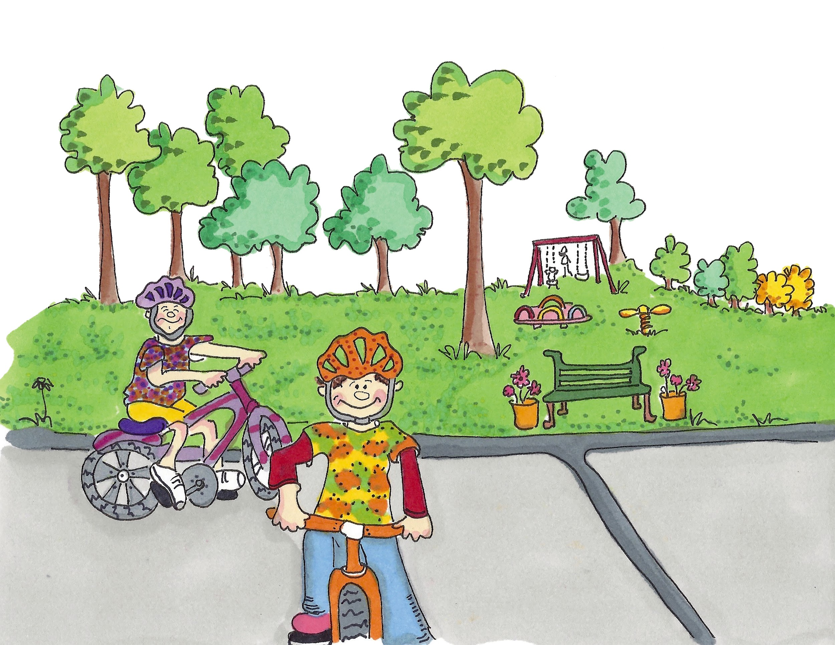
When Isaac Broke His Leg

Slide 2
Hello my name is Isaac. When I fell off my bike and hurt my leg lots of amazing people helped me. I was very surprised who works in health and social care. Did you know it’s not just doctors and nurses?
I was playing on my bike with my cousin Archie.

Slide 3
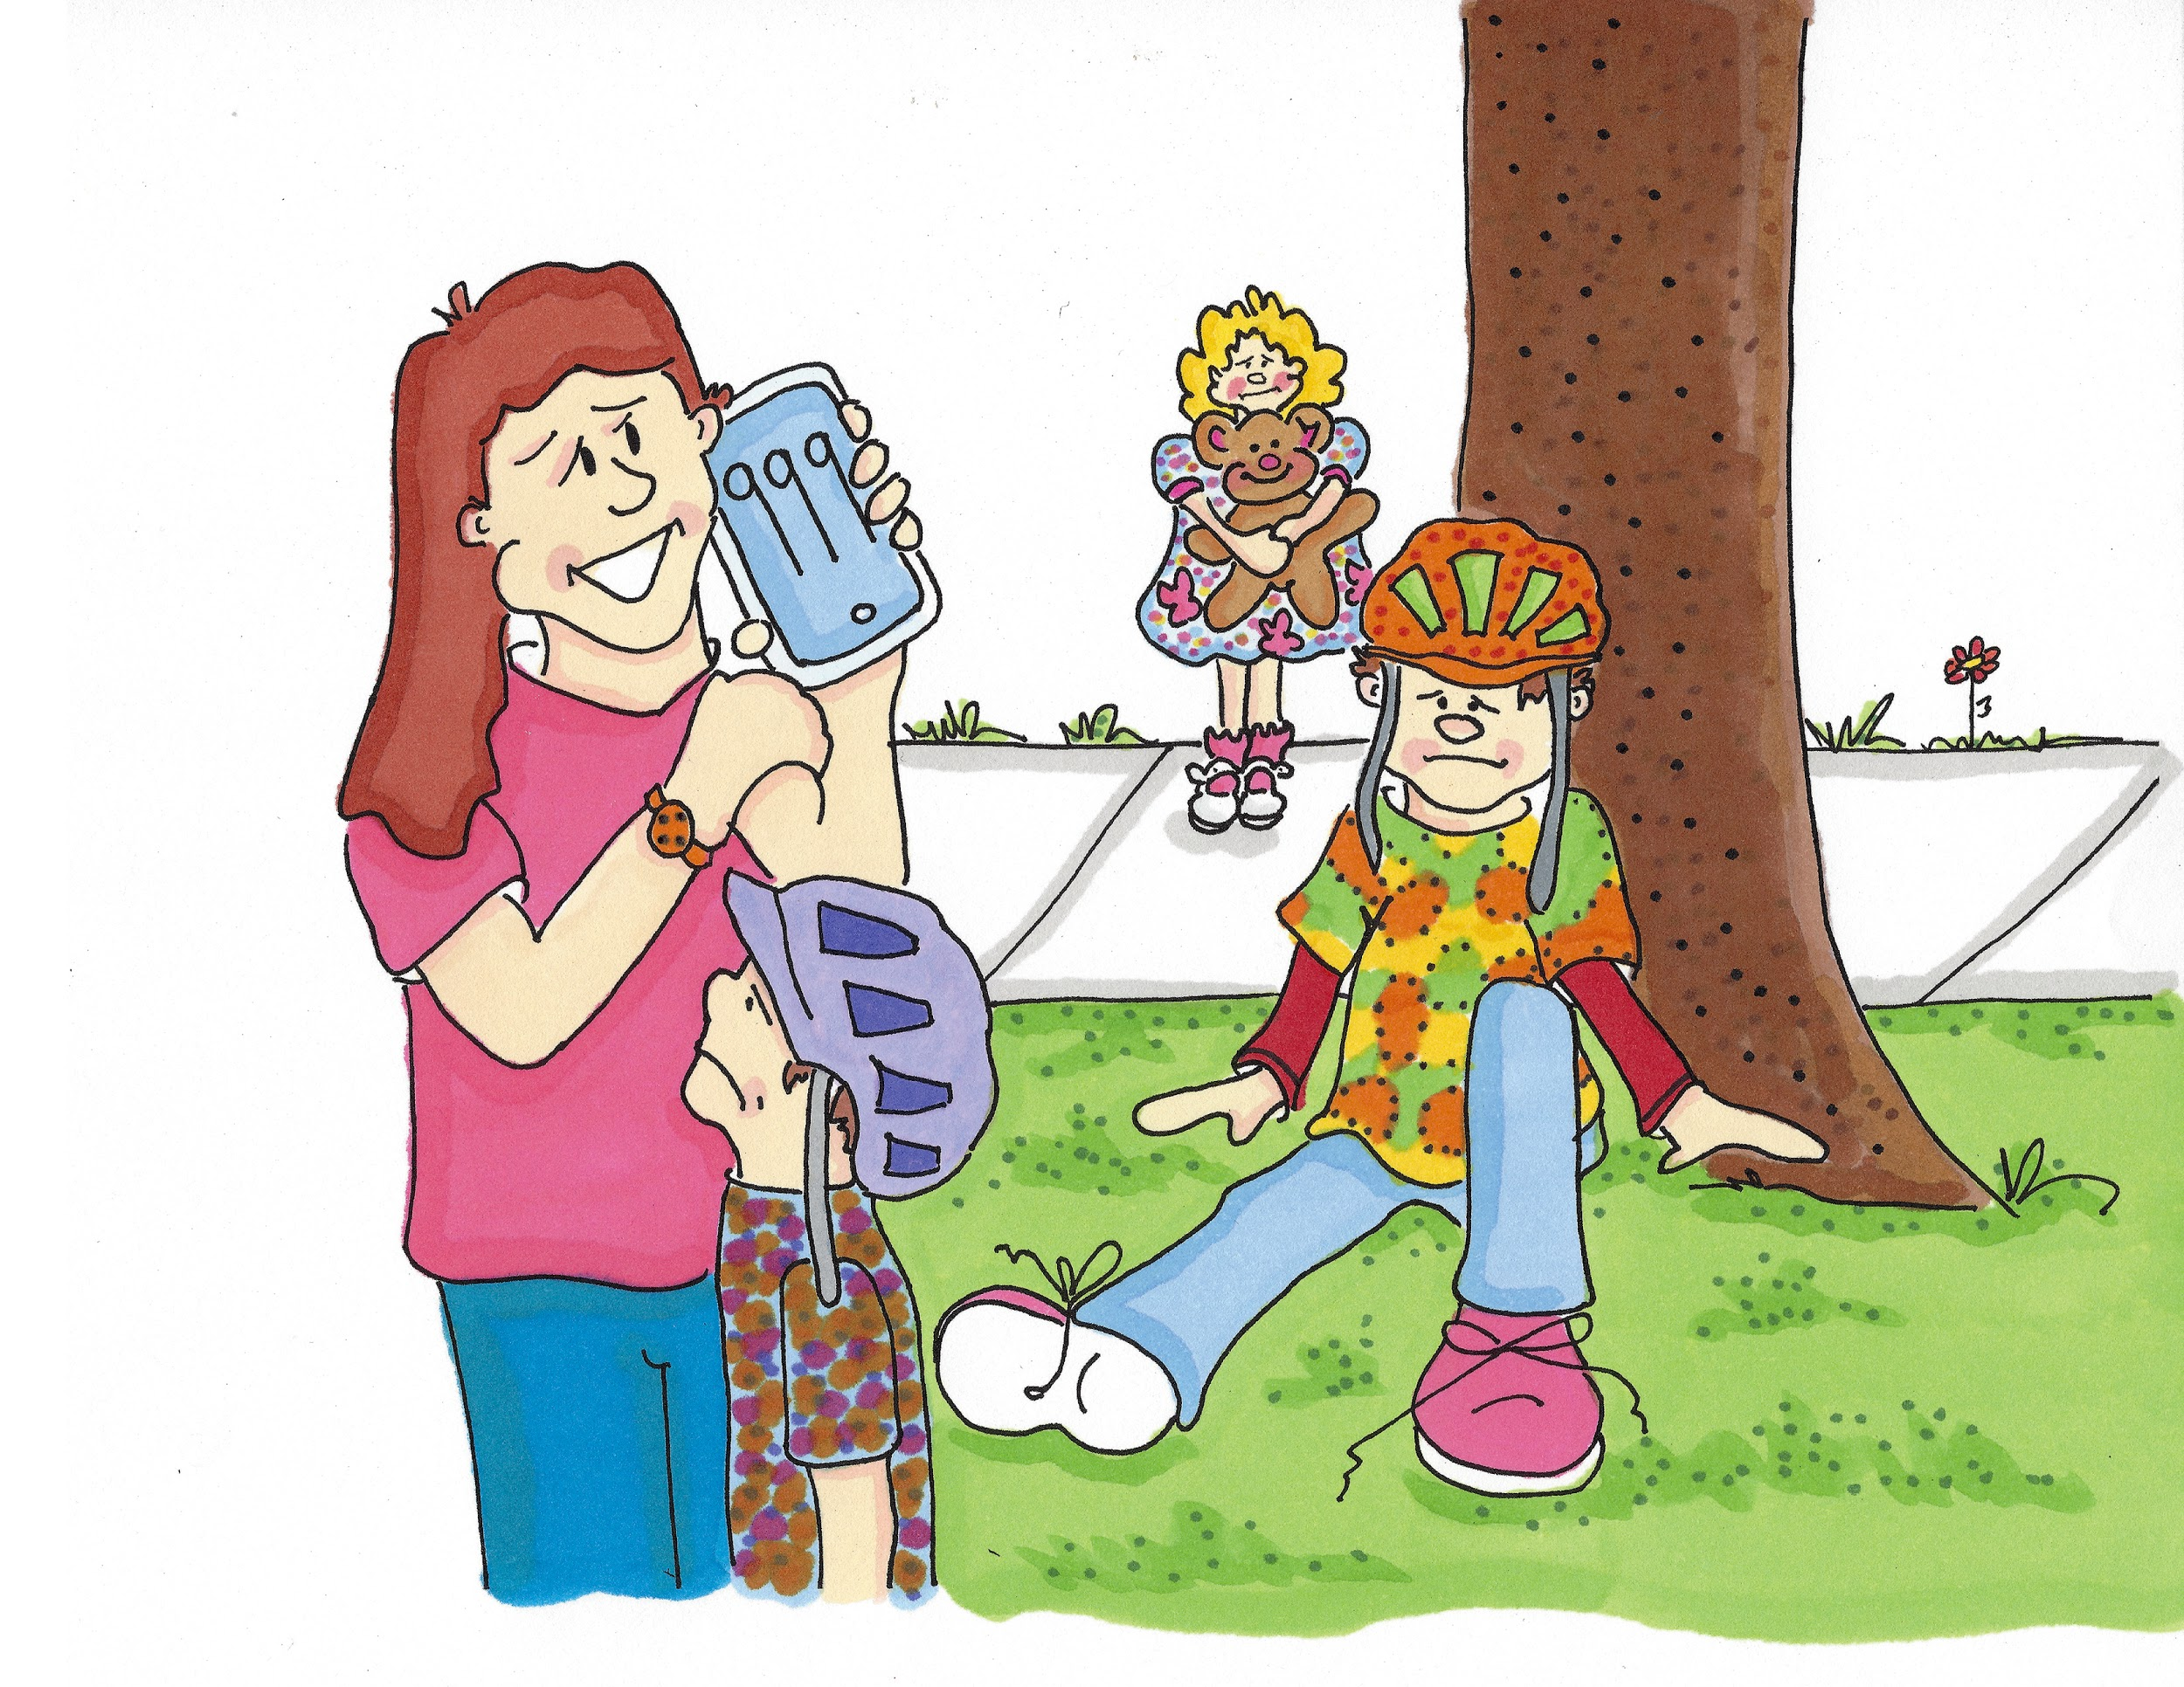
I went too fast and tumbled off my bike. I heard a funny noise and my leg really hurt. I felt dizzy and sick. I cried and cried.
Mummy ran and gave me a cuddle. When she saw my leg Mummy said we must go to hospital. She called 999 and said ‘Ambulance please’. I felt scared.

Slide 4
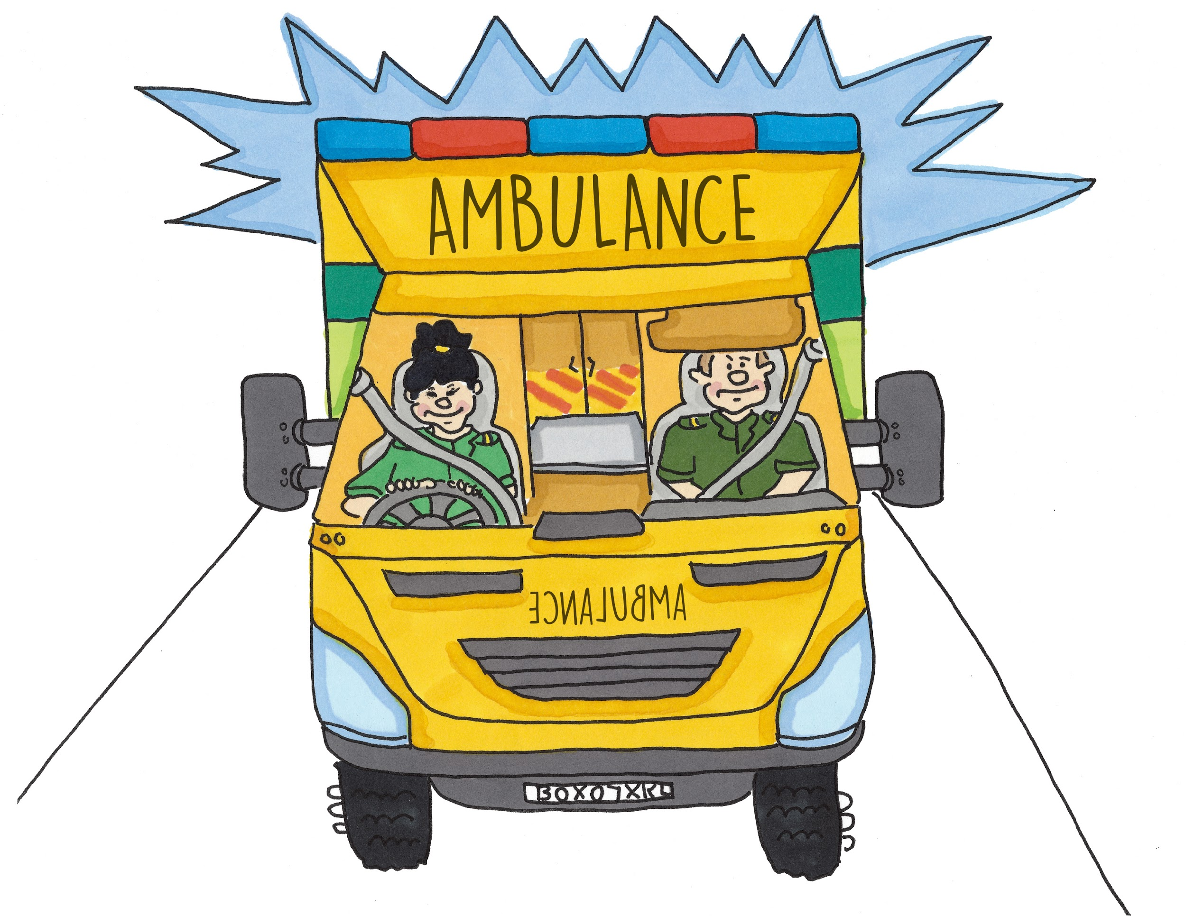
‘NEE NAH NEE NAH’. An ambulance with blue flashing lights arrived.

Slide 5
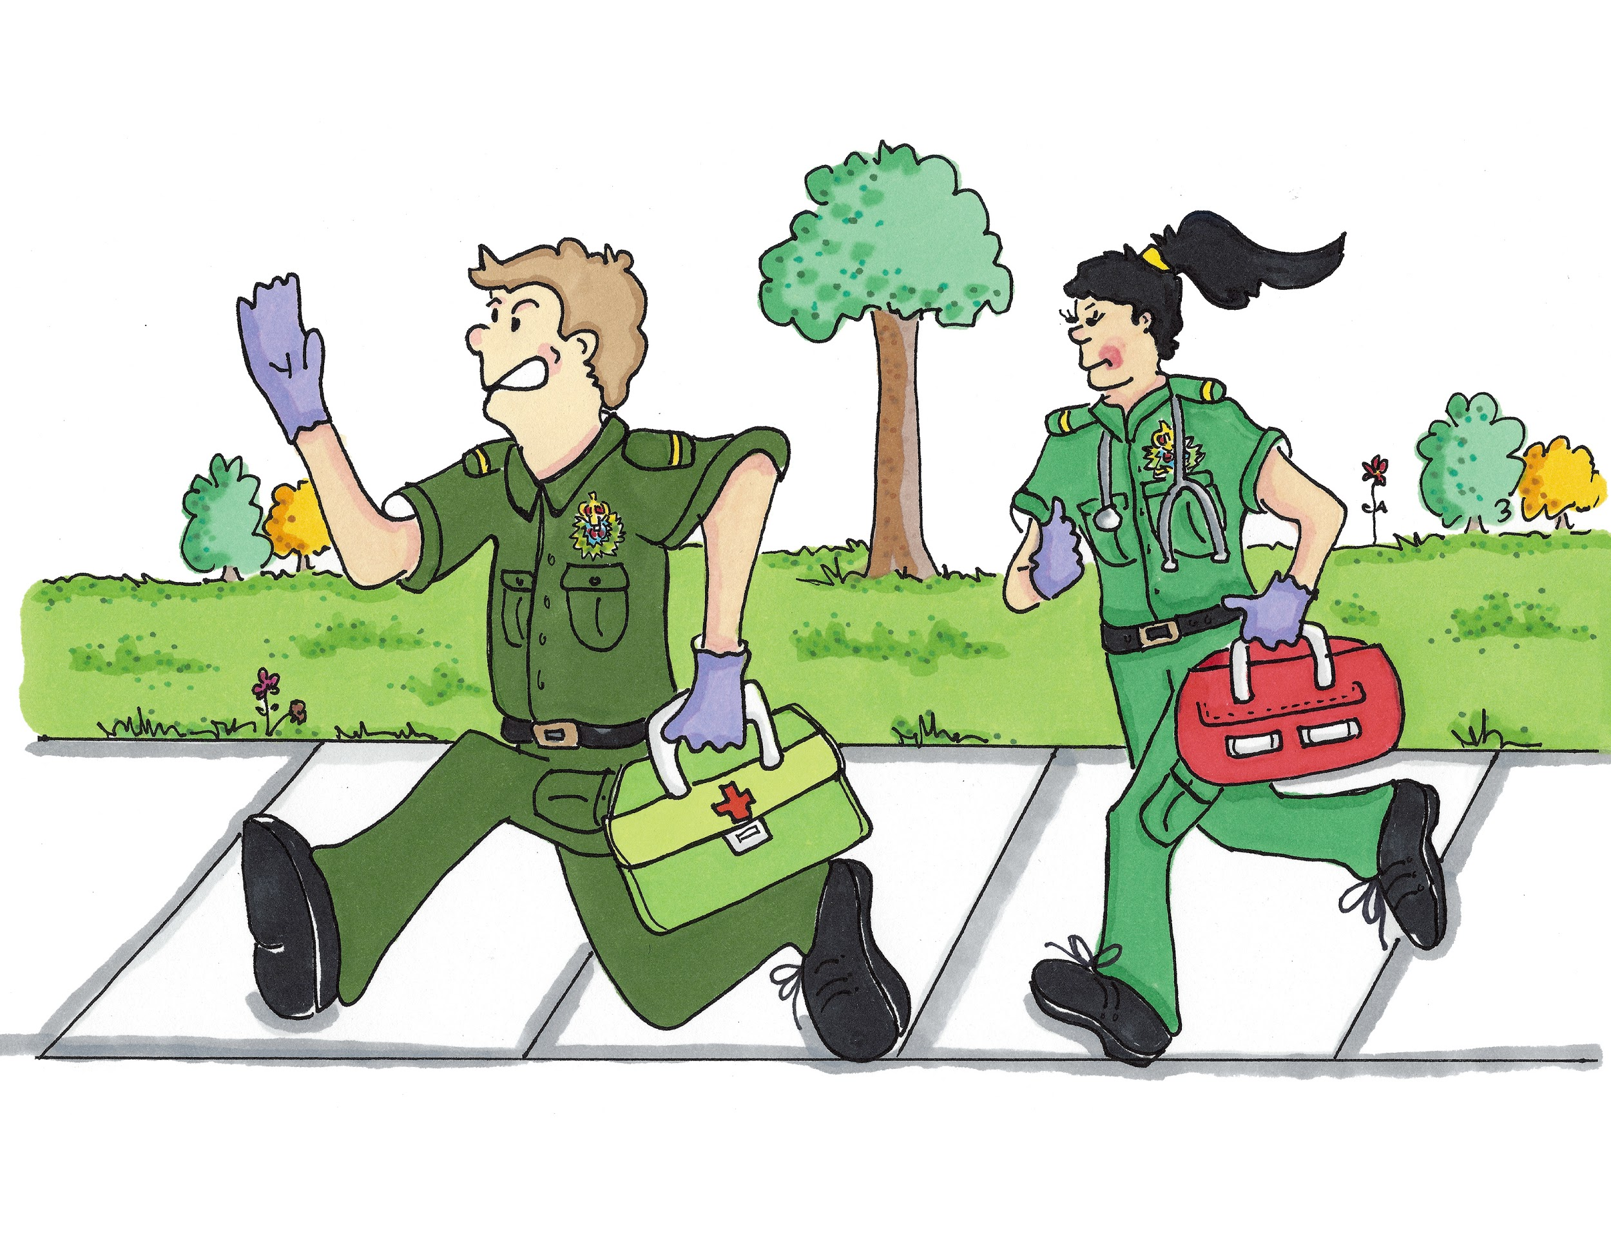
The Paramedics (Pa/ra/med/ics), John and Amira ran to me. They checked my leg and took me to hospital. John said ‘don’t be frightened, Isaac. We will look after you’.

Slide 6
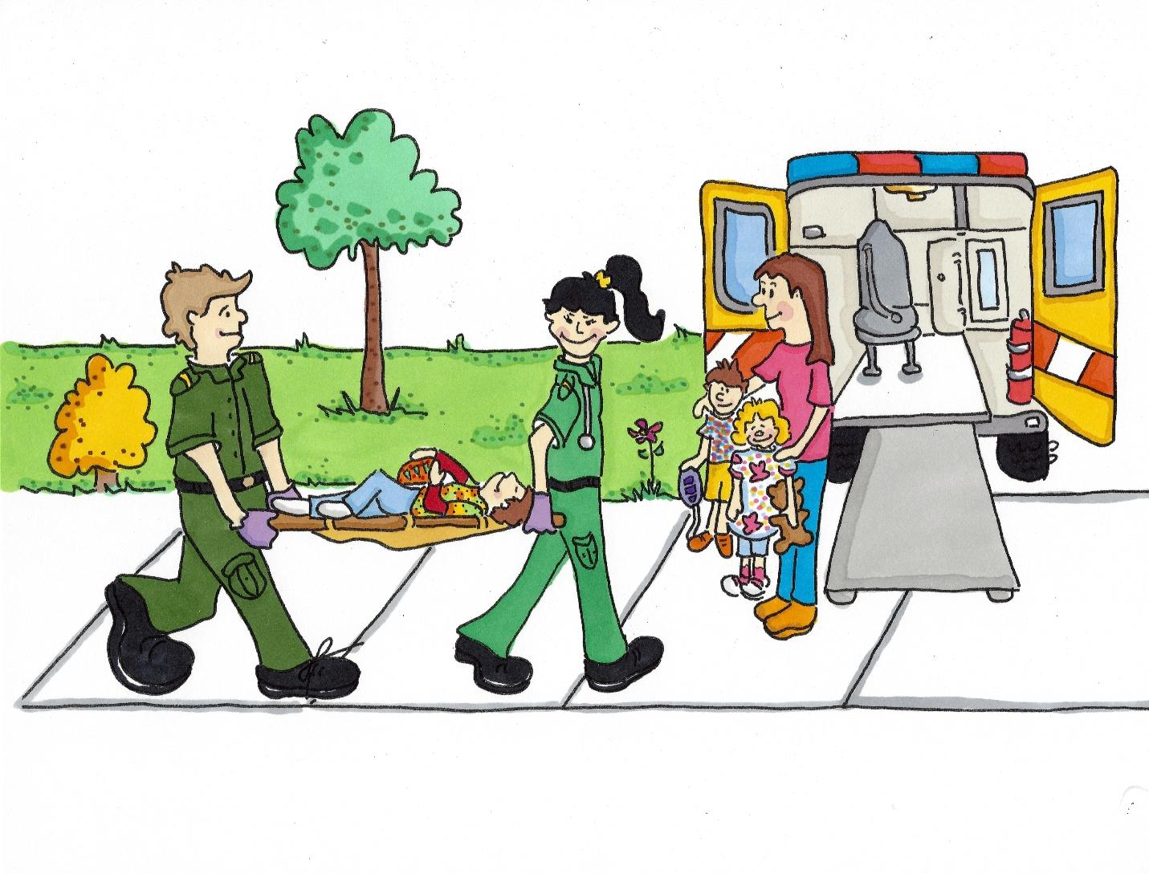
They carried me to the ambulance on a stretcher. Mummy and Archie came too.

Slide 7
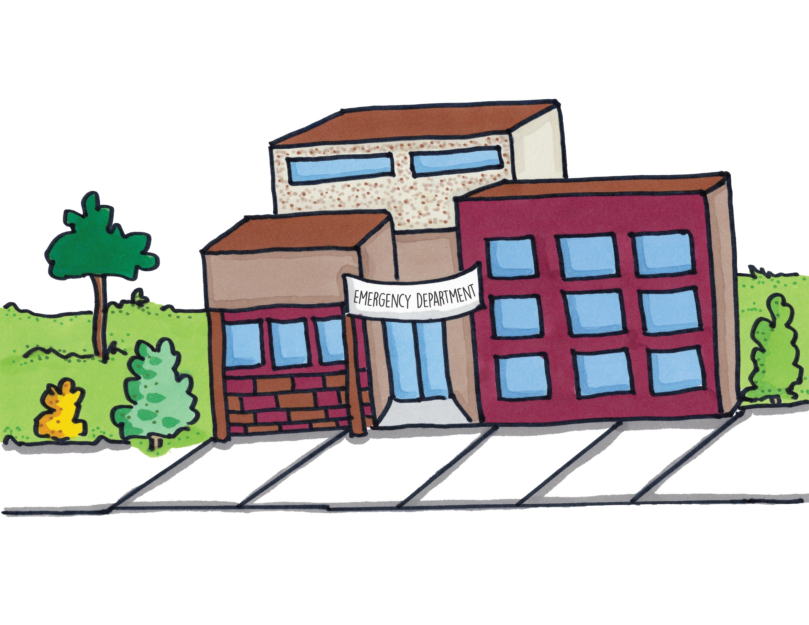
They took me to the hospital emergency department.

Slide 8
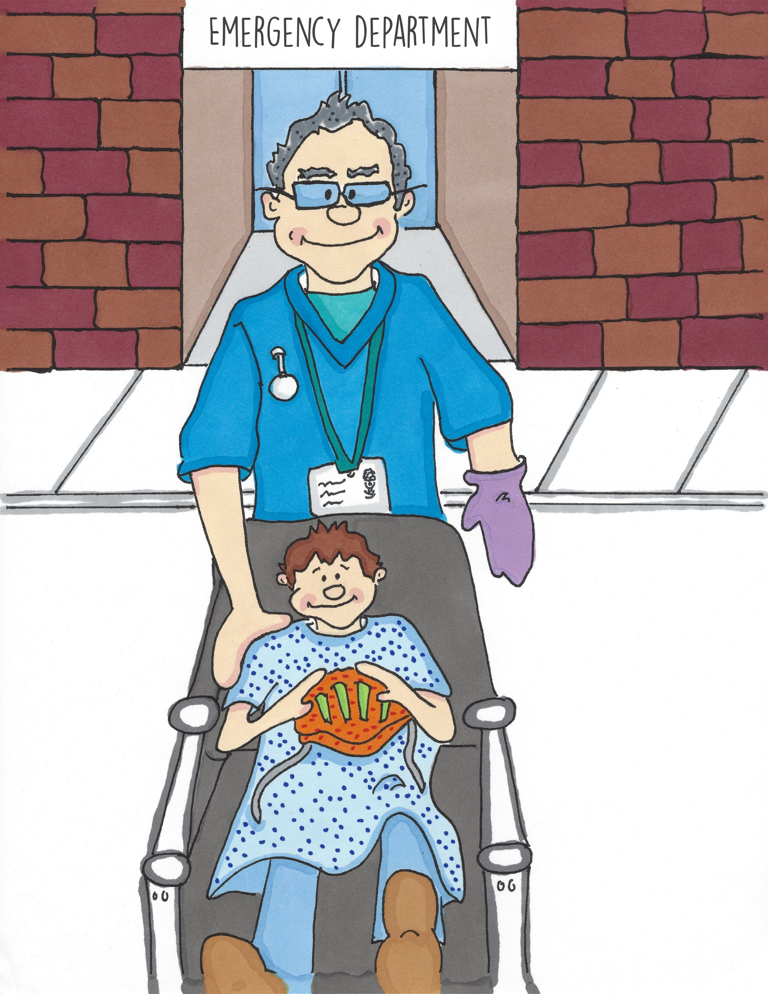
A kind Nurse (Nurs) met us. He said ‘Hello Isaac, my name is Neil. We will all help to make you better’.

Slide 9
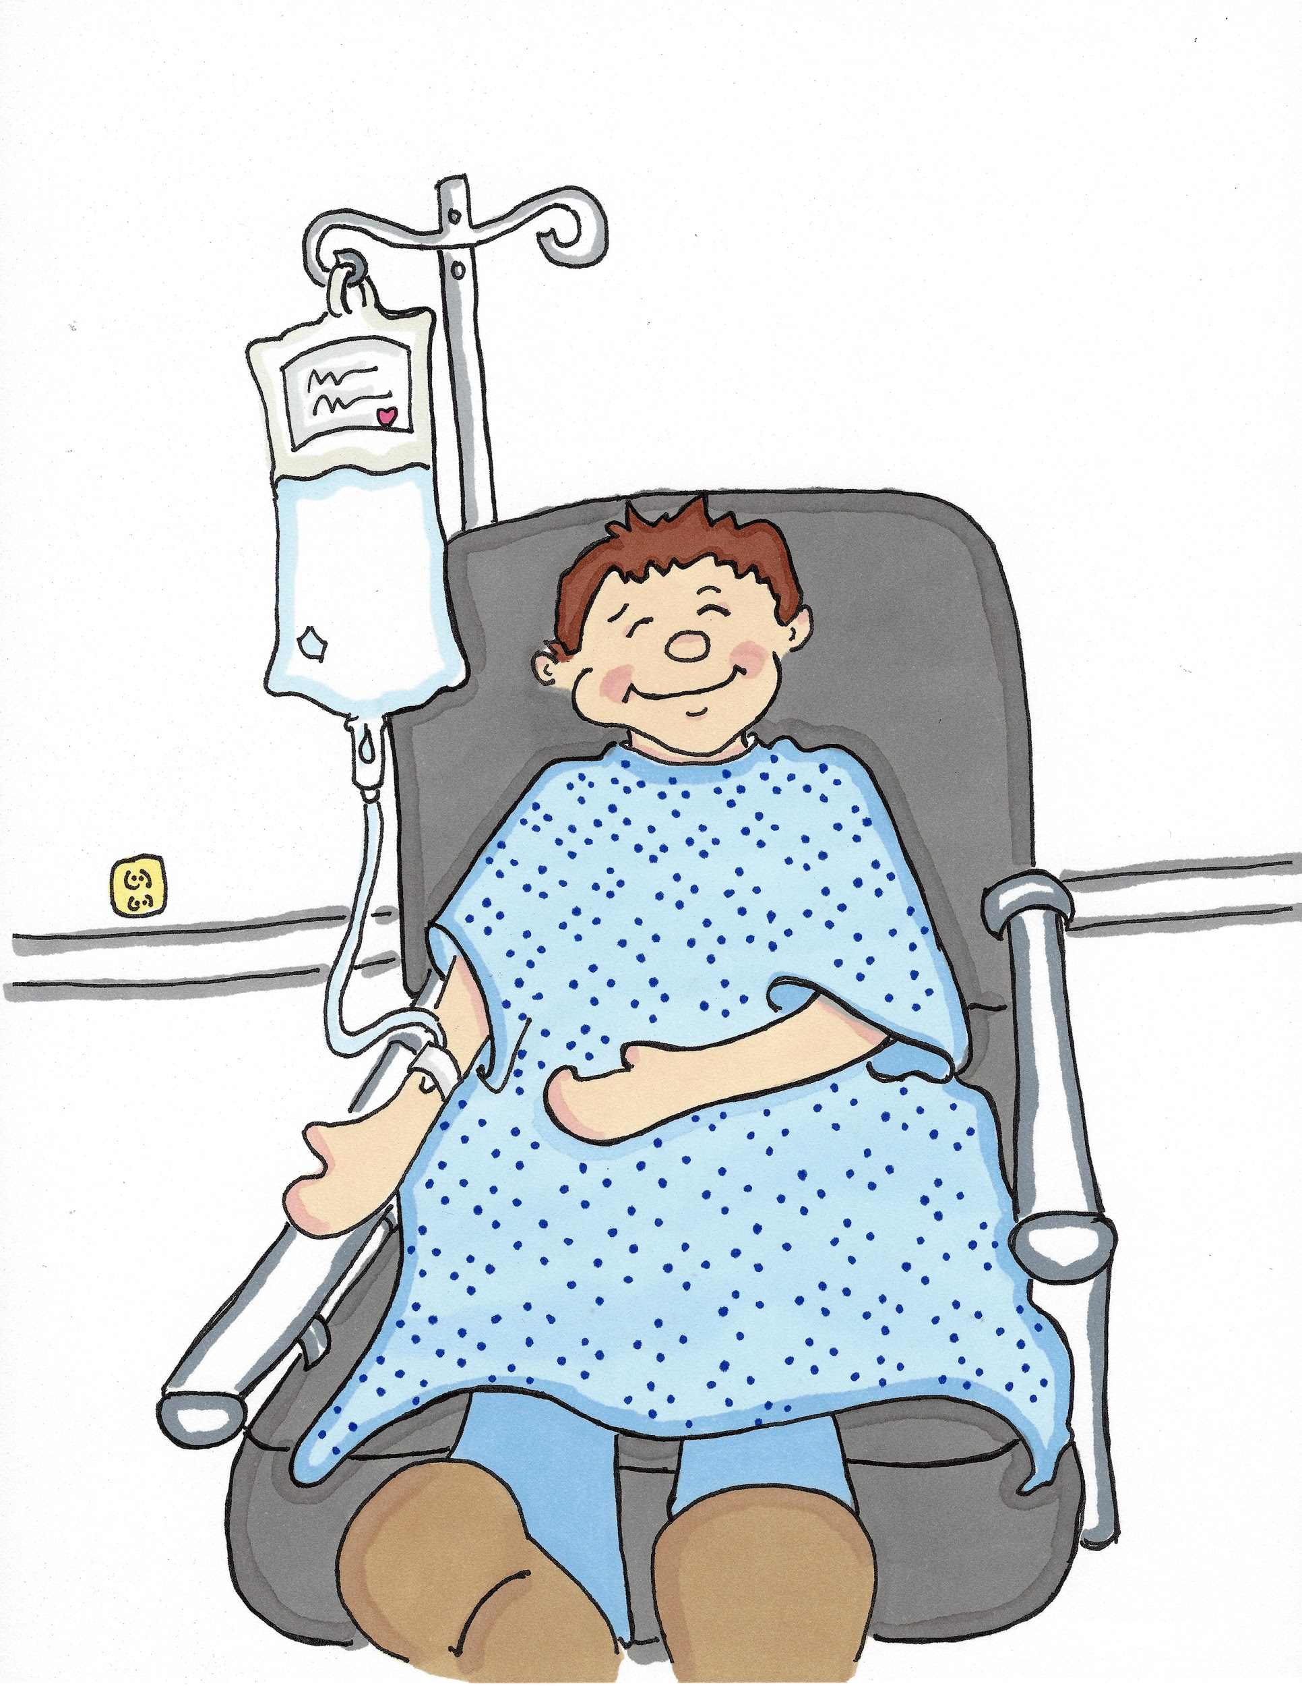
Nurse Neil gave me some medicine into my arm to take the pain away.

Slide 10
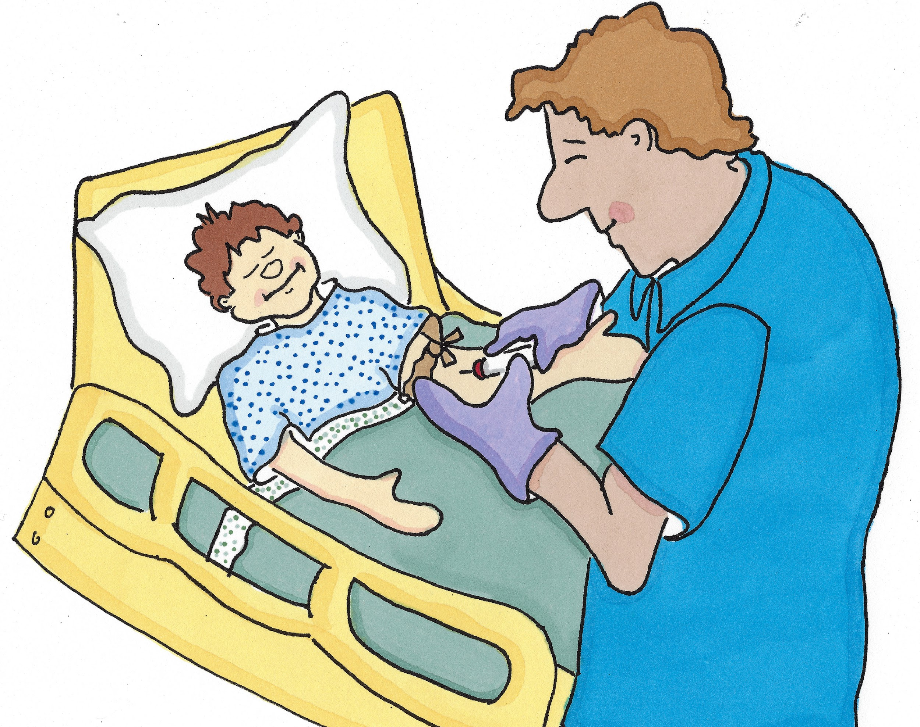
Then a Phlebotomist (Fle/bo/tom/ist) took some blood for testing by a blood scientist (blud sigh/en/tist).

Slide 11
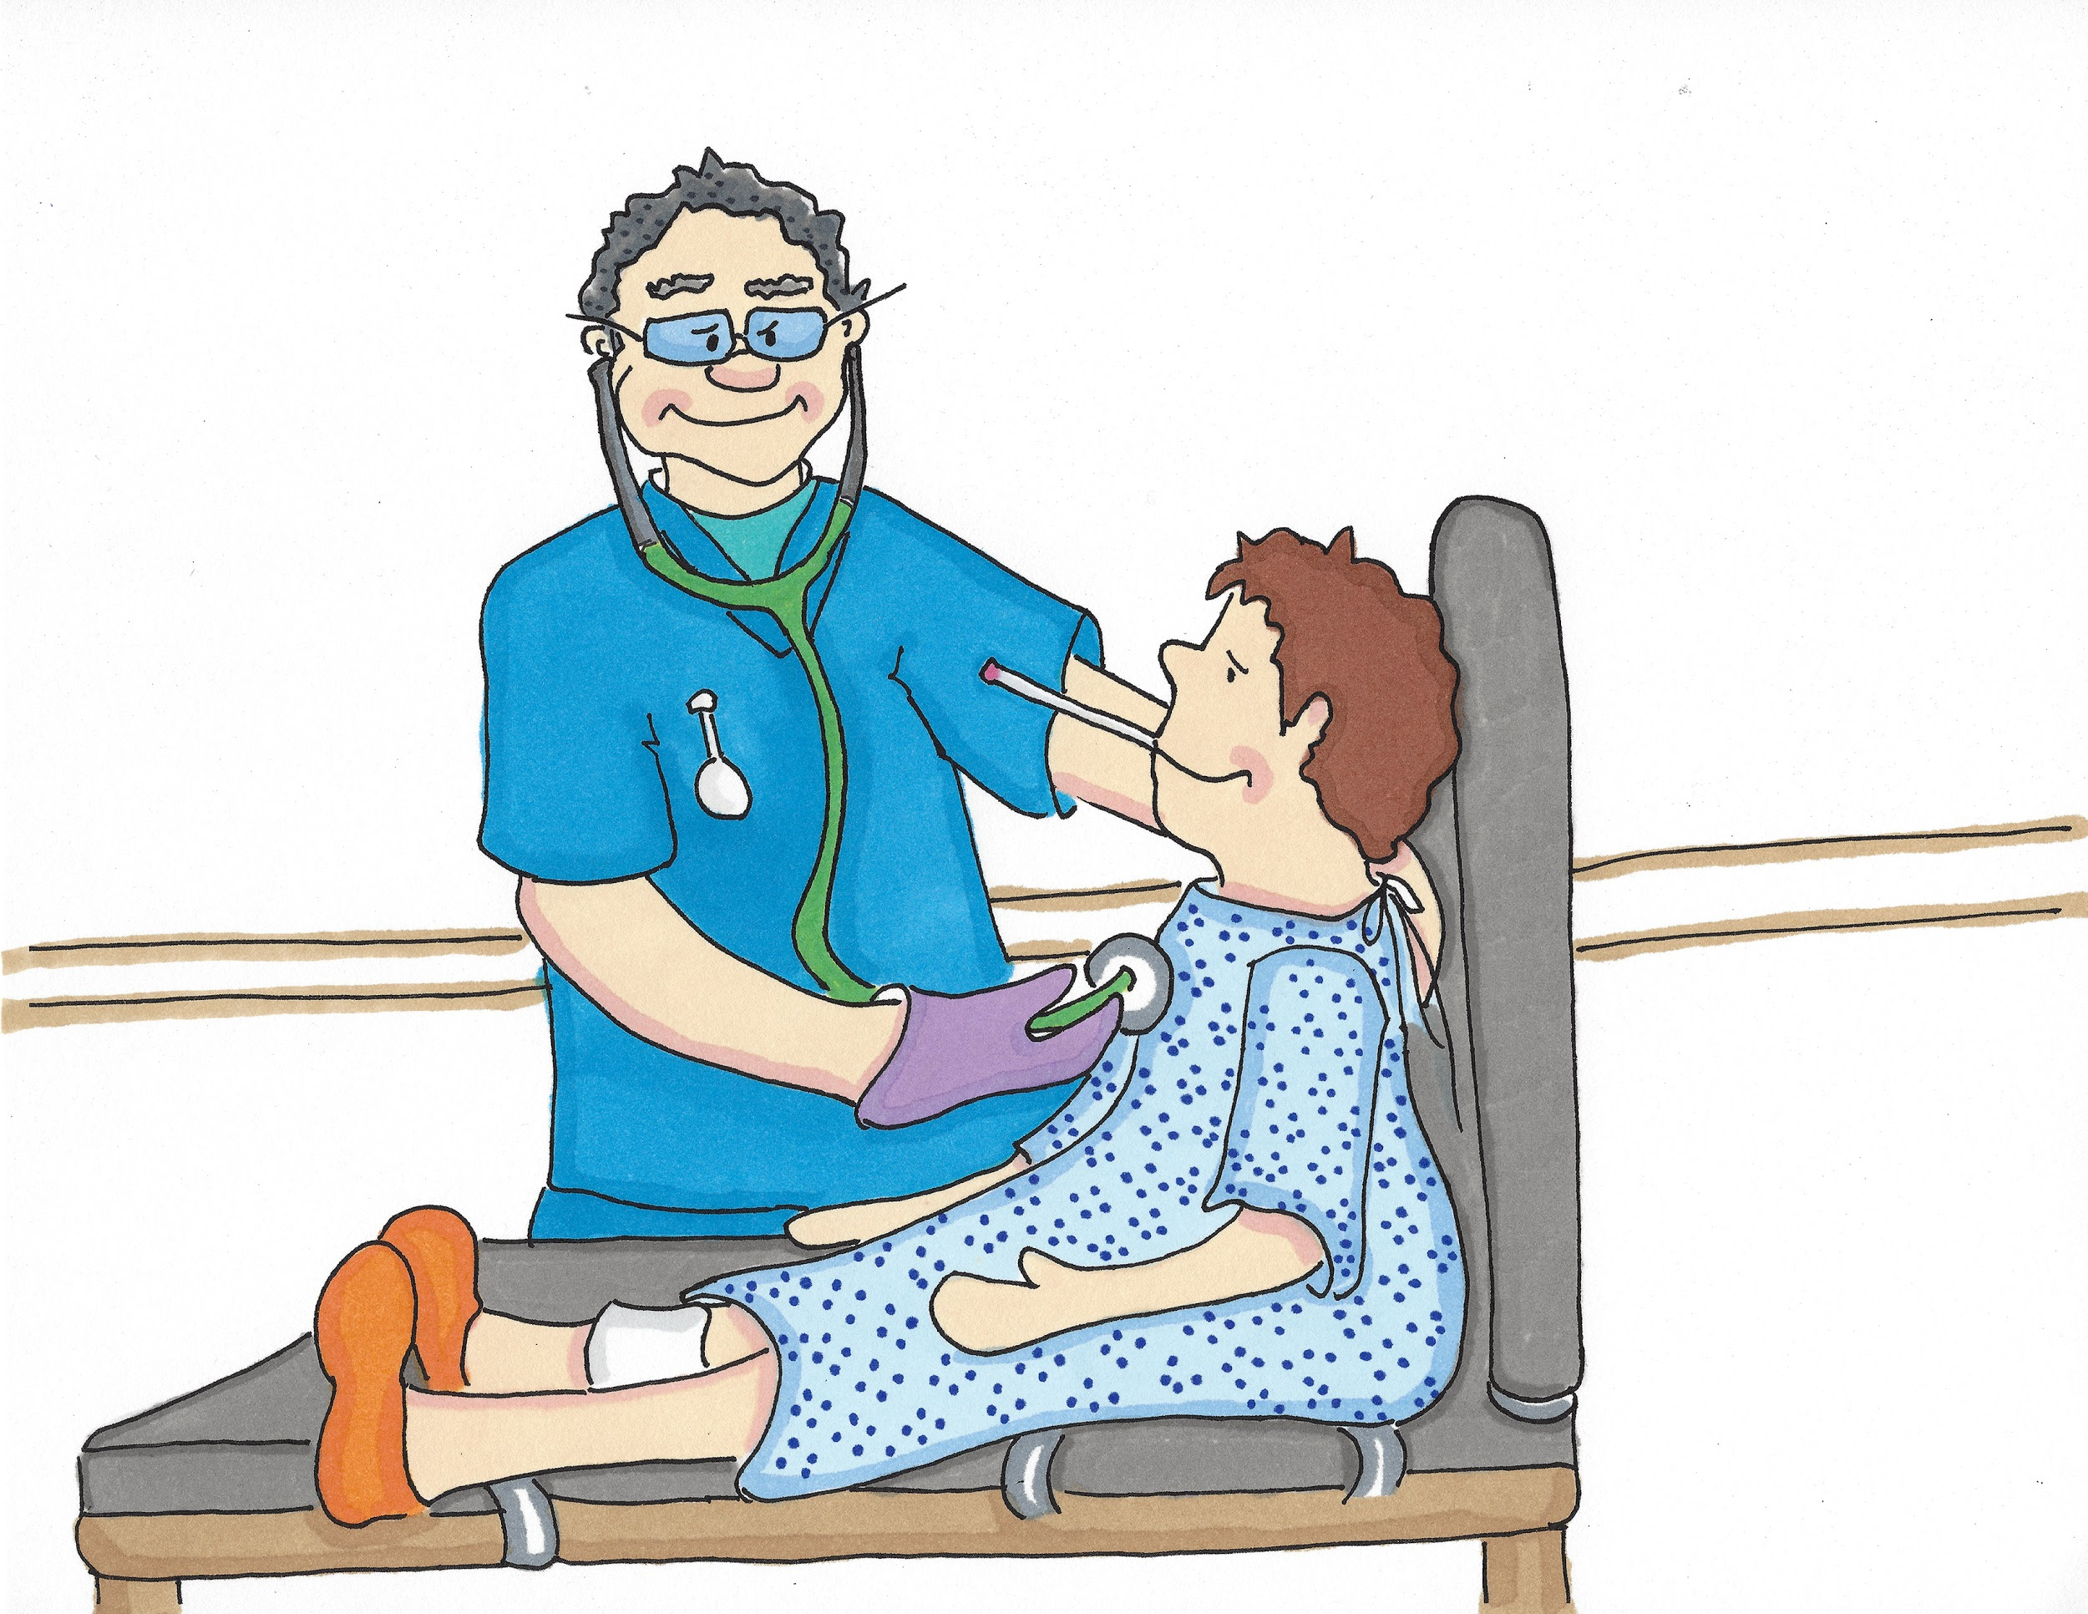
Nurse Neil checked my temperature and listened to my heart. He said ‘You are a brave boy, Isaac’.

Slide 12
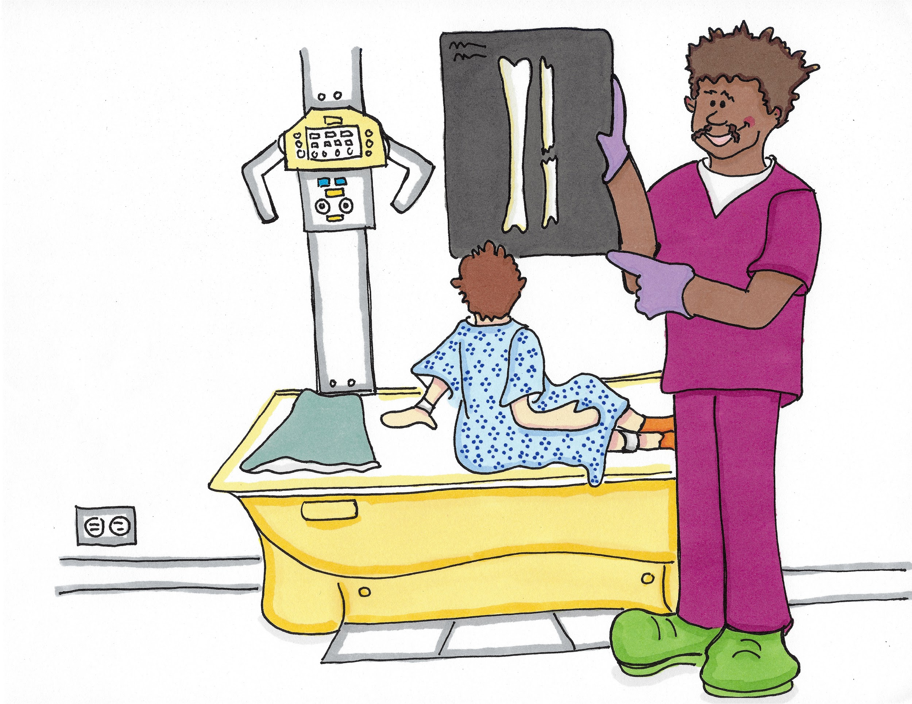
Later a Radiographer (Ray/dee/o/gra/fir) called Aleks took an X-ray of the inside of my leg. He pointed to where my bone was broken.

Slide 13
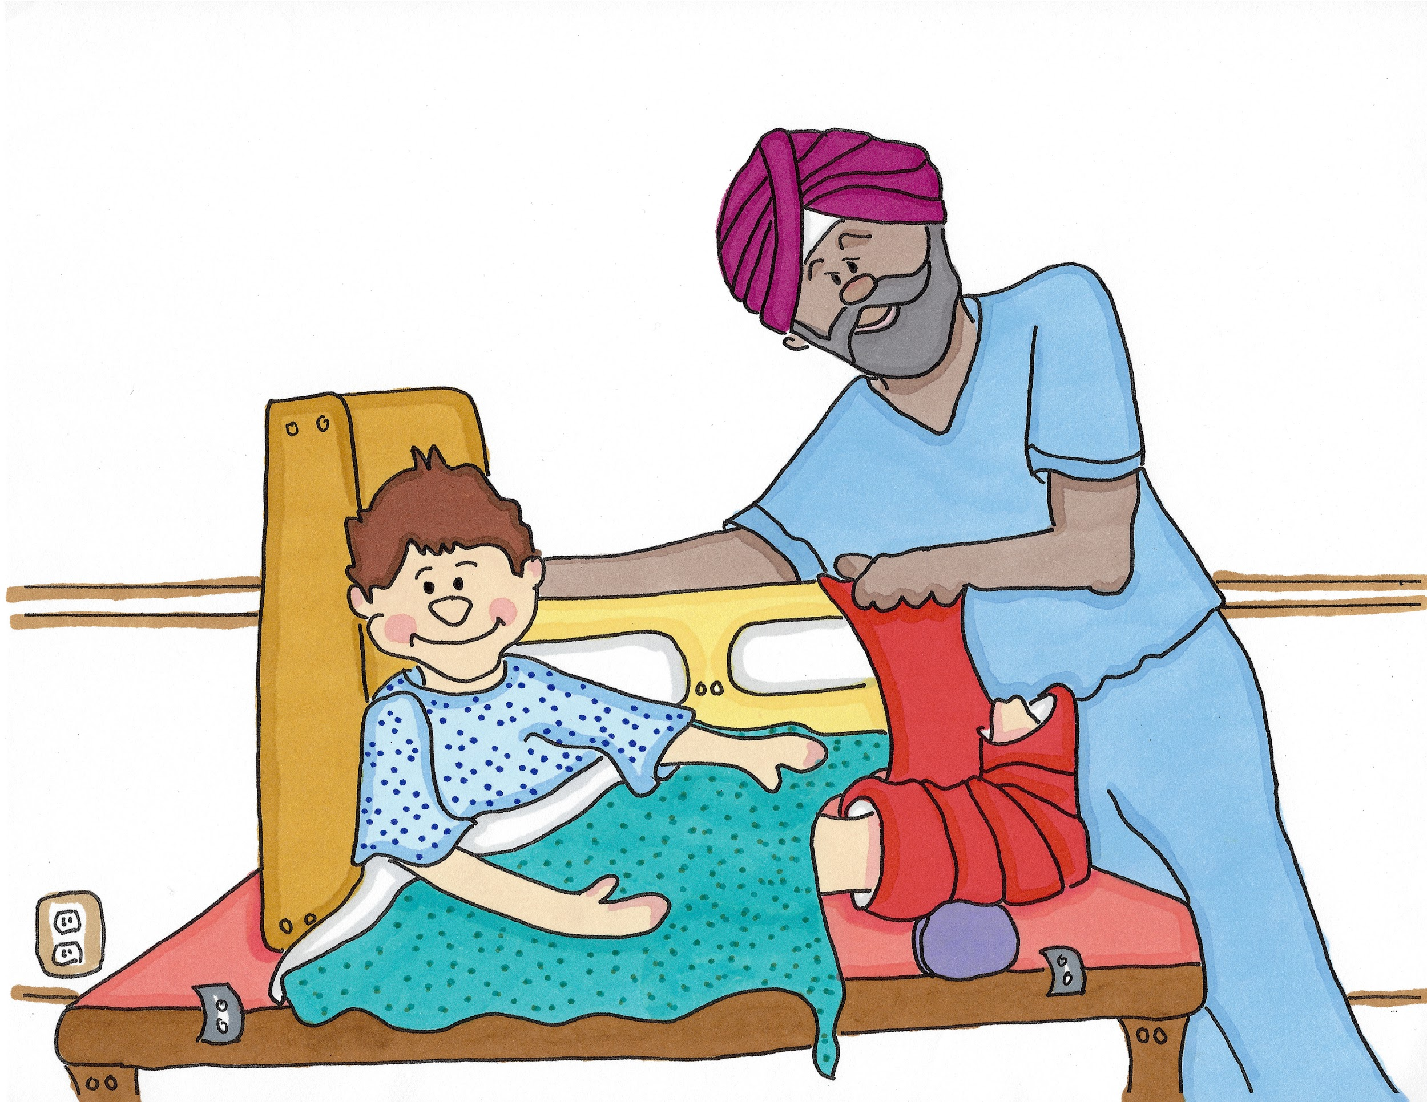
Then the Plaster Technician (Plas/tir Tec/ni/shun) put a plaster cast on my leg. I chose red.

Slide 14
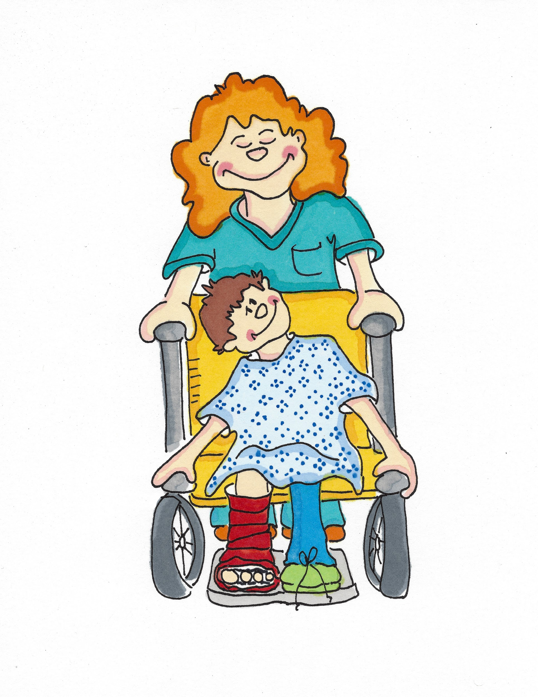
Mo the Porter (Por/tir) took me to the ward where I stayed for a few days.

Slide 15
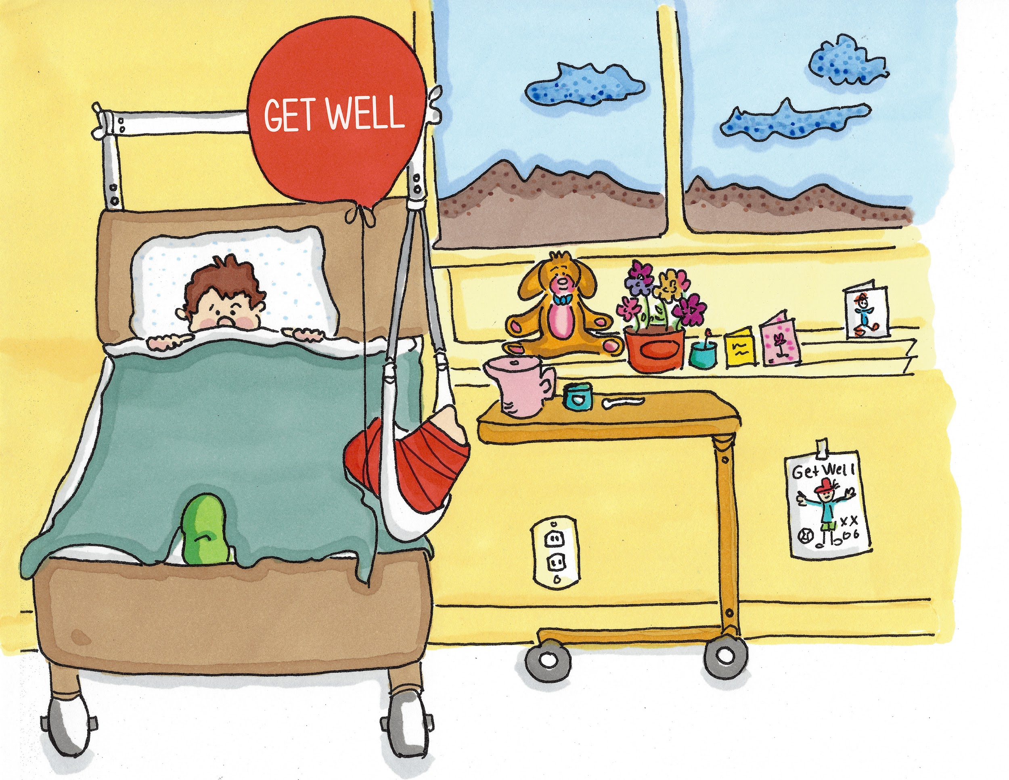
I had to lie in bed with my leg up high.

Slide 16
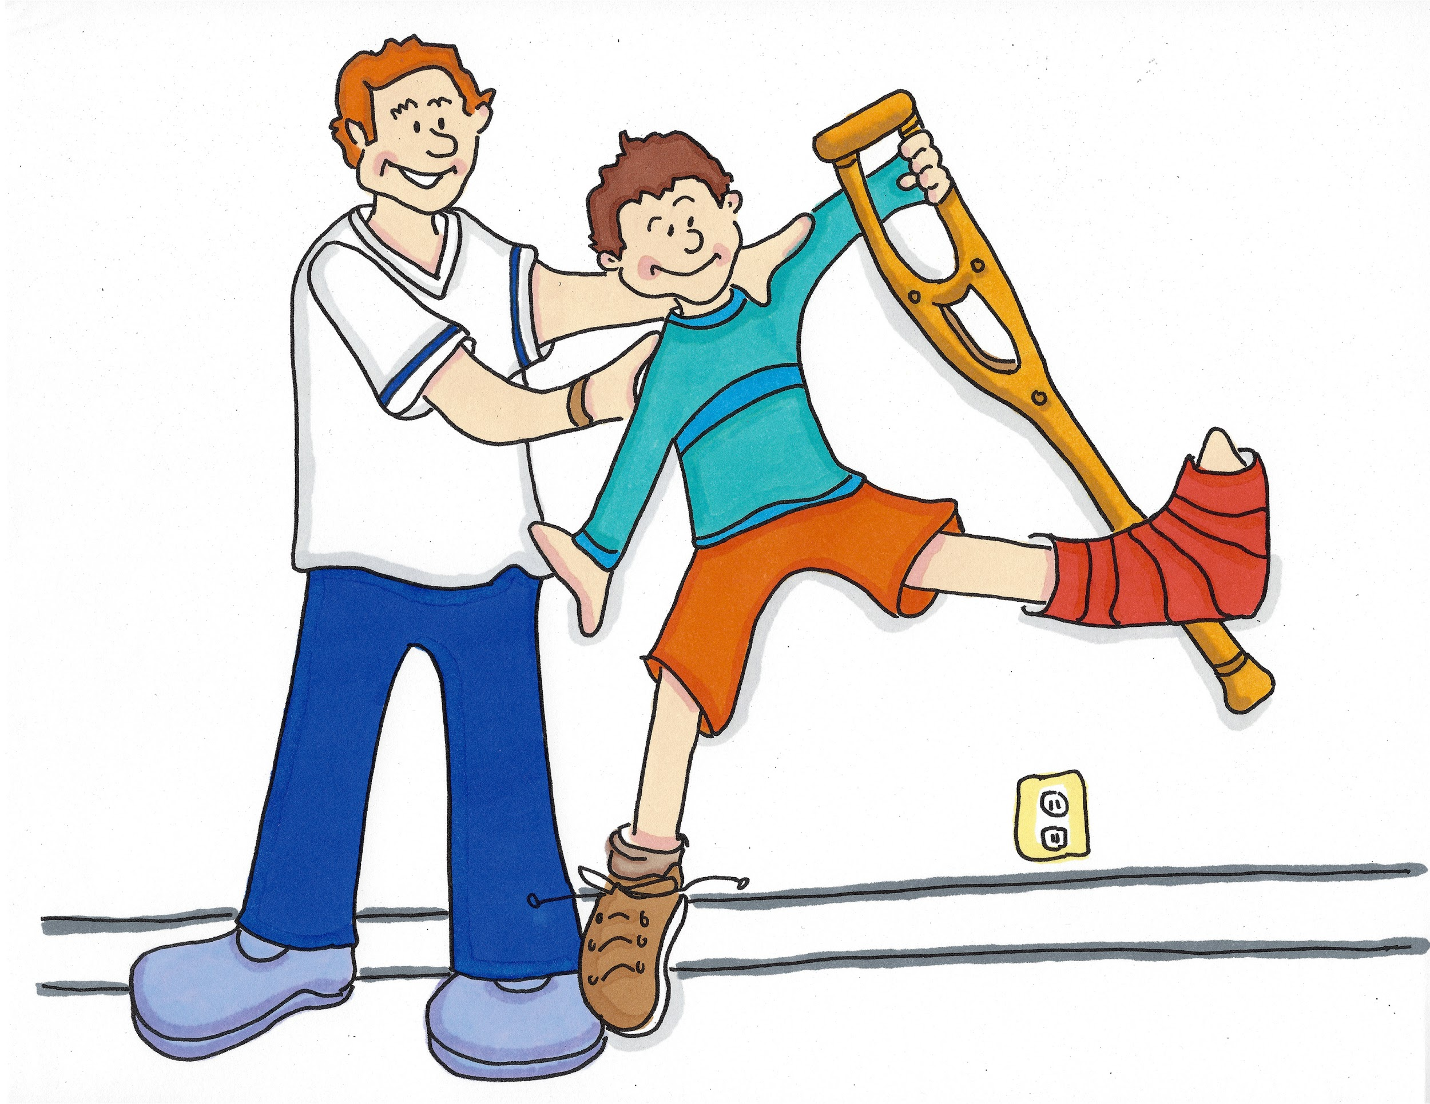
When I had learnt to walk on crutches I was allowed to go home but I needed extra care and help with things I can normally do myself like getting dressed and washing myself. A Rehabilitation Assistant (Ree/ha/bil/i/tay/shun A/sist/ant) visited me each day to help Mummy with my care.

Slide 17
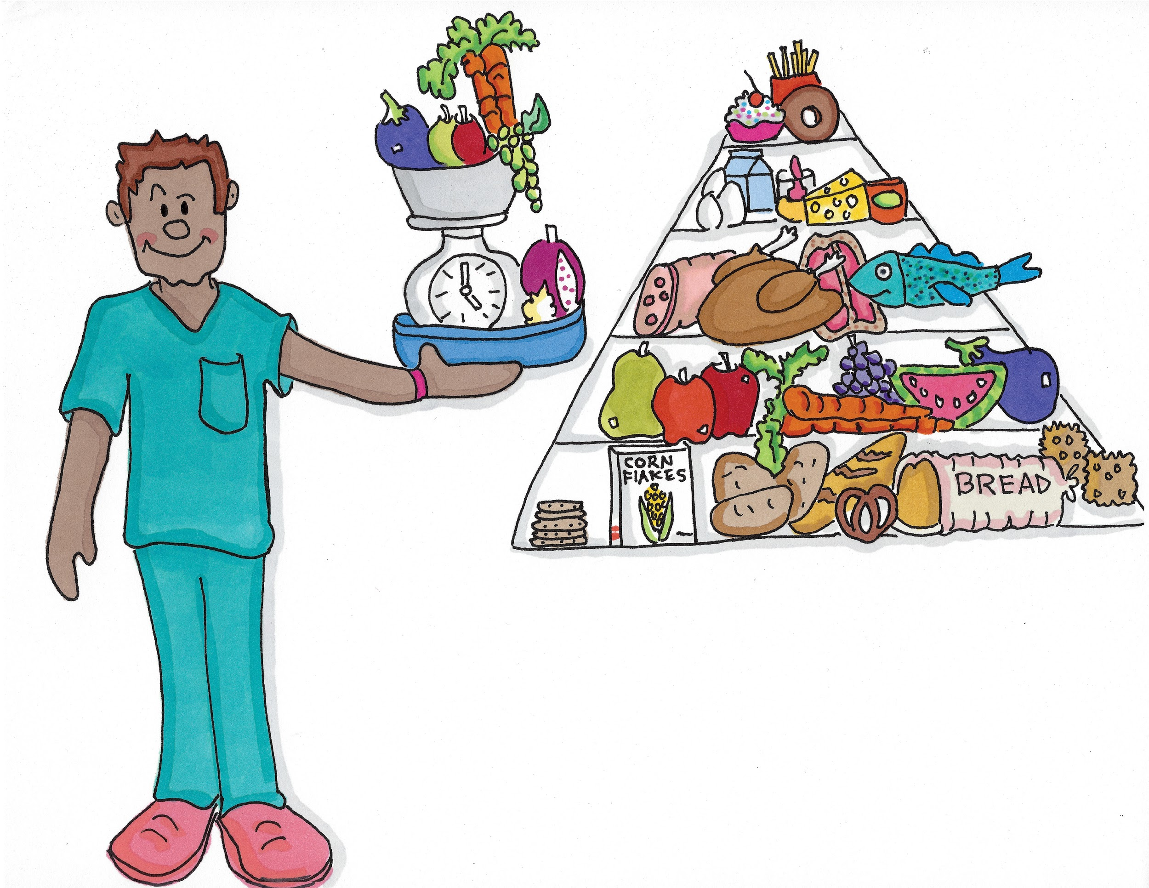
At the local medical centre Stefan the Dietitian (Digh/e/ti/shun) told us about the foods that would help my leg heal.

Slide 18
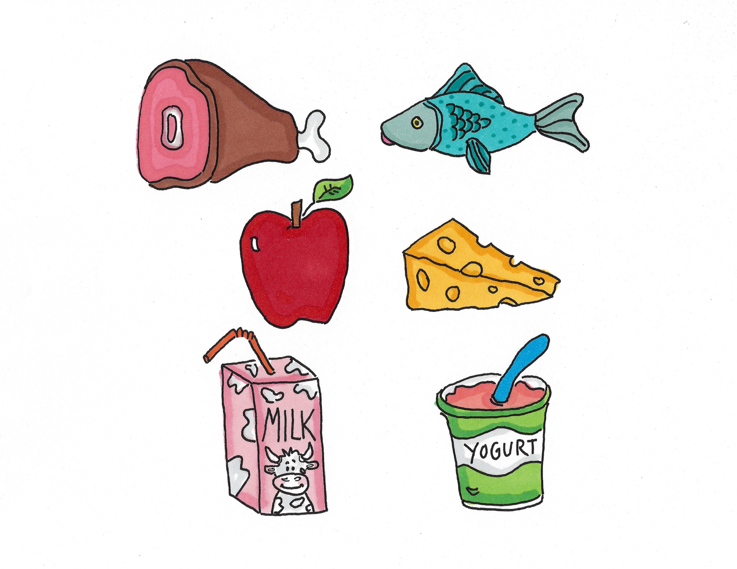
Meat, fish, milk, cheese and yogurt.

Slide 19
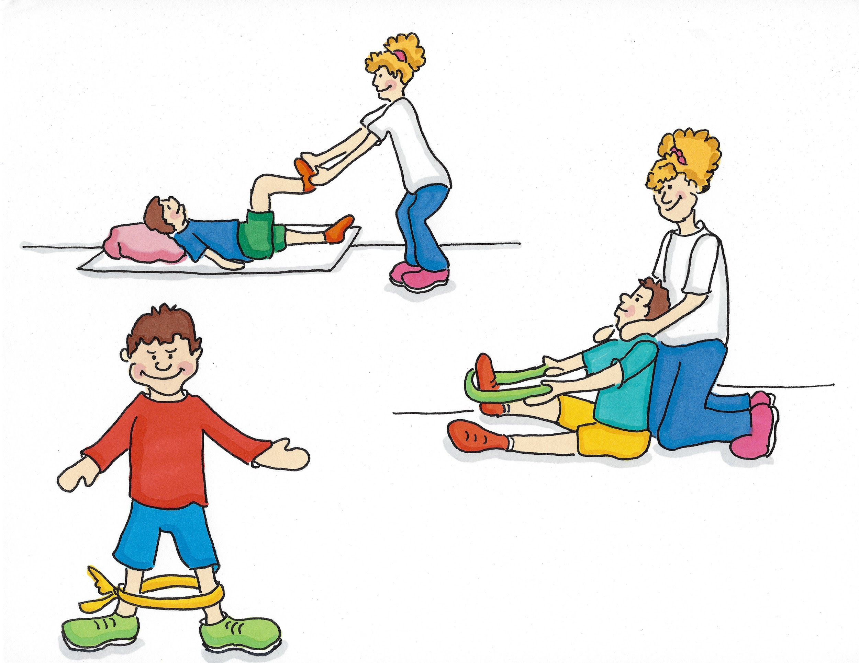
Jess the Community Physiotherapist (Com/yoo/ni/tee Fi/si/oa/the/rap/ist) showed me fun exercises to make my leg stronger and move properly again. I had to go to see her at the medical centre every week and practice the exercises at home.

Slide 20
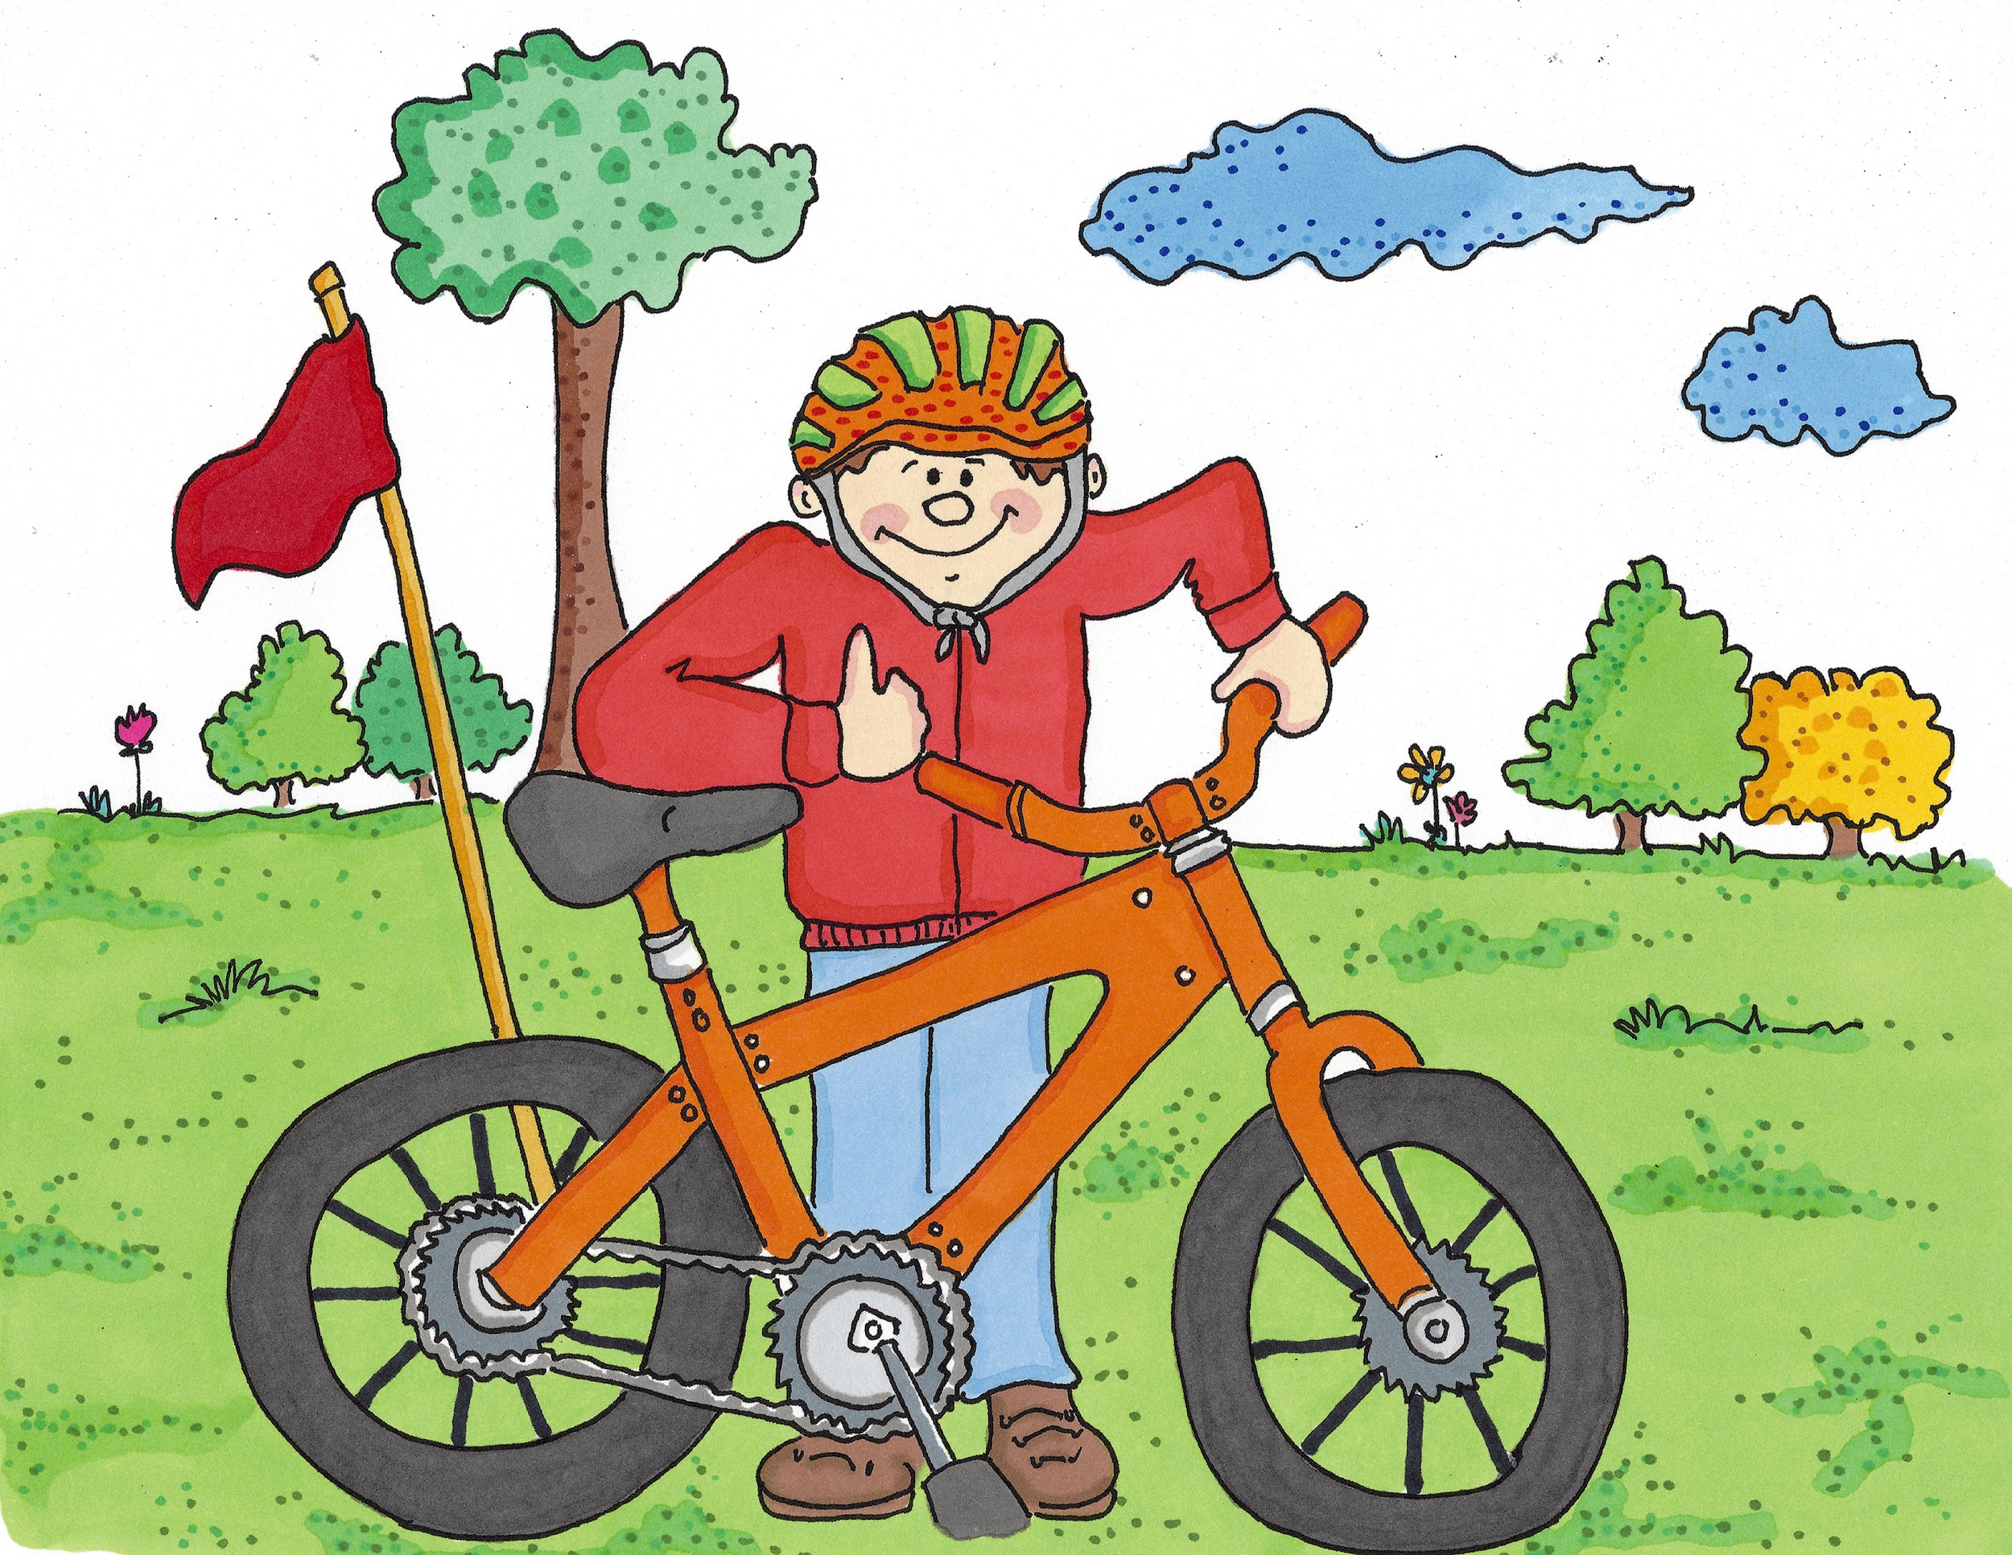
My leg is all better now. I can do everything I did before I fell off my bike.

Slide 21
Everyone does amazing jobs to look after patients.
Would you like to work in health and social care when you grow up?
You could be a...

Slide 22
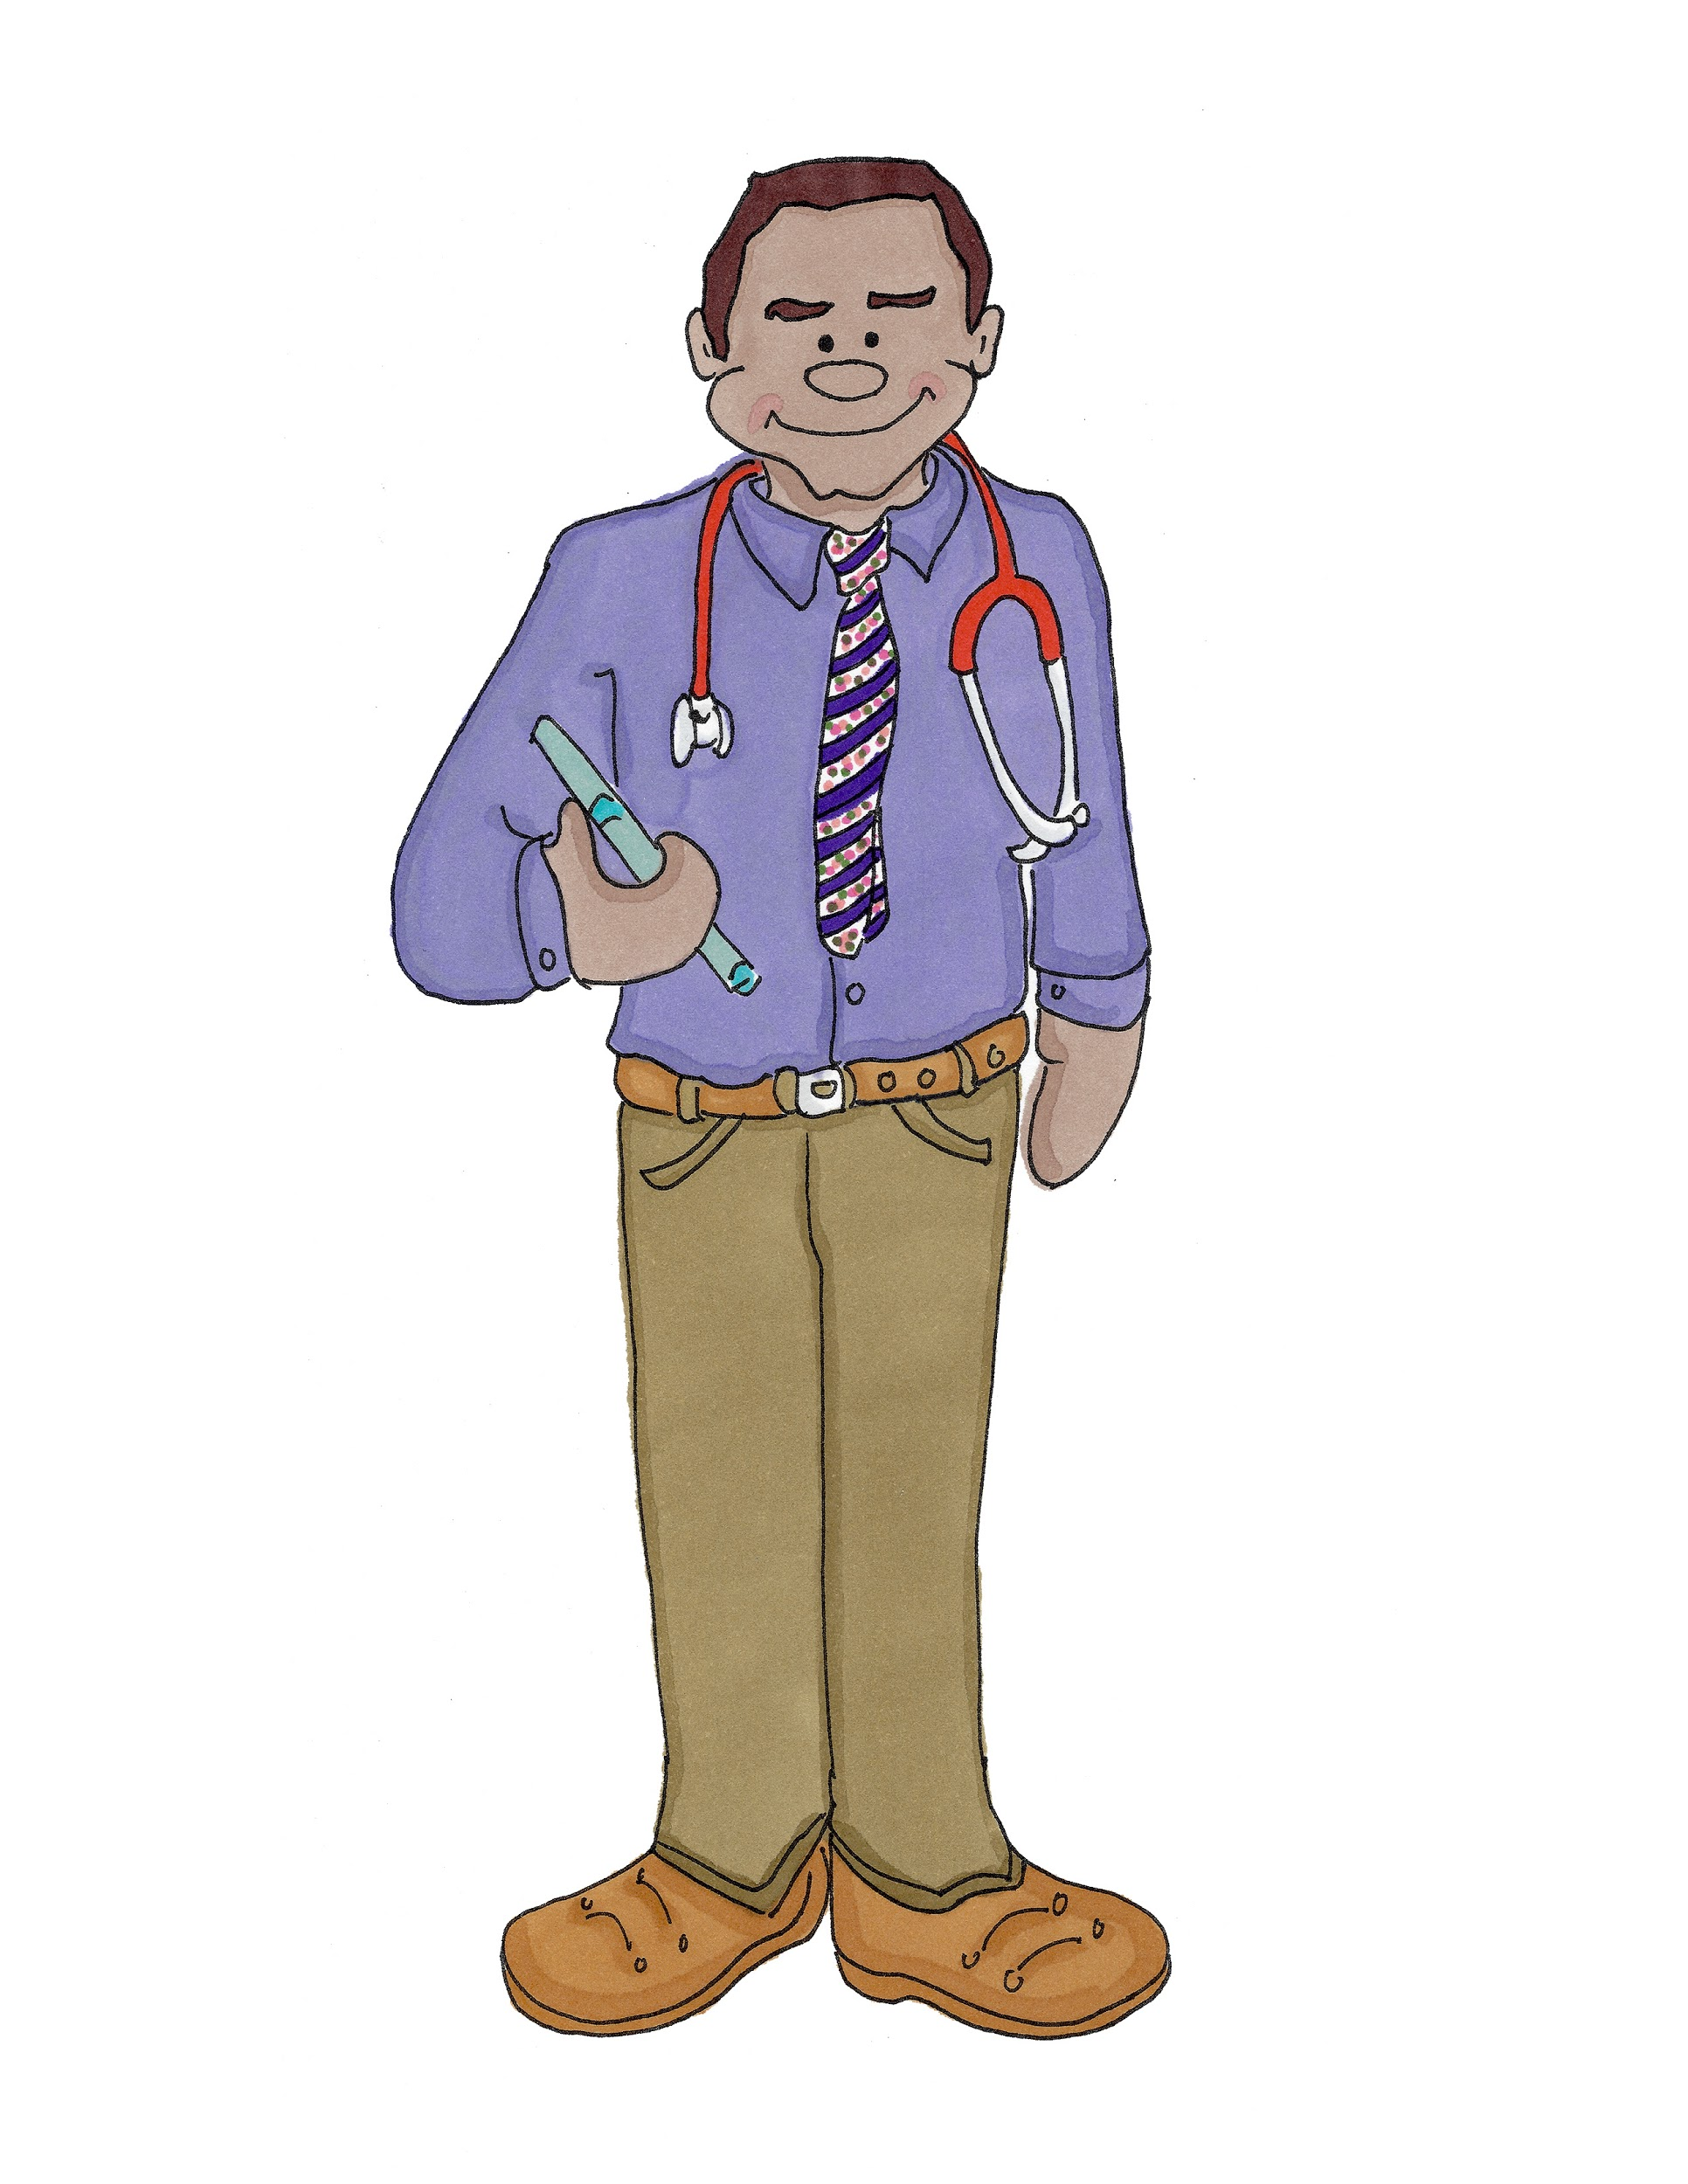
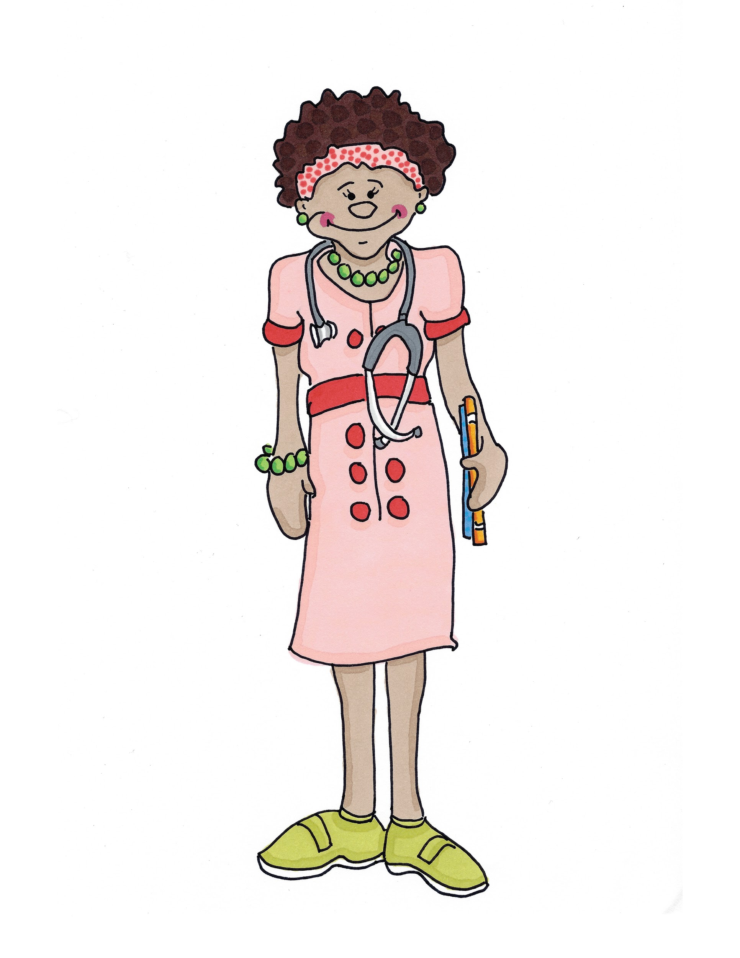
Doctor (Doc/tor)

Slide 23
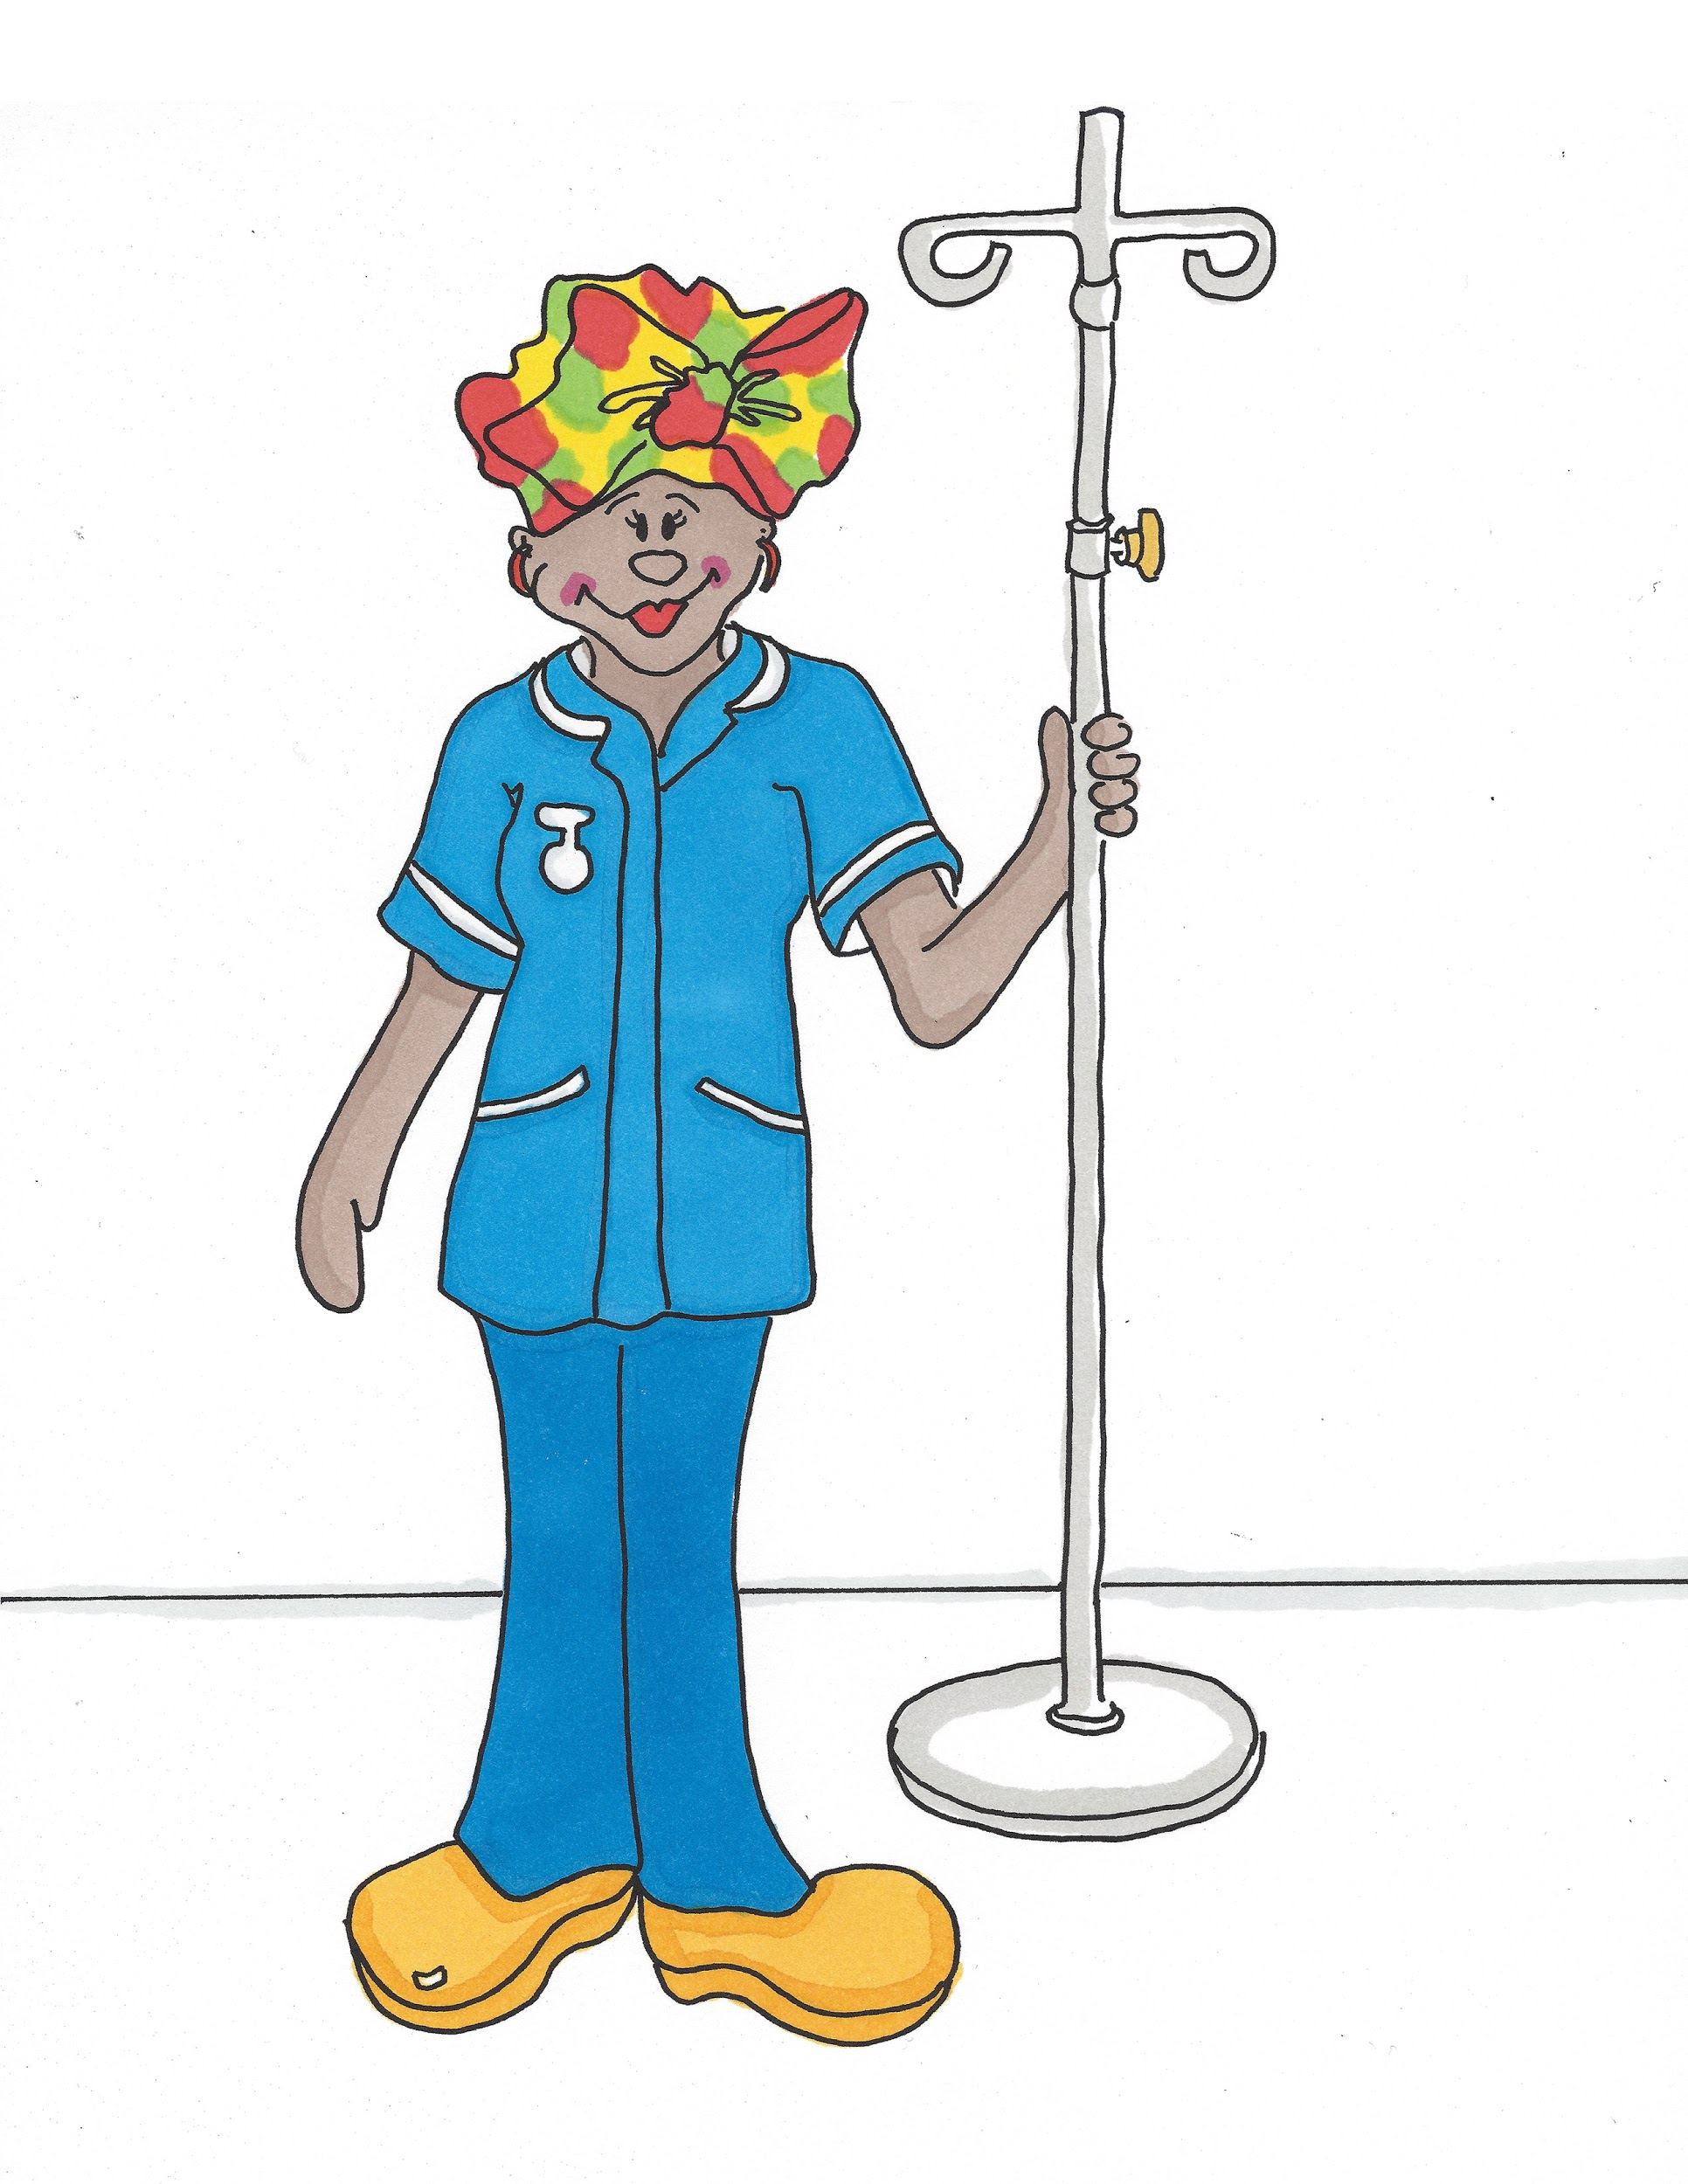
Nurse (Nurs)

Slide 24
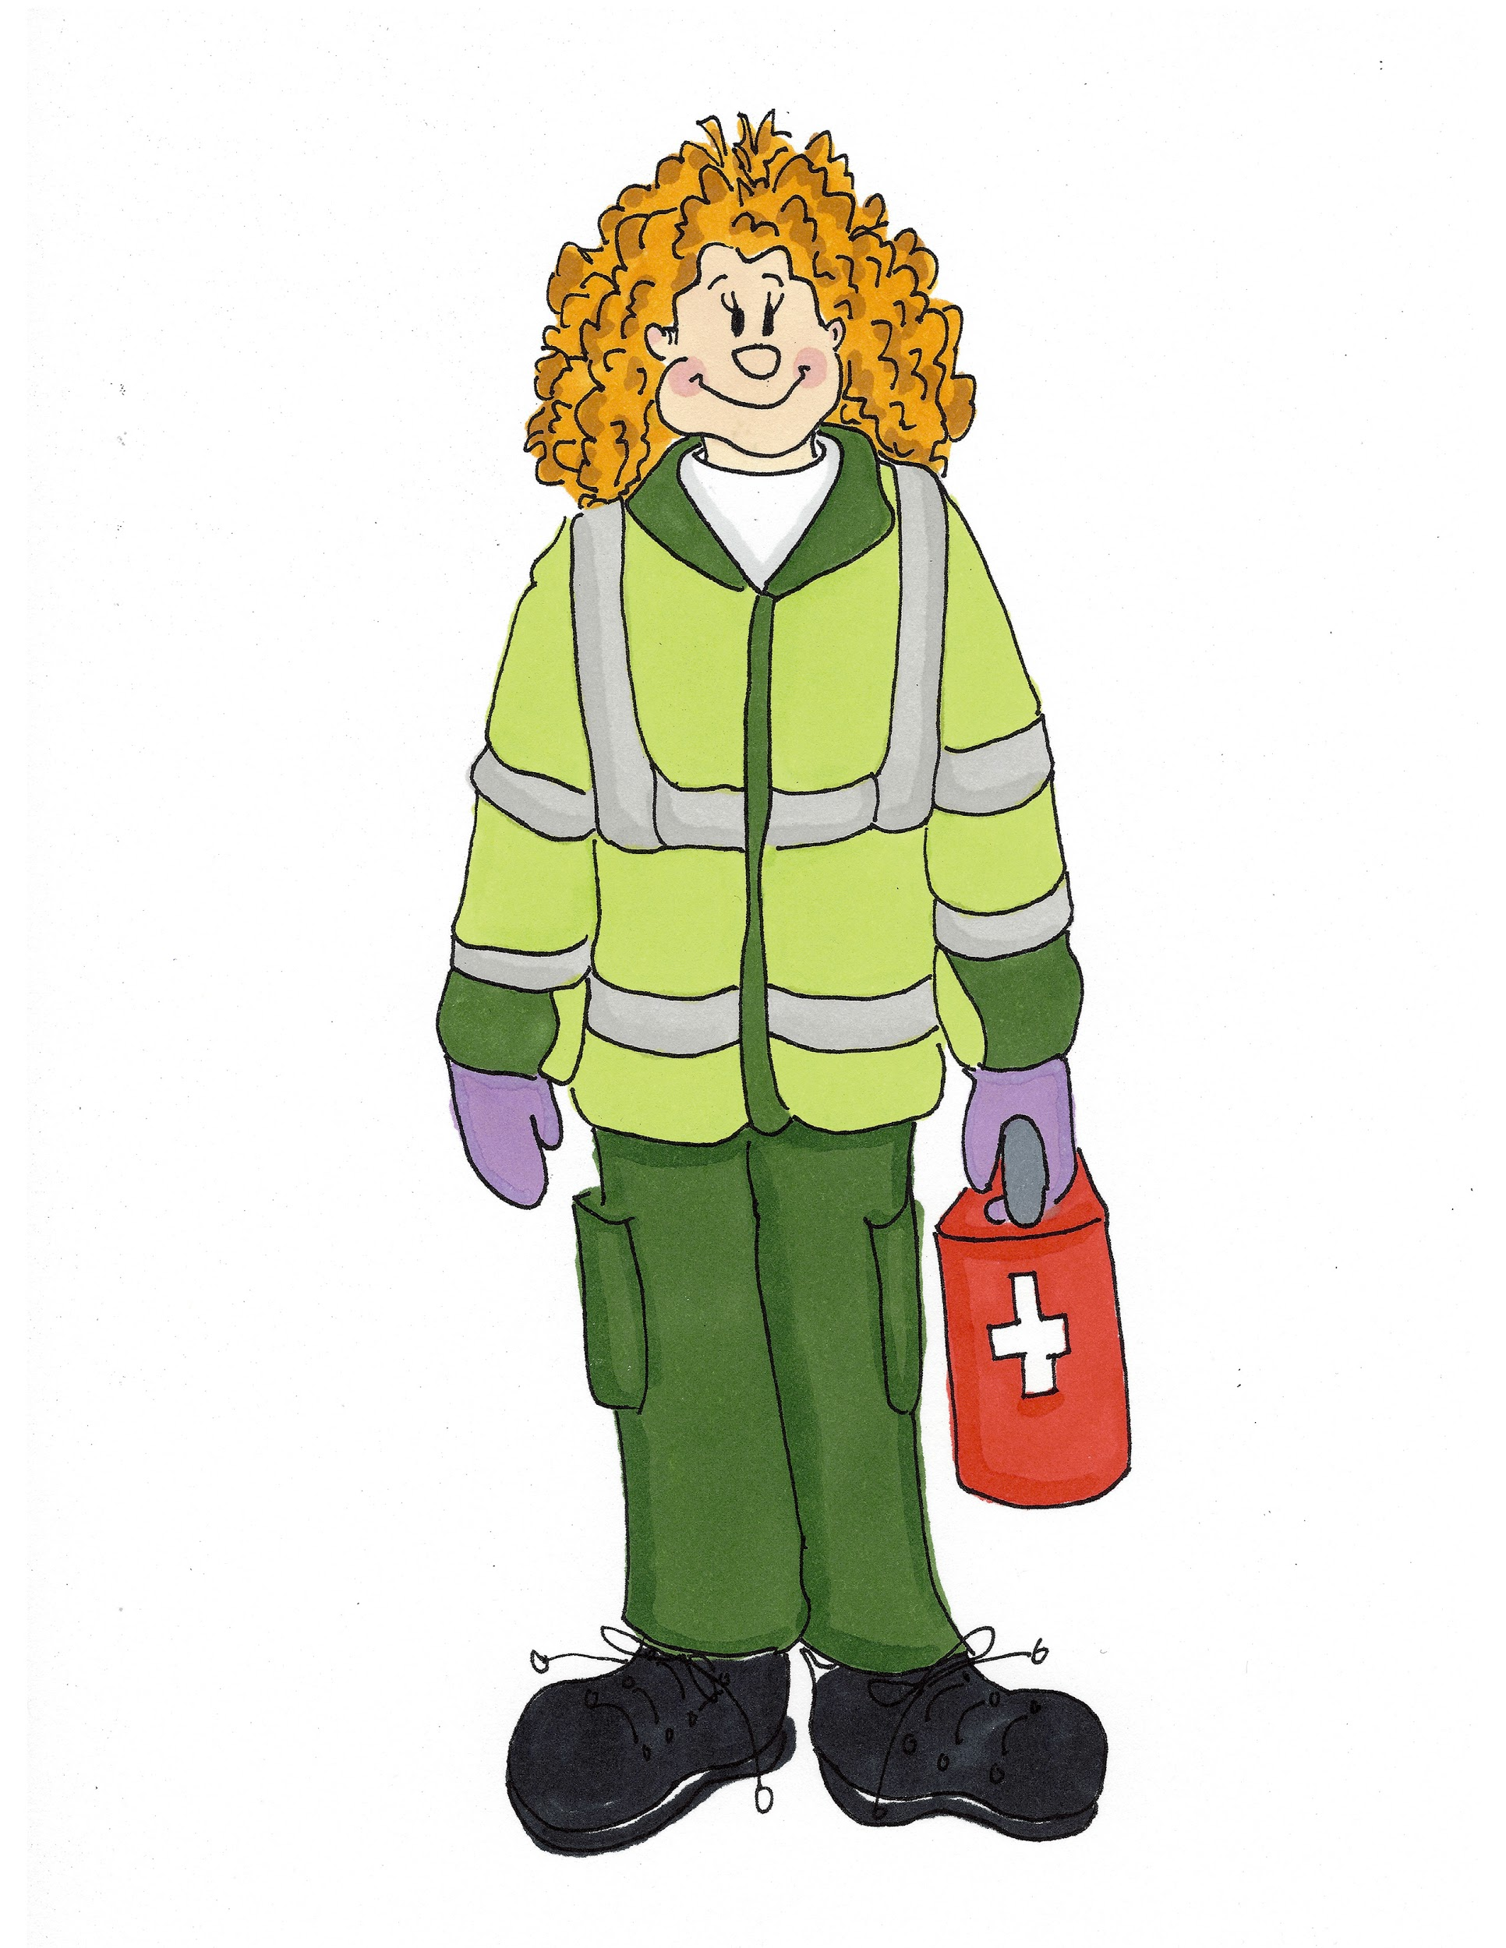
Paramedic
(Pa/ra/med/ic)

Slide 25
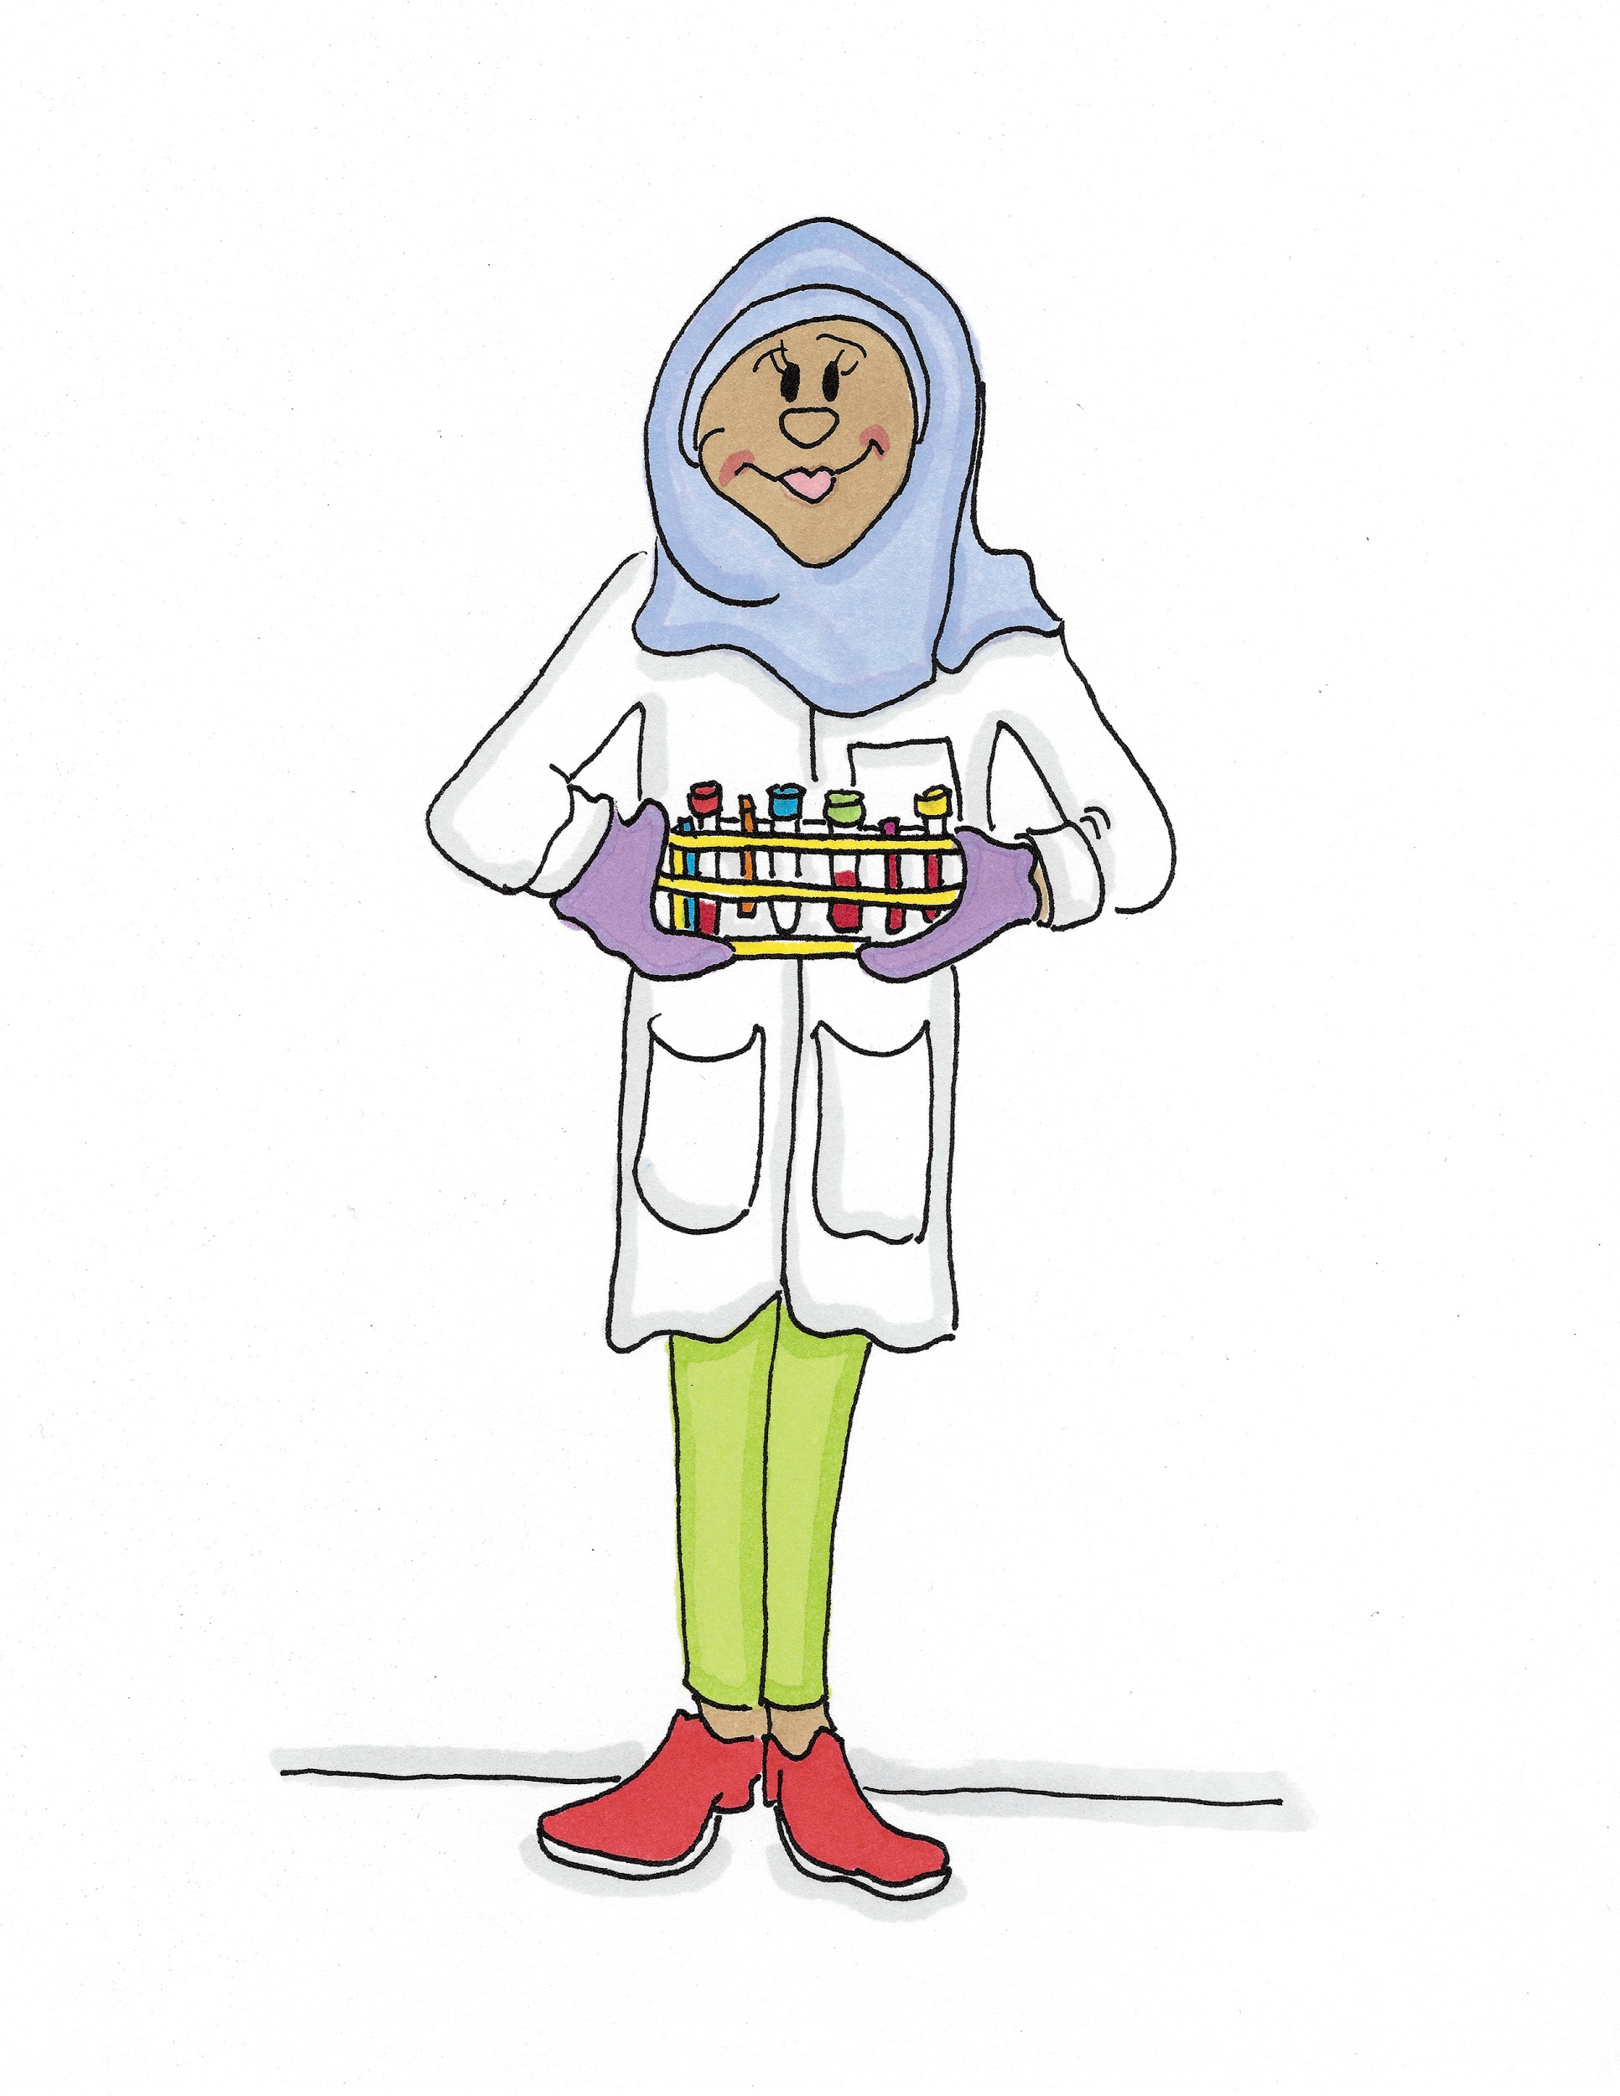
Blood Scientist
(Blud Sigh/en/tist)

Slide 26
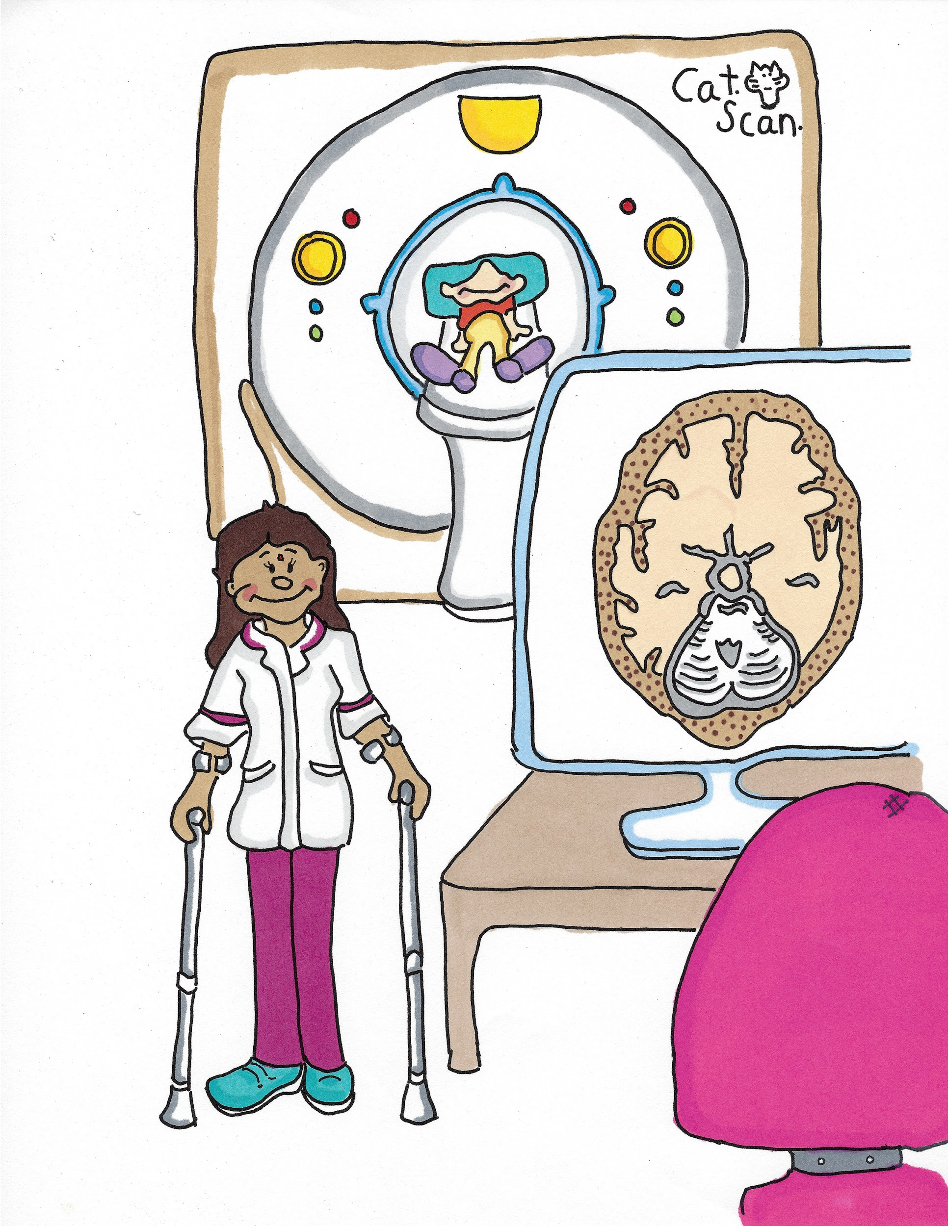
Radiographer
(Ray/dee/o/gra/fir)

Slide 27
Porter
(Por/tir)

Slide 28
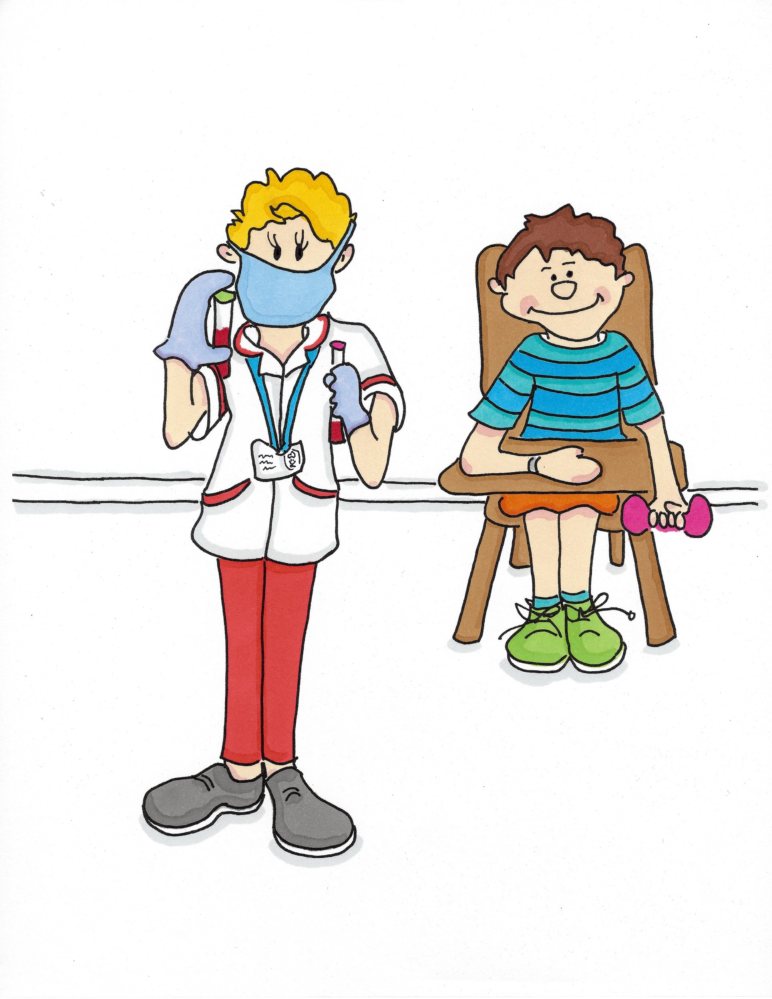
Phlebotomist
(Fle/bo/tom/ist)

Slide 29
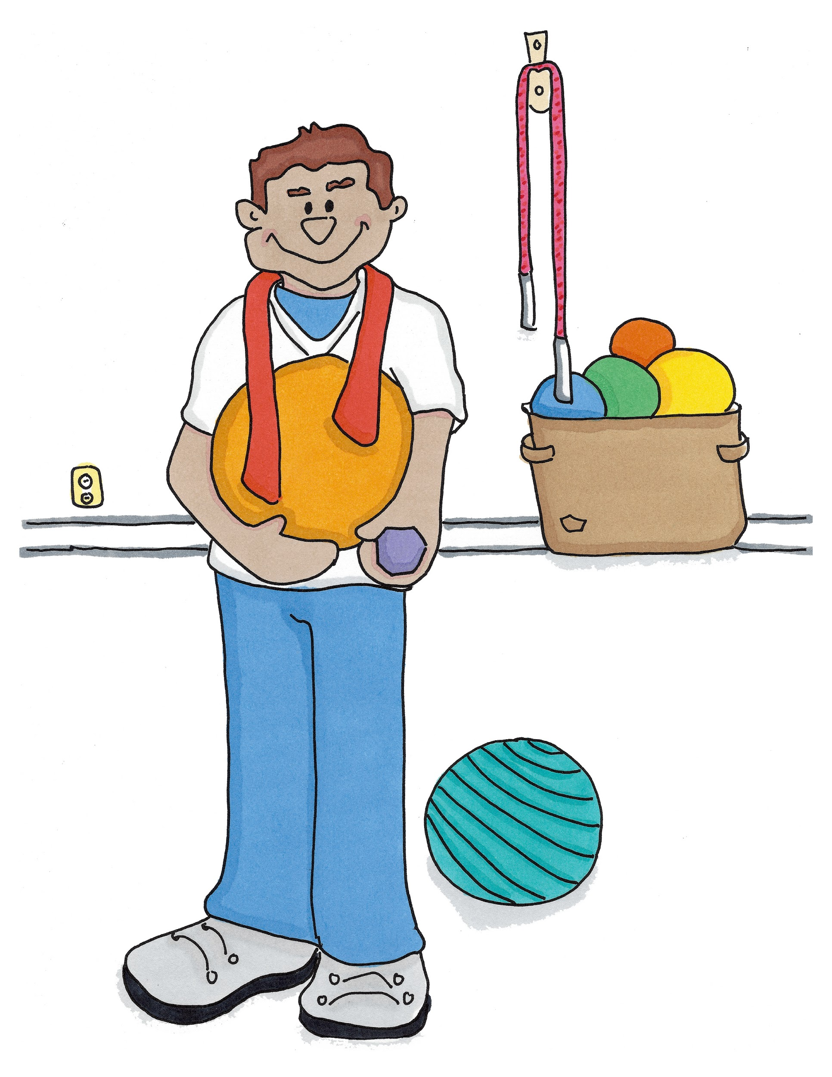
Community Physiotherapist
(Com-yoo-ni-tee Fi-si-oa-the-rap-ist)

Slide 30
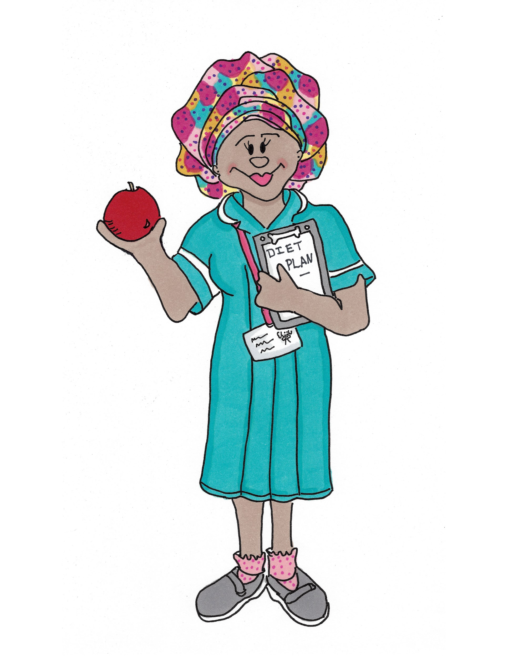
Dietitian (Digh/e/ti/shun)

Slide 31
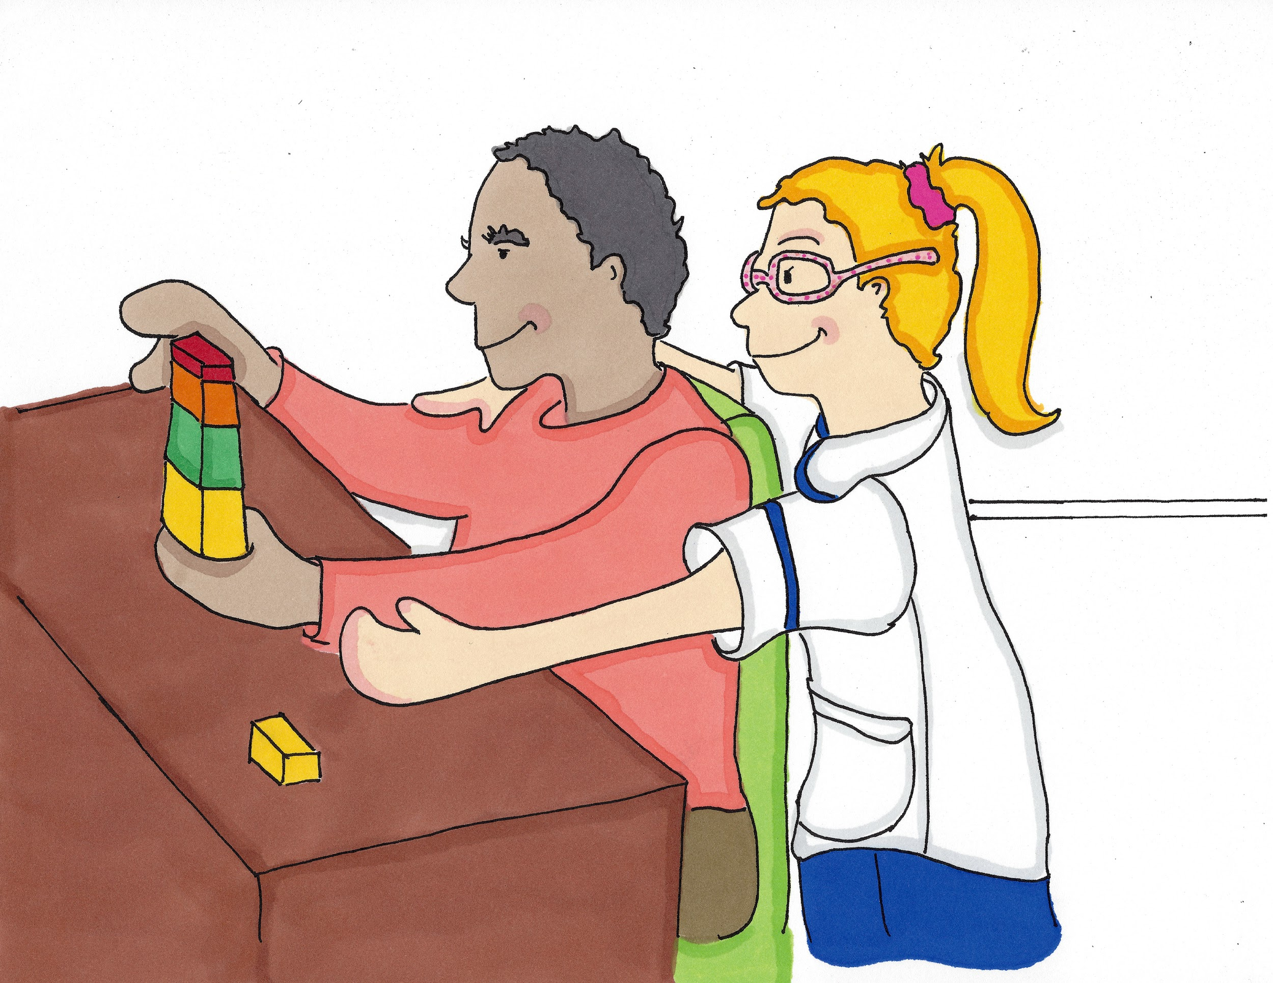
Rehabilitation Assistant
(Ree/ha/bil/i/tay/shun A/sis/tant)

Slide 32
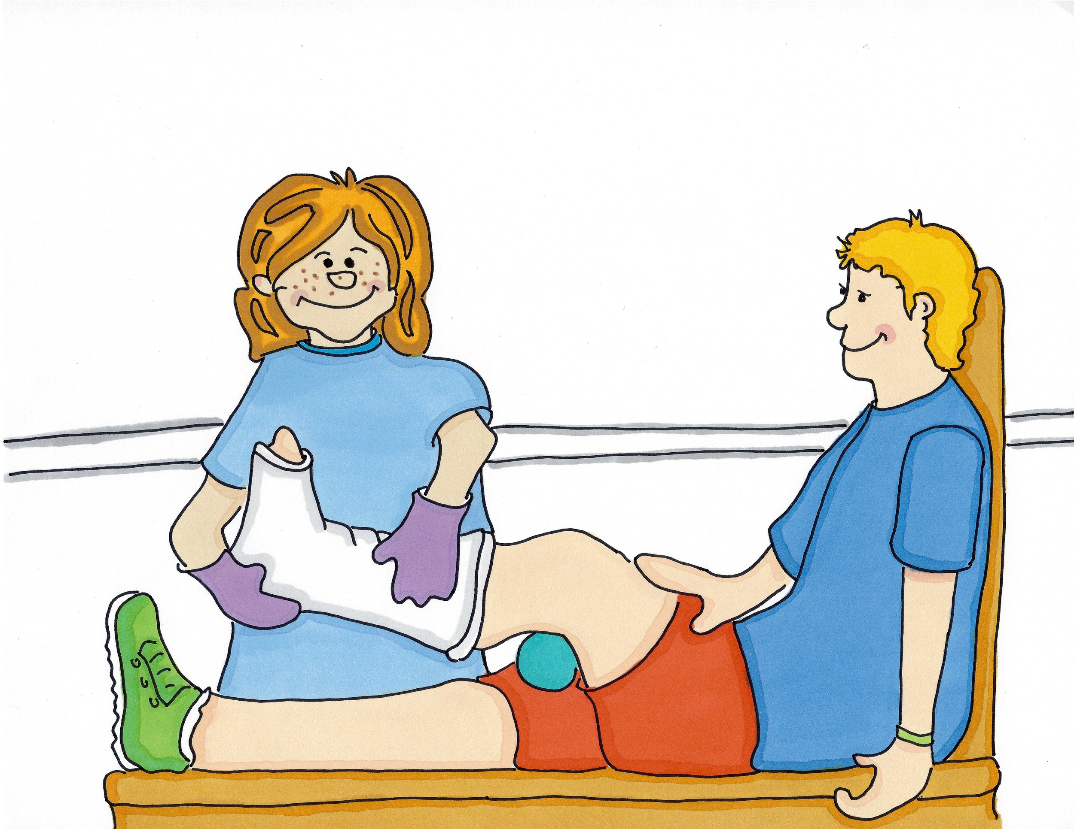
Plaster Technician
(Plas-tir Tec-ni-shun)

Slide 33


