Slide 1
SKILLS
A school assembly
East Sussex Primary Careers Hub
Notes:
This can be a class or whole school assembly.

Slide 2








Are girls better than boys at these skills?
Skills
Are boys better than girls at these skills?
Look at the 8 skills below
Notes:
Encourage children and adults to share their thoughts.

Slide 3
Let’s do a test: stand up if your strongest skill is problem solving
Notes:
Count how many boys and girls stand up – is it an even spread?

Slide 4
Let’s do a test: stand up if your strongest skill is staying positive
Notes:
Count how many boys and girls stand up – is it an even spread?

Slide 5
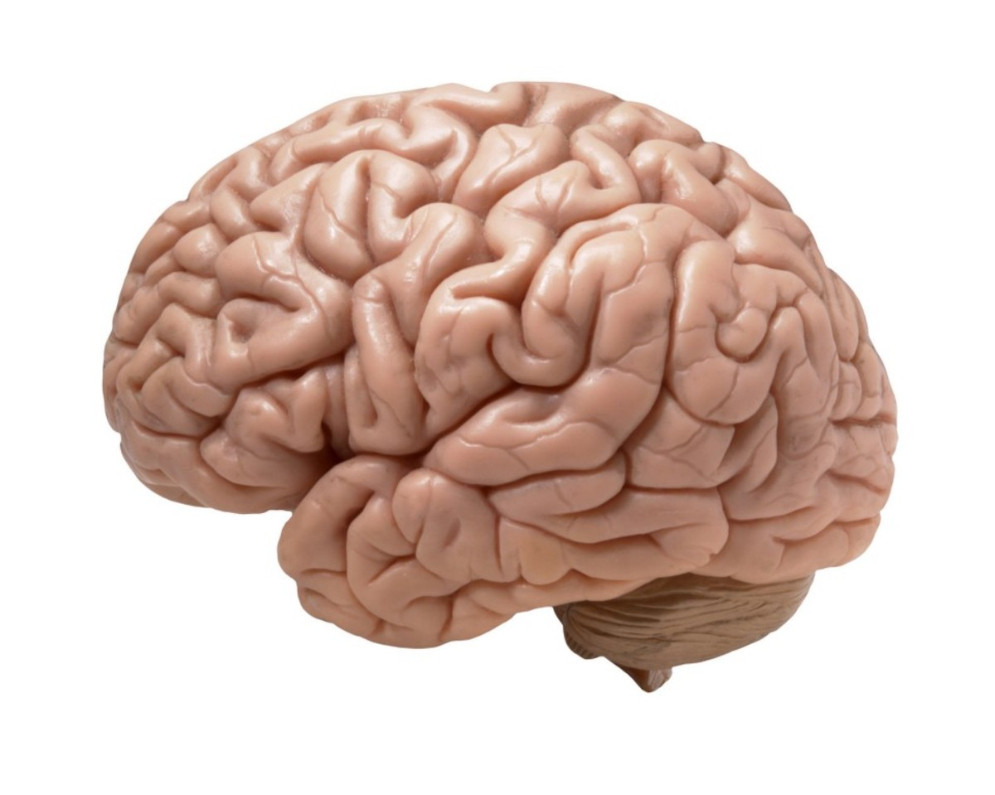
Girl or boy?
Do boys and girls have different brains?
Notes:
Encourage discussion.

Slide 6
Taken from ‘No More Boys and Girls’ BBC 2017
Ginna Rippon | Professor of Cognitive Neuroima | The Careers & Enterprise Company - YouTube
Notes:
Go to https://www.bbc.co.uk/programmes/b09202jz for more information about the programme.

Slide 7

So why are boys and girls often very different?
Self-creation:
The things you do a lot make your brain grow a certain way
Notes:
Discuss the clip – the science now tells us there is no difference between boys and girls, so why are they often very different?
Self-creation – use the example of learning a new skill such as riding a unicycle – it can not be done without repeated practise. This practise causes your brain to grow a certain way.
Toys
Ask children to suggest which toys they think manufacturers often aim at girls – what skills do playing with these toys help their brains develop?
Ask children to suggest which toys they think manufacturers often aim at boys – what skills do playing with these toys help their brains develop?

Slide 8
When does ‘self-creation’ start?
When does ‘self creation’ start?​ | The Careers & Enterprise Company (youtube.com)
Notes:
Take time to discuss this clip.

Slide 9
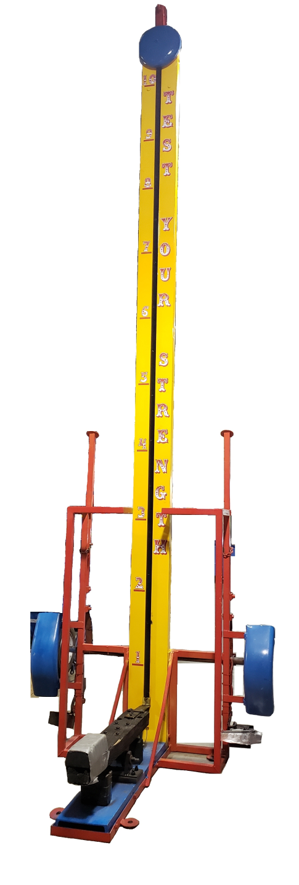
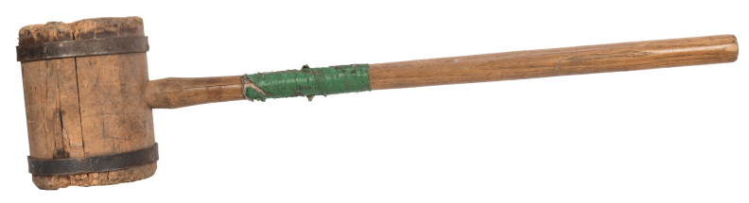
Are boys stronger than girls?
Notes:
Discuss.

Slide 10
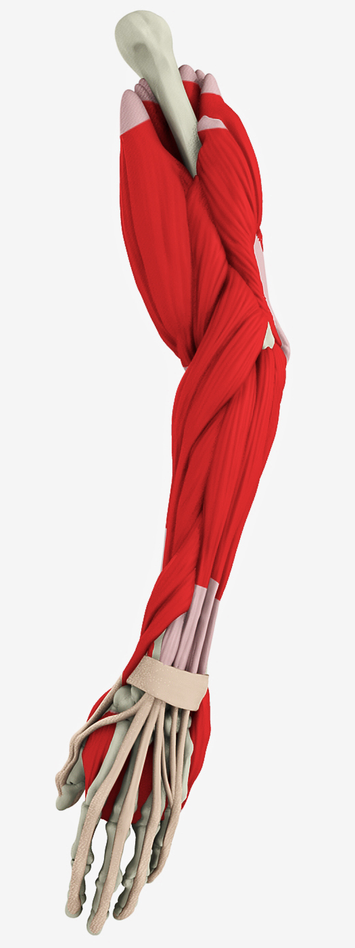
If boys and girls are the same size, they have the same strength. This does not change until they reach secondary school.
Notes:
So, if we know that boys and girls strength is the same, and their brains are the same, can they do the same things?

Slide 11
Skills and Careers

Slide 12

Stand up survey
Everyone stand up!
Start with everyone standing up. Some careers will be gradually revealed by showing the character, interests and skills you might need for these each. If this doesn’t sound like you, you can sit down. When the career is revealed, those left standing will be the most suited to it.

Slide 13

Interested in science
Excellent memory & organisation
Like to help people
Not squeamish
Notes:
All the skills are important for every career, but in this job you need to be particularly strong in…

Slide 14


Interested in science
Excellent memory & organisation
Nurse
Like to help people
Trained to care for sick and injured people.
Not squeamish
Boy or girl?

Slide 15
Nurses – some background
Men were an accepted part of what was then known as nursing in the Middle Ages, where they were often part of monasteries. There is historical evidence that men were carers in the voluntary hospitals and in the poor workhouses of early Victorian England. Men were less likely to be seen as nurses during the time of Florence Nightingale (1820 – 1920), as she discouraged it, and then during the two world wars men were required to join the armed forces. In 2016, only 11.4% of registered nurses in the UK were male https://www.theguardian.com/healthcare-network/2017/mar/01/why-so-few-male-nurses
What impact does this low proportion of male nurses have in the UK?
Notes:
This slide can be used for notes, and may be a good prompt for a philosophy session.

Slide 16
Interested in science
Patient
Curious
Organised and focussed
Notes:
All the skills are important for every career, but in this job you need to be particularly strong in…

Slide 17
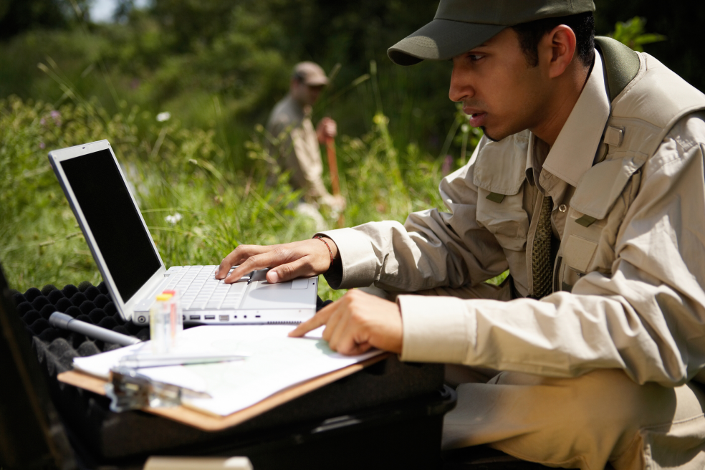
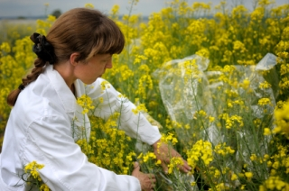
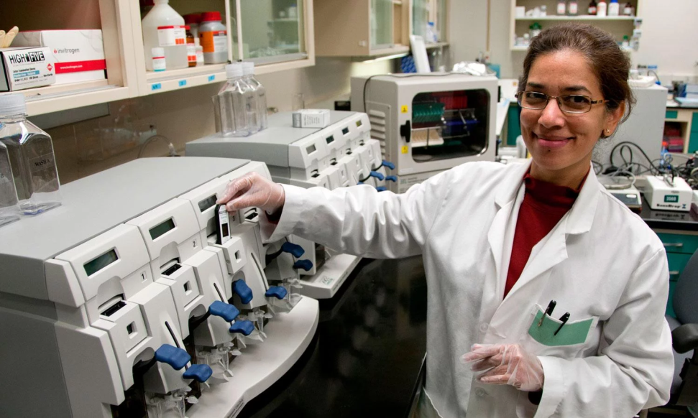
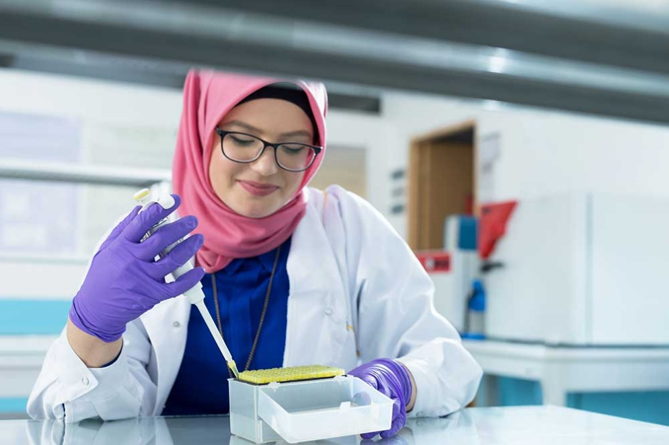
Interested in science
Patient
Scientist
Curious
Studies and has expert knowledge of science
Organised and focussed
Boy or girl?

Slide 18
Scientists – some background
According to the Women in Science and Engineering (Wise) campaign’s latest analysis of UK labour market statistics, women make up just 12.8% of the Stem workforce https://www.theguardian.com/news/datablog/2015/jun/13/how-well-are-women-represented-in-uk-science
What impact does this low proportion of female scientists have in the UK?
Notes:
This slide can be used for notes, and may be a good prompt for a philosophy session.

Slide 19
Good sense of rhythm
Determined: practise all the time
Confidence
Fit, healthy and strong
Notes:
All the skills are important for every career, but in this job you need to be particularly strong in…

Slide 20
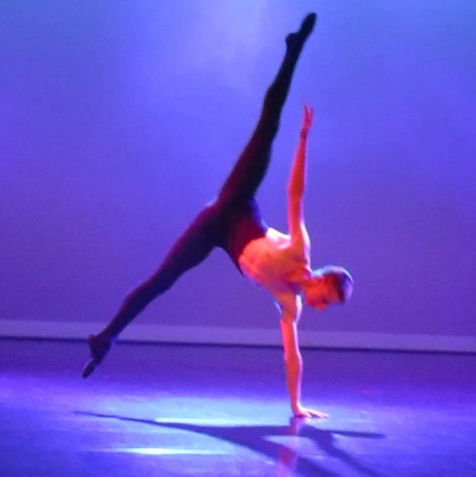
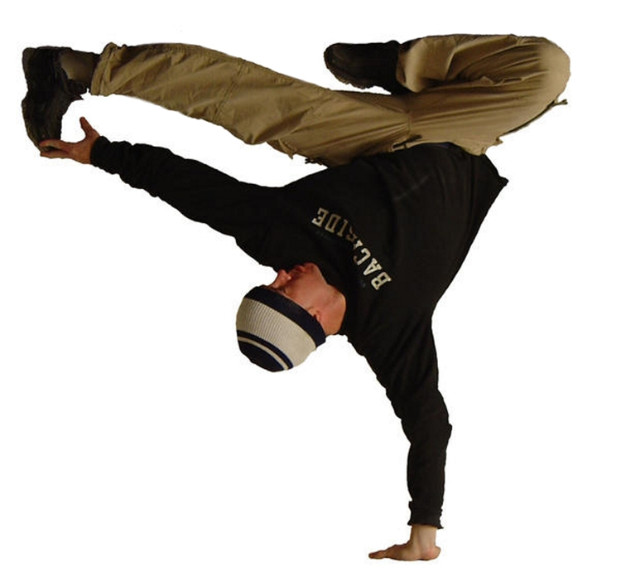
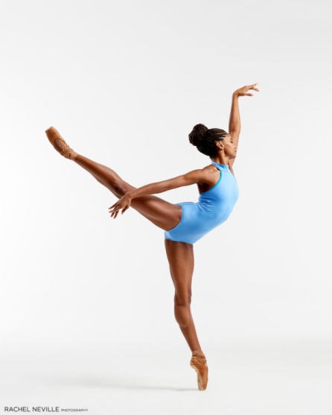
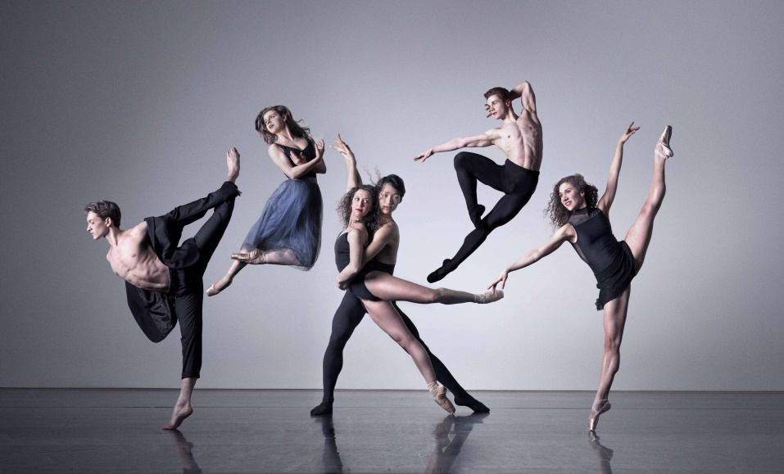
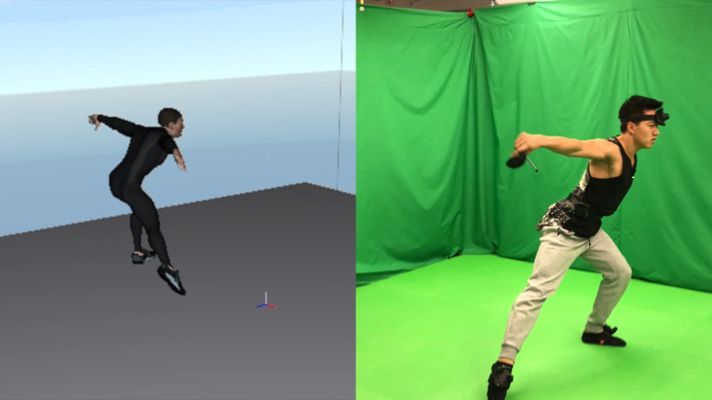
Good sense of rhythm
Determined: practise all the time
Dancer
Confidence
Fit, healthy and strong
Dances to earn money
Boy or girl?

Slide 21
Dancers – some background
It is widely acknowledged that far fewer boys choose to take part in dance activities, with one dance school reporting 95% female students. Some schools are taking steps to encourage boys to take part in dance classes.
What impact does this low male take-up of dance have in the UK?
Notes:
This slide can be used for notes, and may be a good prompt for a philosophy session.

Slide 22
Enjoy thinking of new ways to do something
Like building and making things
Have a good understanding of what things are made of
Can listen and use other’s ideas
Notes:
All the skills are important for every career, but in this job you need to be particularly strong in…

Slide 23



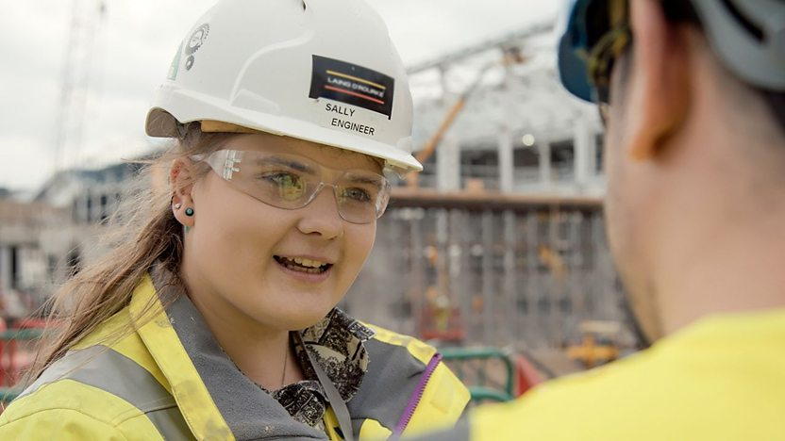
Enjoy thinking of new ways to do something
Like building and making things
Engineer
Have a good understanding of what things are made of
Designs, builds, or maintains engines, machines, or structures.
Can listen and use other’s ideas
Boy or girl?

Slide 24
Engineers – some background
In 2016, Engineering UK declared that the engineering industry was in a crisis period and was losing workers at a troubling rate and would soon be facing a major skills shortage in the UK. Women make up an estimated 11% of engineers in the UK. https://www.pbctoday.co.uk/news/hr-skills-news/women-in-engineering-2/66246/
What impact does this low proportion of female engineers have in the UK?
Notes:
This slide can be used for notes, and may be a good prompt for a philosophy session.

Slide 25

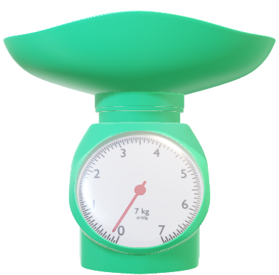

Final thoughts
What will you remember from this session?
How will it affect you?
Do things need to change?
How can that happen?

Slide 26


Slide 27
The East Sussex Primary Careers Hub
Careers.Hub@eastsussex.gov.uk / primarycareershub@eastsussex.gov.uk

