Slide 2
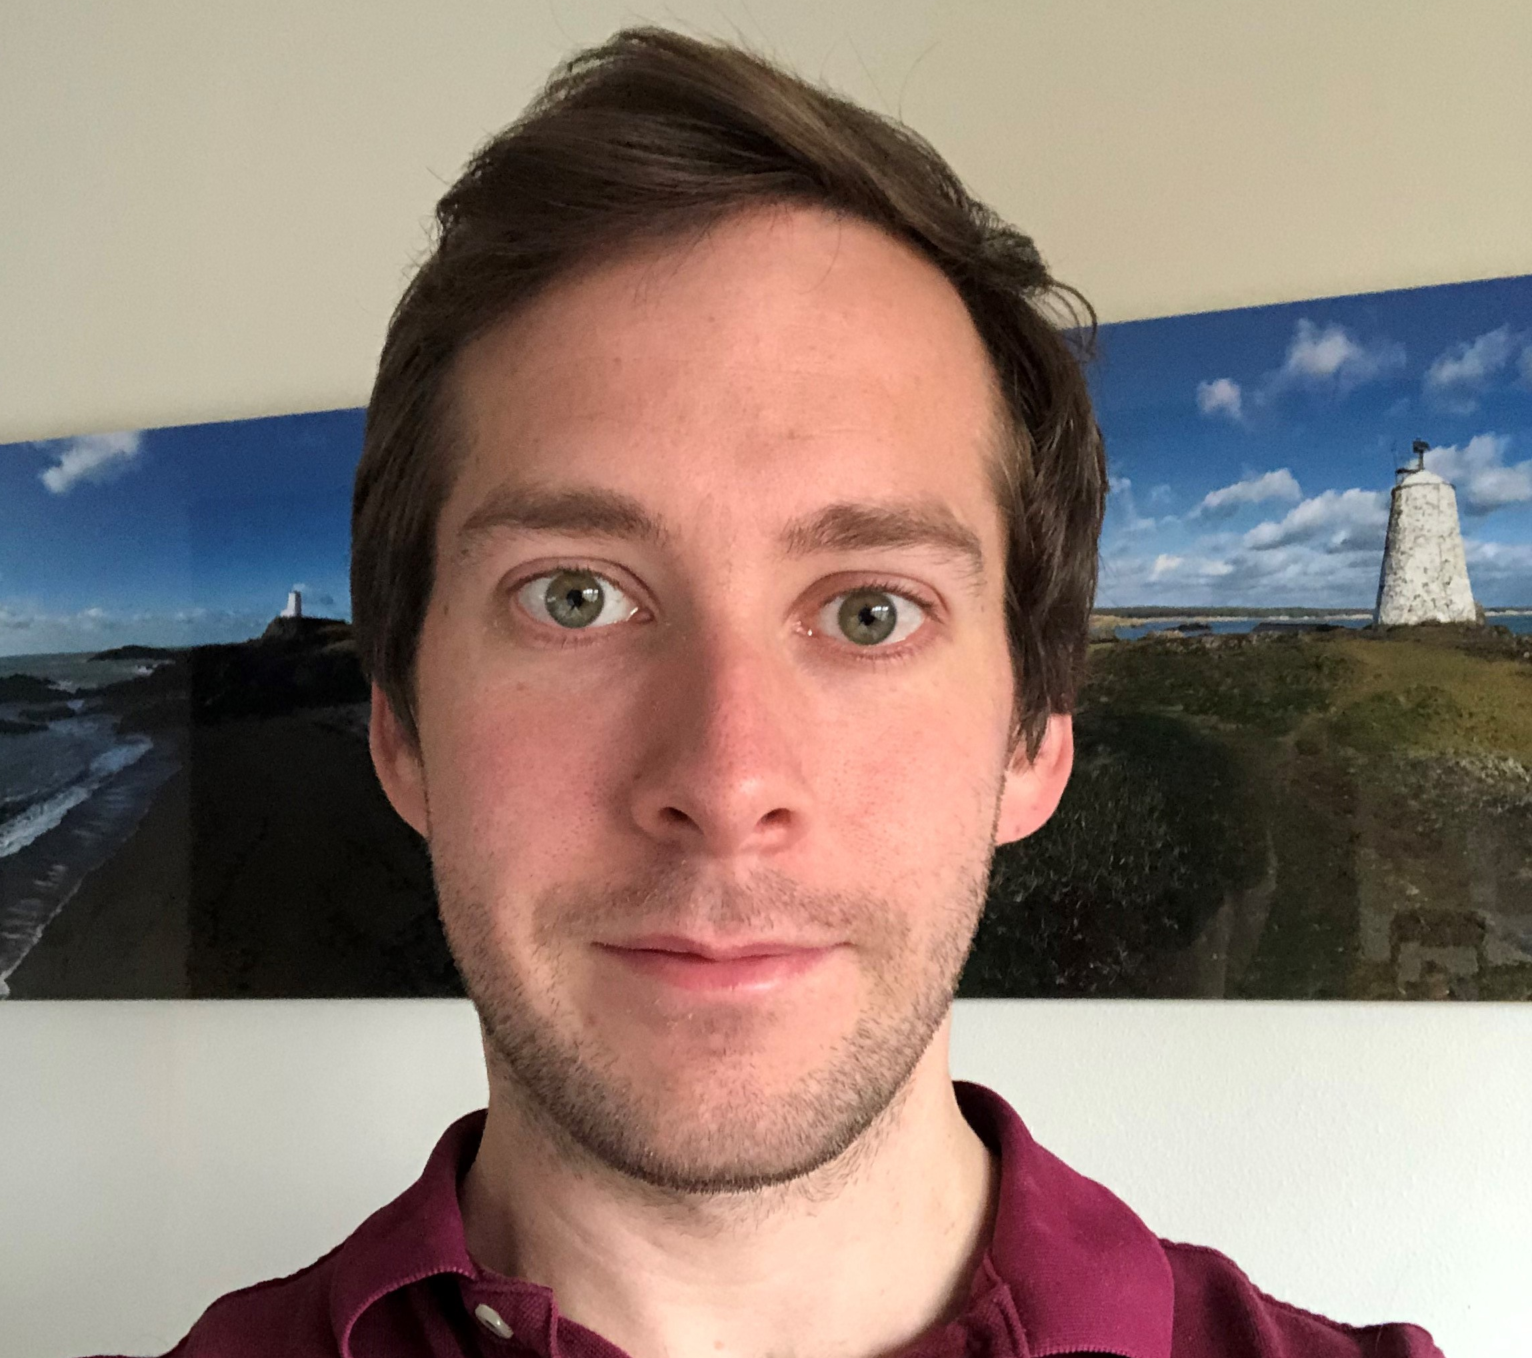
I need to be able to do lots of things at the same time.
Customer Account Manager at Johnson Matthey.
WHAT ARE MY HOBBIES?
WHAT JOB
DO I DO?
I enjoy reading. I am very active, I enjoy riding my bike and climbing mountains.
Daniel
I spend time with customers helping them to solve problems.
WHAT DO I NEED TO BE GOOD AT?
WHAT DO I DO IN MY JOB?
I loved acting in school plays. I also played the clarinet, oboe and bassoon in the school orchestra. My favourite subject was science.
WHAT DID I ENJOY AT SCHOOL?
Notes:
Daniel studied three science subjects and business studies for his A-levels, and he then did a summer placement with Johnson Matthey. At university he studied business studies and chemistry. He worked as a scientist before moving into sales and business.

Slide 3
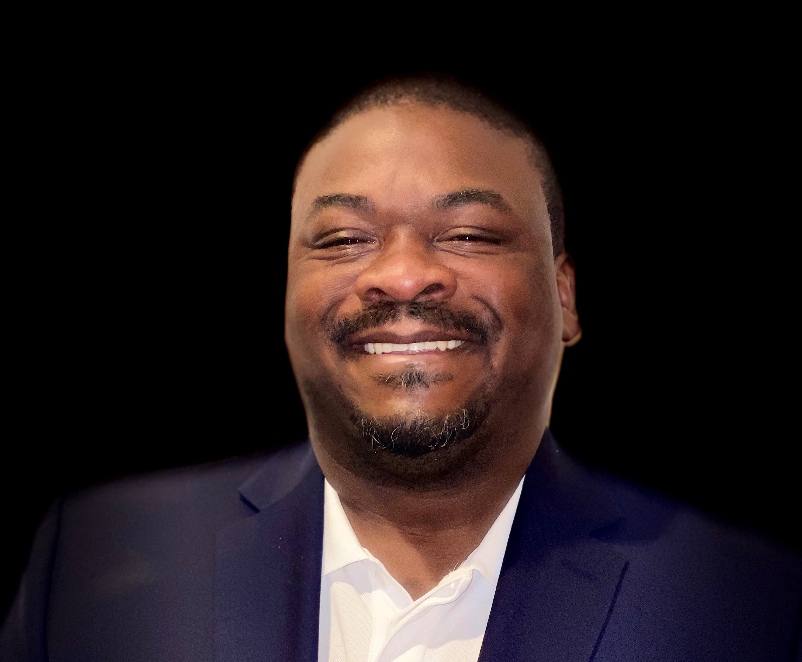
I need to be good at sharing ideas with other people.
Production Manager at Johnson Matthey.
WHAT ARE MY HOBBIES?
WHAT JOB
DO I DO?
I enjoy watching basketball and American football. I am also very interested in history.
Marlon
I work with a team to make sure that we make the right amount of products.
WHAT DO I NEED TO BE GOOD AT?
WHAT DO I DO IN MY JOB?
I grew up in America and went to school there. I always enjoyed science and maths.
WHAT DID I ENJOY AT SCHOOL?
Notes:
At secondary school Marlon chose to study science, advanced maths and language. At university, he started to study a science called pharmacy but he enjoyed the chemistry part so much that he swapped to this instead.

Slide 4
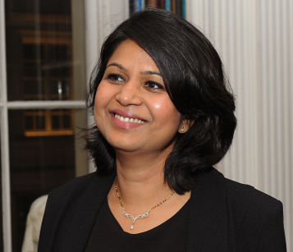
I need to have
a good understanding of engineering and science.
Business Manager for Europe at Johnson Matthey.
WHAT ARE MY HOBBIES?
WHAT JOB
DO I DO?
I spend a lot of my free time encouraging girls to understand that they can choose science careers.
Yati
I lead a team which helps customers to reduce pollution.
WHAT DO I NEED TO BE GOOD AT?
WHAT DO I DO IN MY JOB?
I went to school in India. I enjoyed painting, dancing and crafts. My favourite subject was science.
WHAT DID I ENJOY AT SCHOOL?
Notes:
Yati chose three science subjects and computing at secondary school. At university, she chose chemical engineering as she was really interested in creating something new from science experiments.

Slide 5
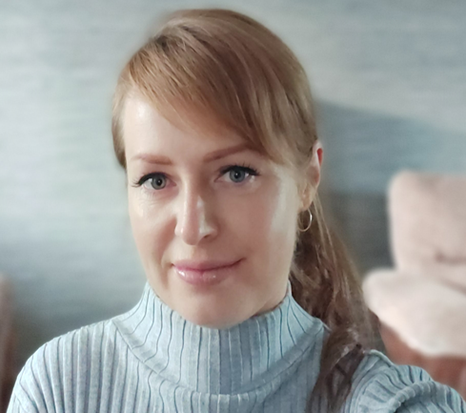
I need to be accurate and careful when testing samples. I need to be very organised.
Quality Control Lab Technician (Apprentice) at Johnson Matthey.
WHAT ARE MY HOBBIES?
WHAT JOB
DO I DO?
I like to read non-fiction books.
I enjoy hiking
and art.
Aneta
I test samples to make sure that products made in the factory are good quality.
WHAT DO I NEED TO BE GOOD AT?
WHAT DO I DO IN MY JOB?
At school I enjoyed art and music lessons and I played a number of musical instruments.
WHAT DID I ENJOY AT SCHOOL?
Notes:
Aneta needed a GCSE in science and Functional skills level 2 in English and maths. She has recently finished her Level 3 apprenticeship and will soon start her Level 5 apprenticeship.

