Slide 1
Careers
An introduction
The East Sussex Primary Careers Hub

Slide 2
Jobs and Careers
When you work to earn money you have a job.
Some people keep doing the same kinds of job for a long time, they get better at it and get more responsibilities. This is called a career.

Slide 3
Know yourself
Though lots of children talk about what they would like to be when they grow up, they actually don’t have to decide this until they are adults.
The most important preparation anyone can do for their future is to know what their talents are and what they enjoy doing.
This Photo by Unknown Author is licensed under CC BY-SA-NC

Slide 4
Education Journey
When children are at secondary school they have to choose which subjects to study for GCSEs at the age of 14.
This is why it is important to know which things you enjoy doing and are good at.
This Photo by Unknown Author is licensed under CC BY-ND

Slide 5
Sectors
Different kinds of jobs are grouped into sectors. You will be learning all about these in school this year.
An example of a sector is Health and Social Care, which has lots of jobs in it such as nurses, radiologists, speech therapists and social workers.
Can you name a sector?
This Photo by Unknown Author is licensed under CC BY-ND

Slide 6
Skills
You will be doing lots of activities to help you develop skills that are really important for school life and beyond.
What do you already know about these skills?

Slide 7
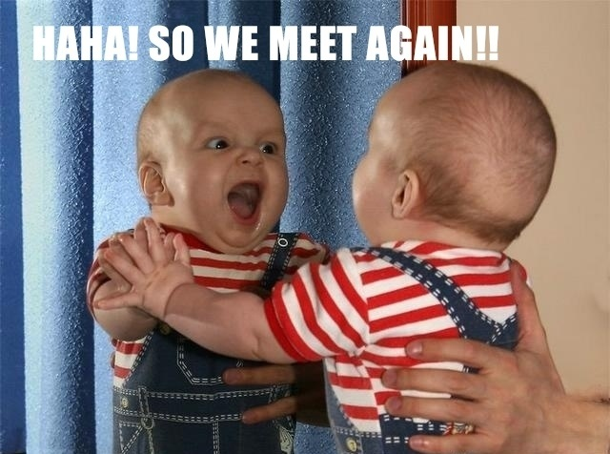
What next?
Know yourself, your strengths, talents, and what you enjoy
Keep having big dreams for yourself (video)

Slide 8
The East Sussex Primary Careers Hub
www.careerseastsussex.gov.uk

