Slide 1
Careers in Initial Teacher Education (CITE)
Training #1 – Unconscious Bias

Slide 2
What is CITE?
Careers in Initial Teacher Education
Training package to support trainee teachers to include careers related learning in their teaching from the very beginning.
Three CPD sessions about different aspects of careers with associated ‘gap tasks’.
Notes:
The aim of CITE is to support trainee teachers to include careers related learning in their teaching from the start of their career. The project consists three CPD sessions with associate gap task.
Additional info:
Previously careers information, advice and guidance was focussed on students in secondary school. However, there is a growing understanding that children are starting to think about ‘what they want to be’ at a young age.
Consequently, CITE aims to help teachers include careers related learning in primary teaching.
The training, and activities, can be used to evidence the following teacher standards (2012)
Standard 5: Adapt teaching to respond to the strengths and needs of all pupils
have a secure understanding of how a range of factors can inhibit pupils’ ability to learn, and how best to overcome these
demonstrate an awareness of the physical, social and intellectual development of children, and know how to adapt teaching to support pupils’ education at different stages of development.
Standard 8: Fulfil wider professional responsibilities
make a positive contribution to the wider life and ethos of the school
take responsibility for improving teaching through appropriate professional development, responding to advice and feedback from colleagues.
References and extra reading:
https://www.gov.uk/government/publications/teachers-standards
https://www.educationandemployers.org/career-related-primary/

Slide 3
Timeline of Activity
ITE Student activity
CPD 1
Careers Education and Unconscious Bias
Follow up Activity
Exploring unconscious bias in school
Reflective Activity: Confidence in challenging biases
CPD 2
Primary Careers Tool
Follow up Activity
Use the Primary Careers Tool in Classroom
Reflective Activity: Confidence using resources
CPD 3
STEM Attributes and STEM Person of the Week
Follow up Activity
Use STEM Person of the Week in the Classroom
Reflective Activity: Confidence using resources
Notes:
Timeline of the project.
This slide can be adapted depending on the context that the training sessions are being used in.
The timeline given is for a model which takes place over a single year.
Another possible model is for CITE to be included in a three year BEd course, in which case, there could be one session each year.
Each session has an associated activity and reflective prompt for students to use as a ‘gap task’. There is time at the beginning of session 2 and session 3 to allow students to share their reflections.

Slide 4



A class of 30 children in employment
Not in employment
Employed in non-STEM fields
Employed in STEM fields
Notes:
We start by looking at what jobs an imaginary class of thirty children might do for employment. This is an analysis of the current job market NOT a prediction of the future job market.
You can see that there would only be 7 children involved in STEM fields and 15 involved in non-STEM fields.
Additional information:
The data are taken from the Office for National Statistics Labour Force Survey 2016. The data for the UK were scaled to represent a class or 30 pupils – with data rounded up or down to the nearest half-child for presentation purposes.
Those not in employment include those that are not actively looking for work – e.g. early retirement, caring for others, illness etc.
References:
https://www.ons.gov.uk/employmentandlabourmarket/peopleinwork/employmentandemployeetypes

Slide 5
30 children in employment (by gender)
Not in employment
Employed in non-STEM fields
Employed in STEM fields
Boys
Girls
Notes:
Handout a copy of this slide for discussion.
This slide shows the breakdown of employment by gender.
Participants should discuss the diagram.
Ask: What do they notice? Are they surprised by this? If not, why?
If there is time, or if this is a large group, spend some time taking feedback of key discussion points.

Slide 6
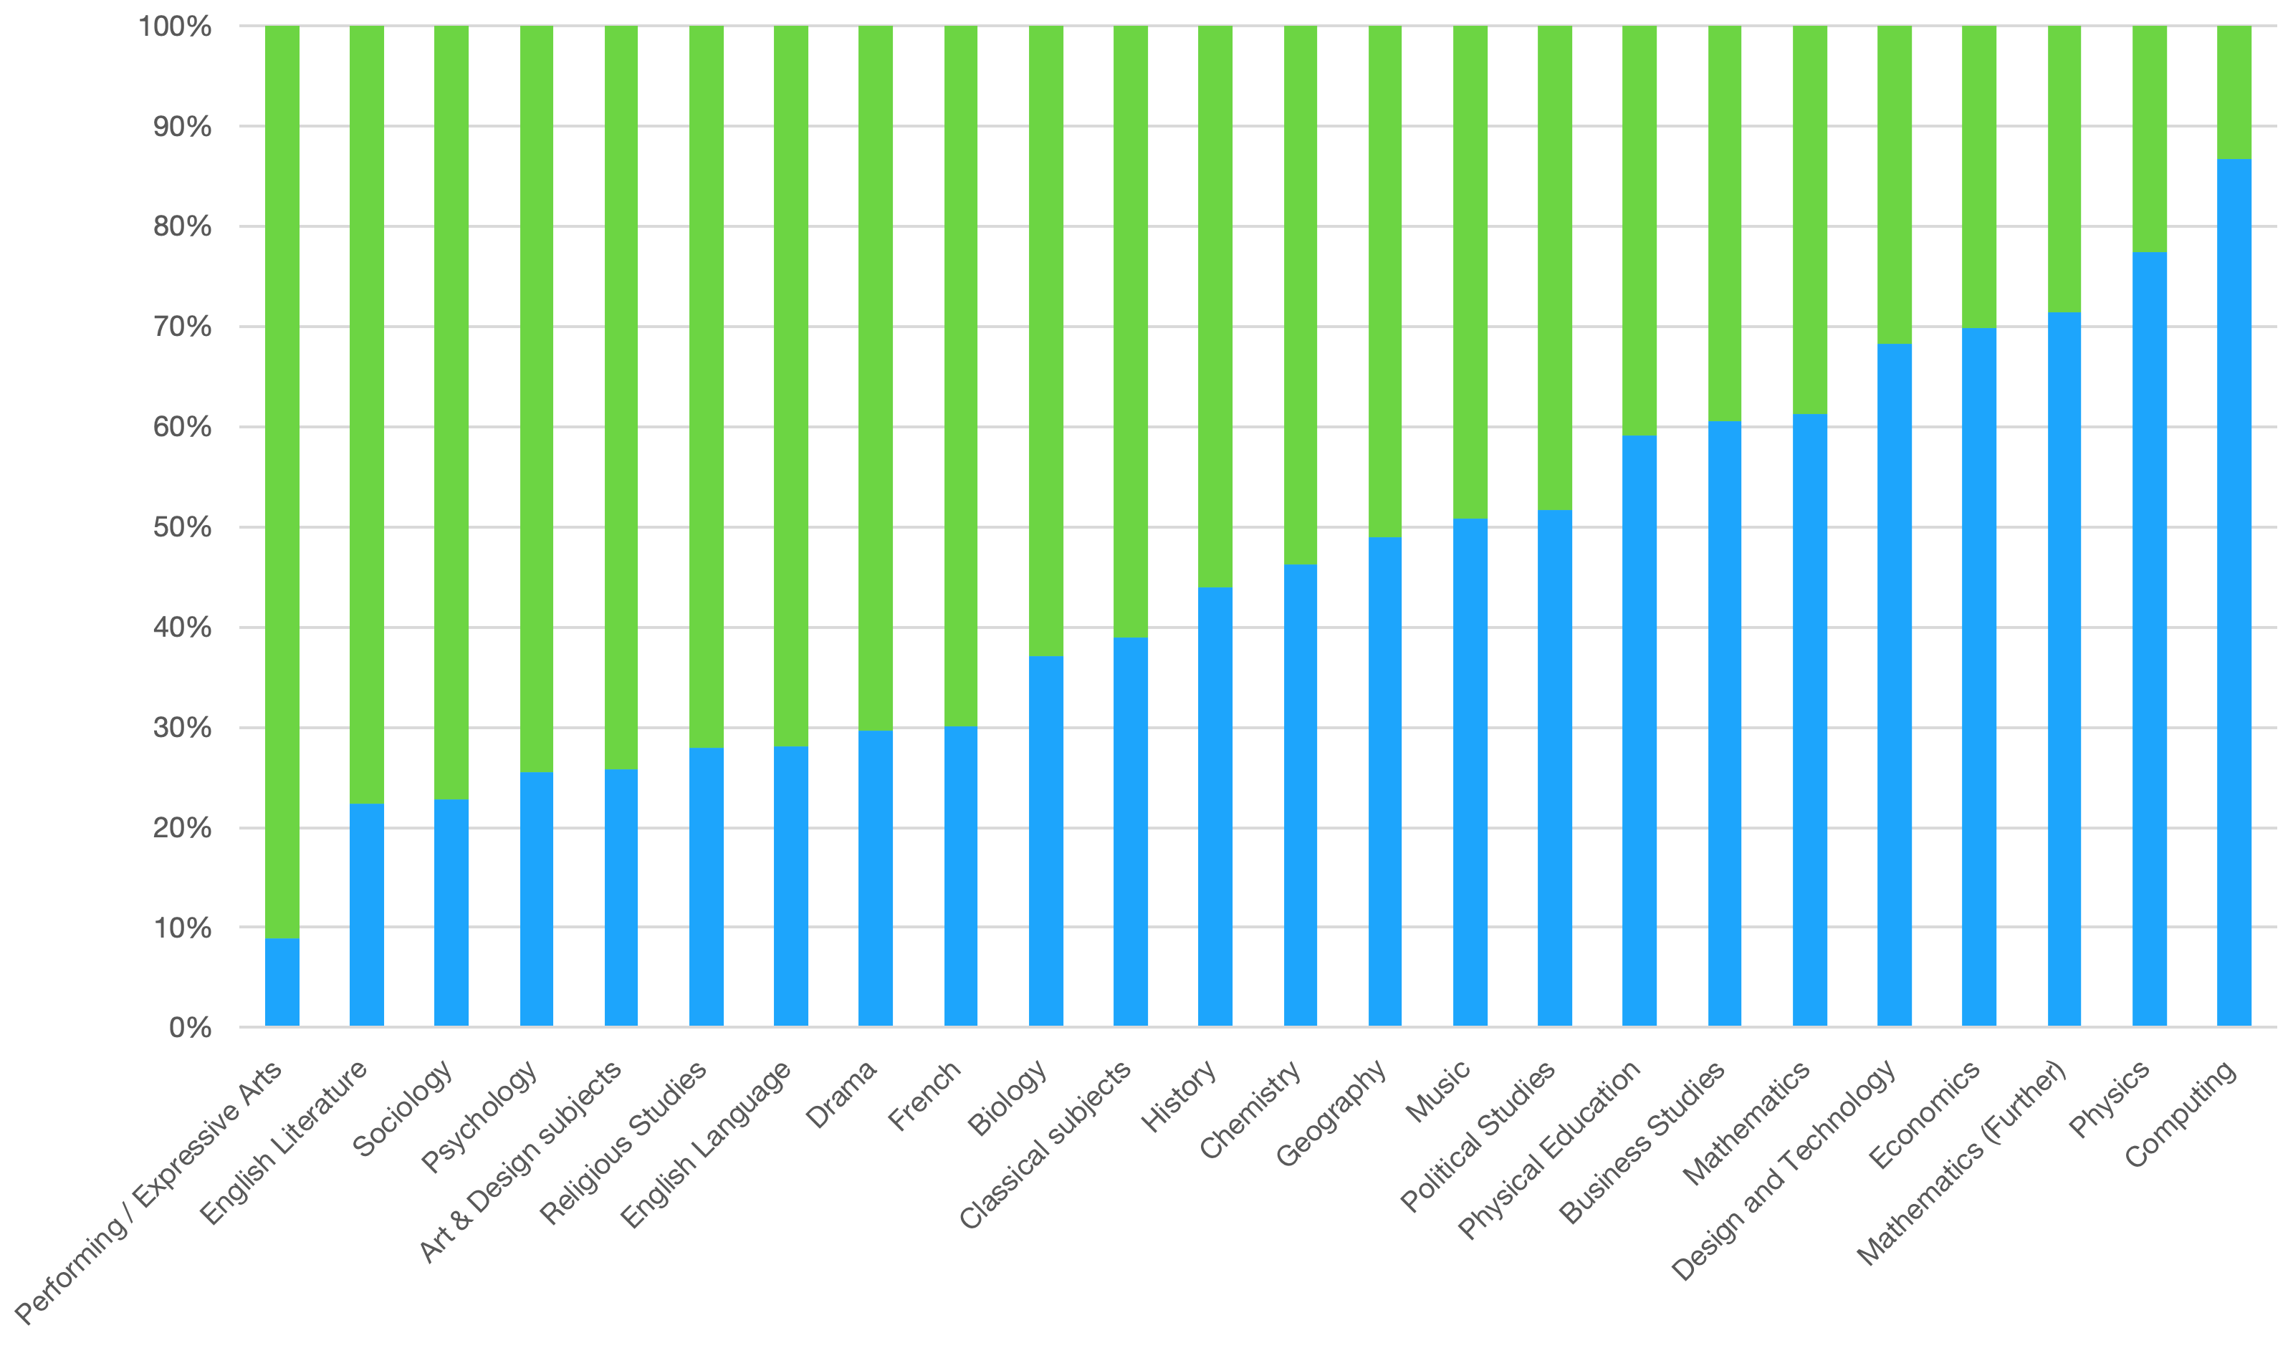

A-Level Exam Entries 2019 by gender
Notes:
Hand out a copy of this slide for discussion
Having looked at the gender split in employment, this slide goes back in time a little bit to look at A-level entries. The diagram shows the percentage of A-level exam entries for 2019 split by gender.
Again, participants should discuss the data.
Ask: What do they notice? Are they surprised by this? If not, why?
If there is time, or if this is a large group, spend a short time taking feedback of key discussion points.
Additional information:
The data are taken from the JCQ A-level exam entries for 2019.
Note that the absolute entry number for different subjects can be quite different.
For example: there were more girls taking A-level Physics (8799 students) than took A-level French (5840 students), and more boys taking A-level Psychology (16500 students) than A-level Computing (9649 students) or A-level Further Mathematics (10380 students).
Reference:
https://www.jcq.org.uk/examination-results/a-levels/2019/main-results-tables

Slide 7
Why careers in primary?
NUSTEM career aspirations research with 450 children in 6 North East primary schools
Children given a list of 30 jobs to sort
  Jobs I know / Jobs I don’t know
  Would like to do / would not like to do / not sure
Notes:
We are going back in time again – this time to look at career aspirations for primary school children from NUSTEM research.
Slide 8
NUSTEM have designed the STEM Career Knowledge and Aspirations tool (STEMKAT) which we have used to evaluate the effectiveness of the work that we do in primary schools over the longer term (Emembolu et al, 2020).
STEMKAT presents a list of 30 jobs to children. The jobs represent all sectors of employment and different levels. They were chosen to ensure that there were jobs that most children would know (teacher, vet, fire fighter, shop assistant) as well as some that they might not know (lawyer, entrepreneur).
Research participants were Year 3 and year 5 children from 6 North East primary schools (450 children). The children were given the list of jobs. They first sorted them into jobs they knew and jobs they didn’t know. The jobs that they didn’t know were removed from the list of jobs. They then sorted the remaining jobs they knew into jobs they’d ‘like to do’, jobs they ‘would not like to do’, and ‘not sure’.

Slide 8
Findings
Boys tend to report that they know many more jobs than girls
As children get older they know about more jobs
Year 5 pupils tend to want to do fewer jobs than year 3 pupils
By age 8 children are already making gendered job choices
Notes:
Slide 9 shows the basic findings of the first data set that was collected in 2015. We will look at the fourth bullet point in more detail.

Slide 9
Top 10 jobs for girls |  |  | Top 10 jobs for boys
Teacher | 71% |  | Game tester | 75%
Hairdresser | 67% |  | Athlete | 51%
Actor/Actress | 60% |  | Detective | 49%
Vet | 60% |  | Soldier | 45%
Athlete | 48% |  | Tennis Player | 43%
Shopkeeper | 47% |  | Mechanic | 43%
Nurse | 46% |  | Pilot | 41%
Doctor | 42% |  | Astronaut | 40%
Game tester | 40% |  | Engineer | 38%
Author | 38% |  | Estate Agent | 34%
Notes:
Hand out a copy of this slide for discussion
This slide shows the top 10 jobs chosen by boys and girls and the percentage of pupils that included that job in their ‘would like to do’ or ‘not sure’ categories.
Participants should discuss the data.
Are there any patterns that they notice? Anything surprising.
Notes:
There are only two jobs that are common to both boys and girls: athlete and game tester.
The STEM jobs that girls are interested in are mainly healthcare related: vet, nurse, doctor (and game tester).
The STEM jobs that boys are interested in are physical science related: game tester, mechanic, pilot, astronaut, and engineer.
The full list of jobs was:
Actor/Actress
Detective
Farmer
Mechanic
Surveyor
Athlete
Doctor
Game Tester
Nurse
Teacher
Astronaut
Engineer
Hairdresser
Pilot
Tennis Player
Author
Entrepreneur
Judge
Politician
Technician
Banker
Estate Agent
Lawyer
Shopkeeper
Vet
Civil Servant
Firefighter
Librarian
Soldier
Zoologist
italicized jobs shows occupations classified as general STEM
jobs in bold show jobs classified as core STEM

Slide 10
Top 10 jobs for girls |  | salary range | Top 10 jobs for boys |  | salary range
Teacher | 71% | £24k - £63k | Game tester | 75% | £15k - £40k
Hairdresser | 67% | £14k - £30k | Athlete | 51% | variable
Actor/Actress | 60% | variable | Detective | 49% | £21k - £59k
Vet | 60% | £30k - £50k | Soldier | 45% | £15k - £35k
Athlete | 48% | variable | Tennis Player | 43% | variable
Shopkeeper | 47% | £11k - £25k | Mechanic | 43% | £18k - £35k
Nurse | 46% | £24k - £37k | Pilot | 41% | £20k - £140k
Doctor | 42% | £37k - £105k | Astronaut | 40% | £40k - £80k
Game tester | 40% | £15k - £40k | Engineer | 38% | £18k - £80k
Author | 38% | variable | Estate Agent | 34% | £15k - £40k
Average £35k
Average £44k
Notes:
Slide 11
This slide adds in the salary range for the jobs shown on slide 10. The data is taken from the national Careers Website job explorer.
Point out the difference in average salary for girls and for boys. Choices in primary school have potential long term consequences for future earning potential.

Slide 11
Science for ‘people like me’
More likely to aspire to a career if it matches your self-concept.
Science is often seen as something that is done by ‘clever people’
NUSTEM research shows that girls are less likely to self-identify as clever, so this will affect their future science participation.
Notes:
Slide 12
The research literature suggests that children and young people are move likely to aspire to a career if it matches their self-concept (Archer and DeWitt, 2013).
In our society, science is seen as something that is done by ‘clever people’, and so children and young people who think of themselves as clever are more likely to aspire to a science career.
NUSTEM research found that girls are less likely to self-identify as clever, and more likely to self-identify as kind. (Padwick et al, 2016). This early self-identification has implications for children’s future science participation, and goes someway to explain the gender split seen in the STEM jobs shown in the table on slides 10 and 11.
References
Archer, L., & DeWitt, J., (2013). ASPIRES: Young people’s science and career aspirations, age 10–14. Final project report. London: Department of Education and Professional Studies, King’s College London.
Emembolu, I., Padwick, A., Shimwell, J., Sanderson, J., Davenport, C., Strachan, R. (2020) Using action research to design and evaluate sustained and inclusive engagement to improve children’s knowledge and perception of STEM careers. International Journal of Science Education, DOI: 10.1080/09500693.2020.1729442.
Padwick, A., Dele-Ajayi, O., Davenport, C., Strachan R. (2016) Innovative methods for evaluating the science capital of young children. IEEE Frontiers in Education Conference. DOI: 10.1109/FIE.2016.7757680

Slide 12
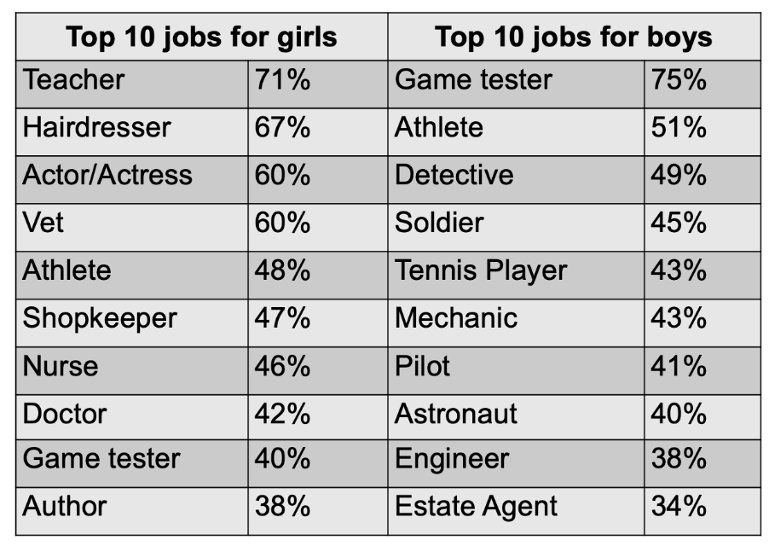
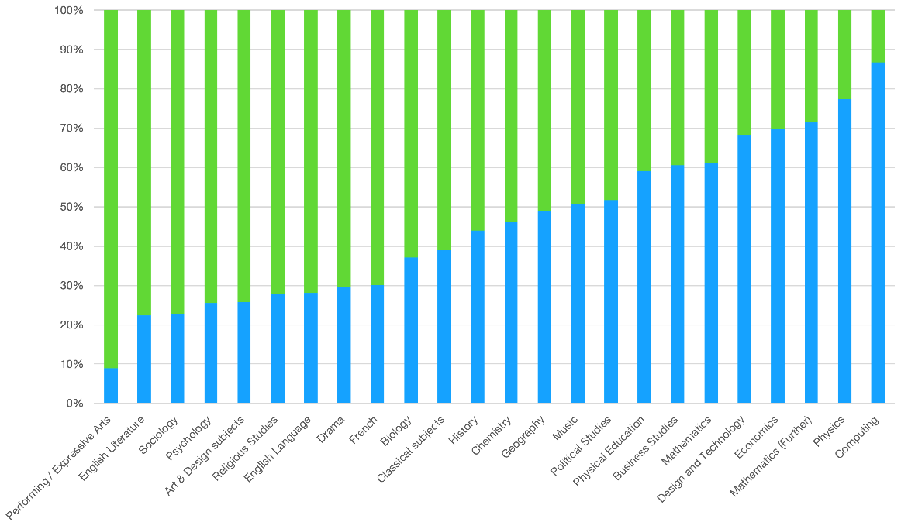
There is a disparity in career aspirations in primary school, in the A-Level Exam entries, and subsequently the careers pathways of males and females.
What might explain this disparity?
Notes:
Ask the group to discuss the question on the slide: What might explain this disparity?
Notes:
Some ideas that might come up include
Opportunities that children see around them.
Girls might do roles that would fit in within childcare because they are aspiring to be a parent.
TV and media influences (e.g. Peppa Pig has only female teachers).
Models in society are already weighted.
Culture playing a role.
Peer pressure.
At this point you might also receive answers which relate to inherent differences in preferences between genders. This will be addressed further in the next two slides, however, it is worth pointing out the different way in which children are treated from an early age, and how that might affect their preferences.
Clarify ideas about broadening aspirations – there is nothing wrong with aspiring to parenthood or other caring role, but it is worth broadening the aspirations so that young people know what opportunities are available to them.

Slide 13
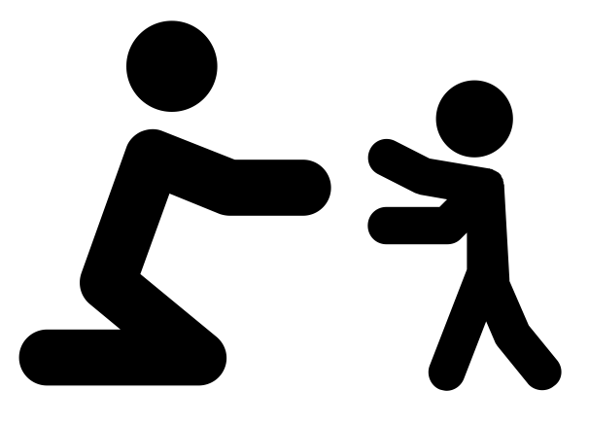

Nature vs Nurture
There are fundamental differences between girls and boys and the career/subject choices they make that are set at the genetic level.
There are personality differences between people that are set at the genetic level.
Boys’ and girls’ attitudes and beliefs are shaped by the society they grow up in.
Notes:
In the next two slides participants will start to unpick the reasons for some of the gender differences in career choices that we have looked at so far.
There has been a tendency in society and in psychology to attribute observed differences in behaviour to EITHER genetic causes OR societal causes. It makes for simple stories.
Slide 14 gives three possible explanations for the differences we’ve seen in previous slides.
The choice differences we see are due to genetic differences between genders
This gives rise to the ‘Men are from Mars, women are from Venus’, or ‘men can’t multitask’ type of idea. If this idea was correct, then there should be clear differences in brains that can be linked to the different behaviours. However, this is not the case. This article from the NY Times is a useful read https://www.nytimes.com/2018/12/03/opinion/male-female-brains-mosaic.html .
If this explanation was correct, we would expect to see similar percentages of women in science research in different regions of the world as can be seen in the 2016 UNESCO data.
48.2% for Central Asia
45.1% for Latin America and the Caribbean
41.5% for Arab States
39.3% for Central and Eastern Europe
32.7% for North America and Western Europe
31.8% for Sub-Saharan Africa
23.9% for East Asia and the Pacific
18.5% for South and West Asia
(http://uis.unesco.org/sites/default/files/documents/fs55-women-in-science-2019-en.pdf)
There are personality differences between people that are due to genetics, and that influences their choices
Psychologists have long been interested in differences in personality. One popular model of personality traits is known as the Big Five. This model suggests that there are five key traits that form our personalities: Openness, Conscientiousness, Extraversion, Agreeableness, Neuroticism. Studies of identical and non-identical twins show that there are higher correlations between aspects of personality between identical twins than between non-identical twins – suggesting a genetic contribution to personality. However, these studies don’t explain all of the differences between pairs of twins.
Children’s attitudes and beliefs are shaped by the society that they grow up in.
A third possibility is that our attitudes and beliefs are socially constructed. We know how to behave as a girl, or as a British person because we have seen and been taught how to behave in this way. Think about queueing. This is an inherently British trait – we have been shown how to queue since we were very little (lining up in play group, being told to wait when getting on the bus etc). That behaviour is socially constructed: there isn’t a genetic reason why we queue and people from other cultures don’t. Similarly, we are ‘taught’ how to behave in gender appropriate ways from birth through praise and approbation of those around us, and the images that we see in society.
References and further reading:
https://www.psychologistworld.com/personality/five-factor-model-big-five-personality
Maltby, J., Day, L., Macaskill, A., (2017) Personality, Individual Differences and Intelligence. 4th Ed. ISBN: 978-1292090511. Especially Chapters 7 and 8.

Slide 14
Nature AND Nurture
There are fundamental differences between girls and boys and the career/subject choices they make that are set at the genetic level.
There are personality differences between people that are set at the genetic level.
Boys’ and girls’ attitudes and beliefs are shaped by the society they grow up in.
Notes:
Evidence suggests that the first explanation is wrong – there is no such thing as a male brain or a female brain – there are only human brains.
There is evidence that personality is influenced, in part, by genetics.
Much of psychology would now say that there is a strong interaction between nature and nurture – they can’t be separated.
Our personalities and choices are influenced both by our genetics and by the society in which we grow up. There is also a growing awareness that the brain is ‘plastic’ for longer than once thought, and that our experiences can shape our brain even later in life. Thus how we are treated, or what we do, can shape our brain.
Thus, the differences that we see in children’s career and subject choices are likely to be due to the interplay of genetics (personality) and society.
References and further reading:
Article about some of the uses of brain plasticity in therapeutic circumstances. https://www.wired.co.uk/article/game-your-brain

Slide 15
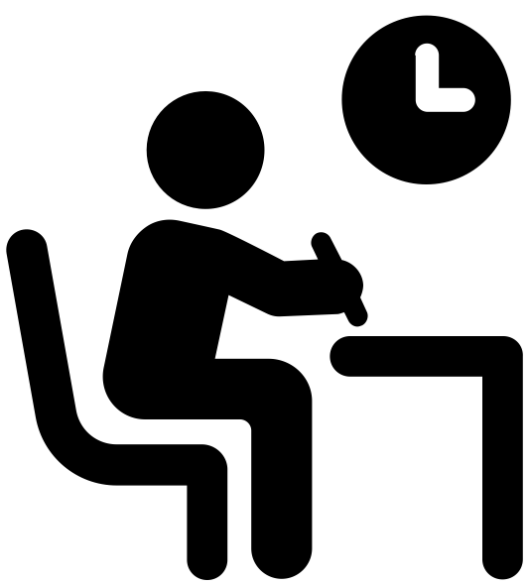



Careers Aspirations
Exam choices
Career choices
Notes:
The session now moves on to consider the network of influences that surround a child, both in the formal education, but also in the informal day-to-day life.
We are looking at who or what might influence children in their career aspirations, their exam choices and their career choices.

Slide 16
Who and what are the main influencers of children?
Notes:
Show this slide and ask participants to name as many influencers as possible

Slide 17
Role Models
Celebrities
Schools
News
Disney
Media
Parents
Musicians
Teachers
TV
Family
Magazines
Sport figures
Books
Uniform groups
Friends
YouTube
Religion
Classmates
Who and what are the main influencers of children?
Notes:
Slide 18 provides a range of different answers, with teachers and schools highlighted – because they are the two influencers that we are interested in for this project.

Slide 18
A teacher’s contribution
We have all grown up within a gendered society
There are stereotypical roles for males and females and we have integrated these stereotypes into our understanding of the world.
We all have biases (conscious and unconscious) that contribute to these stereotypes
Notes:
Having looked at the problem of gendered career choices, we now begin talking about our (teachers) contribution to the problem.
Emphasise that this is not about judging them as teachers or as people, but that there are consequences which arise because we have grown up within a society that proscribes a person’s choices and actions depending on their gender.

Slide 19
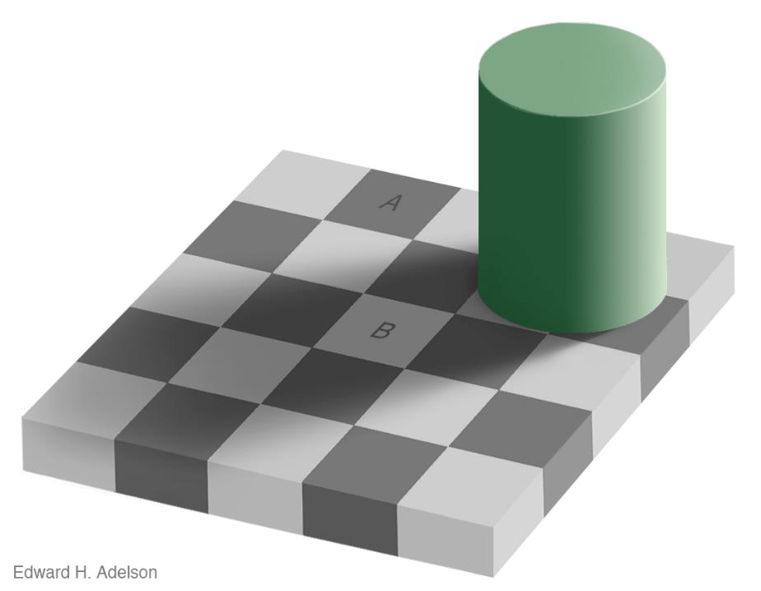
We are all full of biases
Notes:
Give a copy of slide 21, and a pair of scissors to pairs of participants.
This slide is used to illustrate how our brain can interpret information based on what we have experienced.
Ask participants: Which square, A and B, is the lighter colour?
Most participants say that square B is the lighter square. In fact they are the same colour.
Ask participants to carefully cut out square A and put in where square B is. They will ‘see’ that the square changes colour and becomes lighter as it moves from position A to position B. If they move it back to position A it will become darker again.
This is an optical illusion which arises because we are interpreting the 2D image as if it was a 3D object. We have learnt that chess boards have squares of alternating colours, and that objects in shadow are brighter than they appear. Our experience (our bias) means that we interpret the diagram to see the two squares as being different shades of grey, even though they are identical.

Slide 20
Notes:
Hidden slide with the chessboard picture larger for printing.
You will need 1 copy between 2 participants.

Slide 21
A father and his son are in an accident. Badly injured they are rushed to the hospital. In the operating room, the surgeon looks at the boy and says, “I can’t operate on this boy, he is my son.”
How is this possible?
Notes:
Slide 22
This slide presents a riddle which relies on stereotypes.
Participants (because we’ve been talking about gender) may give the answer ‘mother’
However, when out of this context, many people will provide other possible (but statistically less likely) answers such as ‘step dad’, ‘new husband’, ‘gay dad’.

Slide 22
Surgeon = Male
Automatic mental associations
may have caused you to think
“male” on reading “surgeon”
What other careers-related stereotypes are you aware of?
Notes:
We have an ingrained stereotype of a surgeon which is often male. And that colours our answer to the riddle.
Ask participants to give other careers-related stereotypes that they can think of.
The fact that careers related stereotypes come to mind easily shows how ingrained they are. There are also issues about language (e.g. fireman, binman, dinner lady/nanny) which shape our ideas.
It is important to note that we hold the stereotypes whether we agree with them or not. Our quick, automatic response will often revert to these stereotypes, and it takes effort to think of the alternative.

Slide 23
In schools
On average, teachers give boys more time than girls to answer questions in class.
Boys are more likely than girls to raise their hands in class than girls.
White males tend to get more attention from the teacher than other groups.
When teachers are asked to remember their ‘best’ students, the answers are overwhelmingly males.
Sadker & Sadker, 2009
Notes:
Myra Sadker and David Sadker spent 25 years looking at the experience of school for girls in America. They used a range of research methods, including direct observation of classroom practice.
Some of their findings are shown on this slide.
References and further reading:
Sadker, D., Zittleman, K.R., 2009 Still Failing at Fairness: How Gender Bias Cheats Girls and Boys in School. ISBN: 978-1416552475

Slide 24
Male and female teachers both interact more with boys than girls, but the difference is greater for male teachers.
All interactions | Lessons with male teacher (%) | Lessons with female teacher (%) | Science interactions | Lessons with male teacher (%) | Lessons with female teacher (%)
Whole class | 67 | 64 | Whole class | 51 | 43
Teacher to boys | 21 | 21 | Teacher to boys | 32 | 32
Teacher to girls | 12 | 15 | Teacher to girls | 18 | 25
Eliasson et al., 2016
Notes:
This slide presents more recent research from 2016. The researchers worked in 6 schools across Sweden, and observed video recordings of 14 teachers and 195 pupils (85 boys and 110 girls). Their focus in this study was on the interactions between teachers and pupils. They looked at all interactions (general classroom instructions etc.) and interactions that were focussed specifically on science.
The data from the study show that male and female teachers both interact more with boys than with girls, but that the difference is greater for male teachers. This applies regardless of whether all interactions were looked at, or just science specific interactions.
Note that the difference was present for female teachers – they are showing gendered interactions because of the gendered nature of society.
You might also want to discuss the different types of praise interactions that may be used with boys and girls and the effect of that on pupils: girls are praised for ‘goodness’, and boys praised for effort. (Dweck, 2006). This can lead to girls thinking that their abilities are innate and unchangeable, and boys thinking that they can develop ability through effort and practice.
References and further reading
Dweck, C. (2012) Mindset. ISBN: 978-1780332000
Eliasson, N., Sorensen, H., Karlson, K.G., 2016. Teacher-student interaction in contemporary science classrooms: is participation still a question of gender? International Journal of Science Education, 38:10, 1655-1672.
https://www.psychologytoday.com/us/blog/the-science-success/201101/the-trouble-bright-girls
The power of words: How to give praise that motivates and empowers girls. https://www.amightygirl.com/blog?p=26248

Slide 25
Bias in Primary Education
The pattern of classroom interactions can unintentionally reinforce messages of expected and accepted behaviours.
Many fictional texts uphold traditional stereotypes.
Teaching materials and displays can reinforce gender stereotypes.
Ideas about what children are ‘good’ at, and subsequently what paths are open to them are embedded at an early age.
There is a surprising amount of sexist language and behaviour used in society and this could be picked up and imitated by young children.
Notes:
This slide provides suggestions of five different ways in which bias might affect children’s education in primary.
Print out the slides from UB Primary Bias Discussion Exercise and share with participants – the second slide in each case provides further points to support the main statement.
1. The pattern of classroom interactions can unintentionally reinforce messages of expected and accepted behaviours.
Boys are more likely to shout out and so get more time
Teacher punishes an entire class for the actions of a minority
Girls are often used as a behaviour management strategy.
2. Ideas about what children are ‘good’ at, and subsequently what paths are open to them are embedded at an early age.
The phrase ‘typical boy writer’ becomes an excuse for low achievement
Extra-curricular clubs conform to gender stereotypes
Children can be selected for extra-curricular activities based upon strengths and confidence
3. Many fictional texts uphold traditional stereotypes.
Non-fiction texts often portray scientists as men in white lab coats, reinforcing the stereotype
Fiction texts: Heroes are usually male. Women and girls often need saving.
4. There is a surprising amount of sexist language and behaviour used in society and this could be picked up and imitated by young children.
‘Don’t be such a girl’.
‘Man up’.
‘Can I get two strong boys to help carry some books?’
‘Stop being so girly.’
5. Cultural change will only be achieved in all members of the school community are involved, including parents and carers.
Text taken from a homework handout. ‘Please find attached some tricky words, works we can’t sound out. … the children will find it very useful to know these words by sight. Try making another set and play pairs, snap or hunt the tricky word around the house. Boys particularly like the latter because it’s physical and competitive especially if you use a timer. See if you can spot tricky words when you’re out and about or when you’re reading books together.’
6. Teaching materials and displays can reinforce gender stereotypes.
Images on displays often conform to gender stereotypes.
Presentations and resources can include stereotypes and stereotypical language.
Note that this discussion may provide challenging for participants and will need to be handled carefully. They can also be directed towards additional information as appropriate.

Slide 26
Language in the classroom
“He writes like a typical boy.”
“What a pretty dress you’re wearing today Sophie.”
“I need two strong lads to help me carry these books.”
“OK guys, pens down.”
“You’re being very kind there Emily.”
“Don’t be such a girl Josh.”
Notes:
Slide 27 provides some additional prompts for consideration about language in the classroom.
The phrase ‘OK guys, pens down’ is often the most controversial example of a gendered statement that might be heard in the classroom. Participants might feel that ‘guys’ has become a non-gendered term. However, as with many ‘generic’ terms, the default is male – consider who you would draw or describe if you were drawing a group of males. As teachers, it is worth considering if there are other terms that could be used to ensure that both boys and girls are included.
This blog post describes one company’s attempt to think about gender inclusive language to replace ‘hey guys’. https://www.hotjar.com/blog/gender-inclusive-language-workplace/
UNESCO produced guidelines on gender-neutral language in 1999. Although old, the principles still hold and you can download a copy from https://unesdoc.unesco.org/ark:/48223/pf0000114950?posInSet=1&queryId=a45a3fc4-738d-4da4-96c8-fa1bbf7833b2. If you want to find out more, searching for ‘gender-neutral language’ will provide many examples from different professions and organisations.

Slide 27
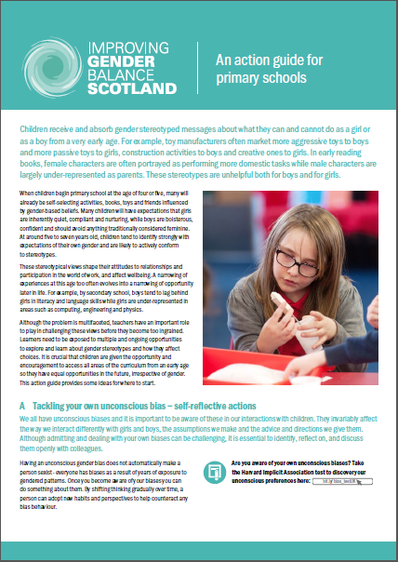
What can we do about this?
Be consciously aware of the issue
Think carefully about the messages in lesson materials, literature, displays, etc.
Think about our choice of language and the underlying messages it sends
Be aware of choices you make regarding classroom management
Notes:
This slide contains some initial strategies that could be used to start to tackle the issue of unconscious bias in classrooms.
Further detailed ideas can be found in materials produced by Improving Gender Balance Scotland: https://education.gov.scot/improvement/learning-resources/improving-gender-balance-3-18/
This includes an Action Guide for ELC practitioners and for primary schools.

Slide 28
Summary
Gendered careers choices can be explained due to societal (nurture) influences
Schools and teachers are an example of a societal influence
We are all biased in some form e.g. stereotypes
These unconscious biases affect our teaching practice …
… which may influence the career choices made by children
There are strategies/structures we can use to lessen the effect of bias
Notes:
This slide contains a brief summary of the session so far.

Slide 29
The CITE Tools
Created to help you deepen your understanding of bias in primary education and careers further during your placements.
Linked to Teaching Standards in order to support your placement.

Slide 30
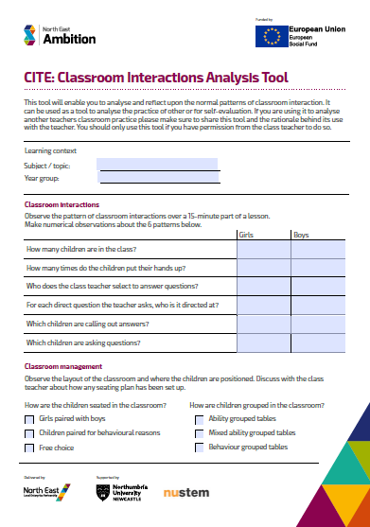
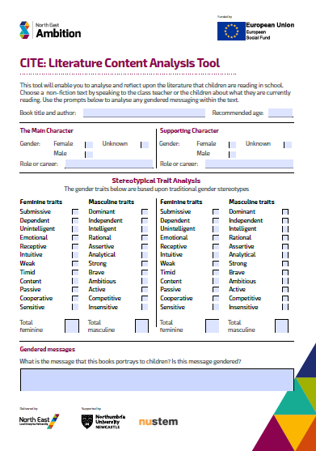
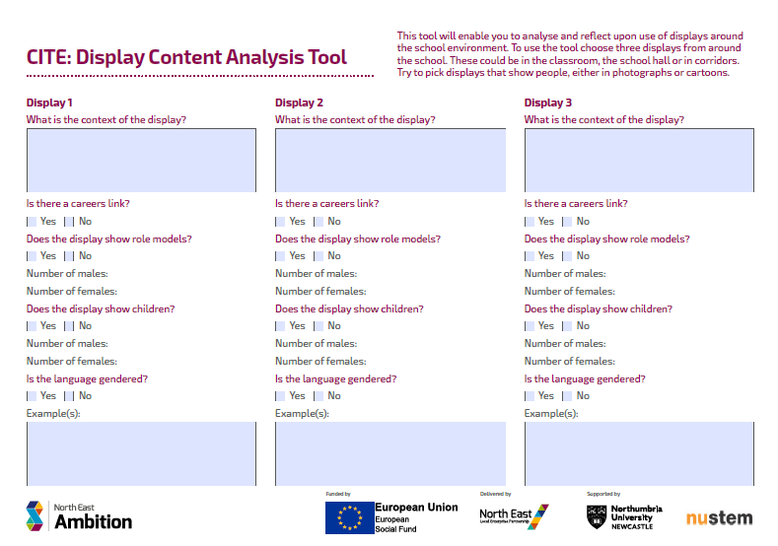
Tool 1: Classroom Interactions Analysis Tool
Tool 2: Literature Analysis Tool
Tool 3: Display Content Analysis Tool
Notes:
This slide introduces the ‘gap task’ and the three tools that were created to support participants to think about bias and gender in primary schools.
Participants should choose one (or more) of the Tools and use it to examine gender and careers in their placement school. They could also use the exercise as a prompt for discussion with their school based mentor about unconscious bias in the school context.
Tool 1: Classroom Interactions Analysis Tool
This tool allows students to look closely at the classroom interactions that take place during their observations of teaching. Emphasise that Tool 1 should only be used with permission of the teacher being observed. In order to reduce observation effects, it is also suggested that participants ask permission, and then wait a little while so that the teacher behaviour is not affected.
Tool 2: Literature Analysis Tool
This tool allows students to look at the main and supporting character in a children’s story book, and how they are described.
Tool 3: Display Content Analysis Tool.
This tool allows students to look at displays around the school and examine careers content that may be included.
It is important to note that these tools are not intended to be an assessment of the school, but opportunities for the participants to think reflectively about gender and careers.

Slide 31
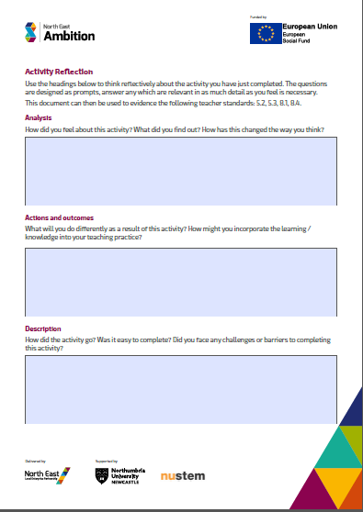
Activity Reflection
Analysis
How did you feel about this activity? What did you find out? How has this changed the way you think?
Actions and outcomes
What will you do differently as a result of this activity? How might you incorporate the learning / knowledge into your teaching practice?
Description
How did the activity go? Was it easy to complete? Did you face any challenges or barriers to completing this activity?
Notes:
To support the participants to reflect on the CPD and their learning, each tool has reflective prompts on the back. These are intended to guide thinking about the issues they have explored using the tool. The reflective prompts are common to all three tools.
You may wish to ask participants to complete the activity within a set period of time, and return their completed forms to you.
Alternatively, you may wish to ask them to bring the completed forms to the next training sessions

Slide 32
Next steps
  Planning for using the tools.
  Which tool?
  When?
Notes:
By Phone
0191 227 4458
By email
nustem@northumbria.ac.uk

Slide 33
NUSTEM, Northumbria University
nustem@northumbria.ac.uk
0191 227 4458
https://nustem.uk/
Notes:
By Phone
0191 227 4458
By email
nustem@northumbria.ac.uk

Slide 34
References
Eliasson, N., Sorensen, H., Karlson, K.G., 2016. Teacher-student interaction in contemporary science classrooms: is participation still a question of gender? International Journal of Science Education, 38:10, 1655-1672.
Sadker, M. and Sadker, D., 2010. Failing at fairness: How America's schools cheat girls. Simon and Schuster.

Slide 35
Further reading
Banaji, M.R. and Greenwald, A.G., 2016. Blindspot: Hidden biases of good people. Bantam.
Dweck, C., 2012 Mindset. ISBN: 978-1780332000
Fine, C., 2010. Delusions of gender: How our minds, society, and neurosexism create difference. WW Norton & Company.
Maltby, J., Day, L., Macaskill, A., (2017) Personality, Individual Differences and Intelligence. 4th Ed. ISBN: 978-1292090511. Especially Chapters 7 and 8.
Gina Rippon (2020) ‘The Gendered Brain’, ISBN: 978-1784706814
https://www.iop.org/education/teacher/support/girls_physics/resources/file_72045.pdf
https://www.iop.org/education/teacher/support/girls_physics/resources/file_69612.pdf
https://www.psychologistworld.com/personality/five-factor-model-big-five-personality
https://www.nytimes.com/2018/12/03/opinion/male-female-brains-mosaic.html

