Slide 1
CEC Primary Project– Careers for 2030
Road Map 5 –
Health & Social Care Sector

Slide 2
Task 1:
Please think about what type of career you would
like in the future.
Give 2 careers you would like to do.
Career 1
Career 2

Slide 3
What does Health mean?
We are free from illness and we have a healthy body (physical) and mind (mental)

Slide 4
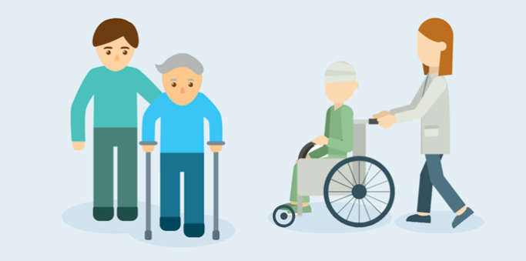
What is Social Care?
–
People who may need extra support with daily tasks.
This may be an older person or a young person
with
additional needs

Slide 5
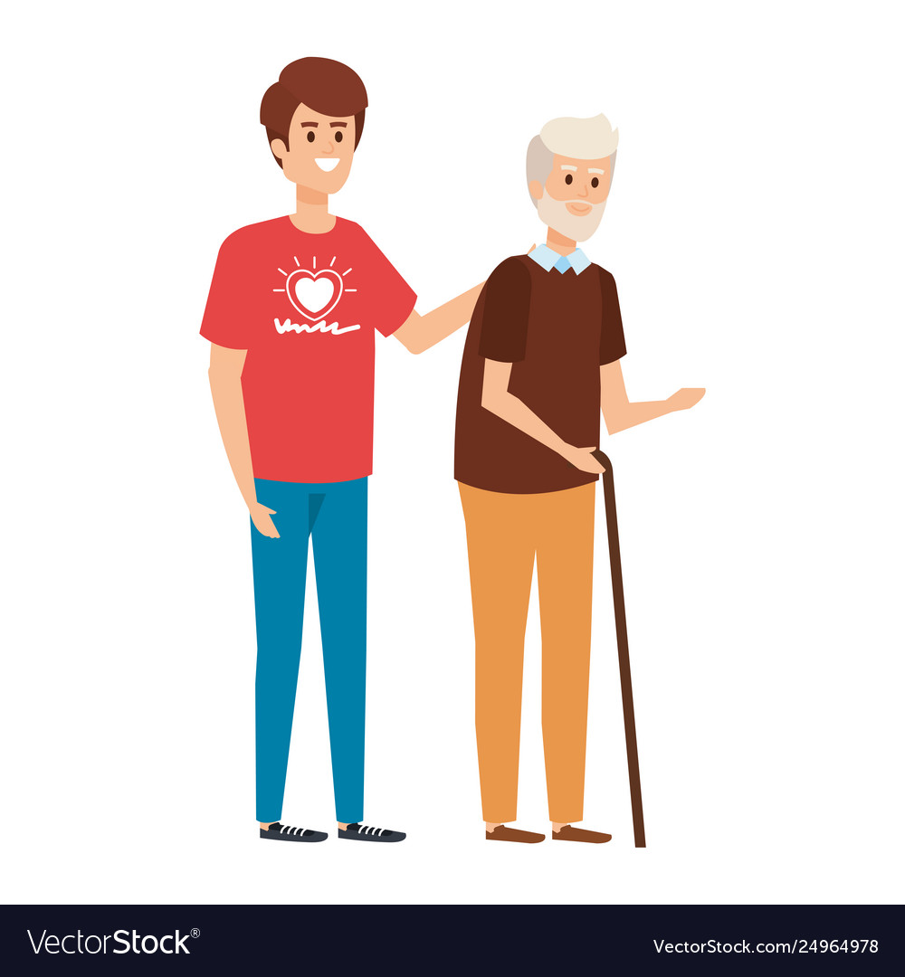
What jobs exist in this sector? …….
Dentists
Midwives
Paramedics
Nurse
Speech Therapists
Social Workers
Youth Worker
Dietitian
Mental Health
Care of the Elderly
Doctors
Childcare Assisstant
Health Experts
Occupational Therapist (OT)
You can work in the care sector looking after children or the elderly
- or offering people support
- or App developer
- or a health and fitness advisor

Slide 6
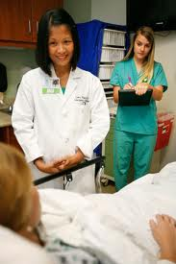
What jobs exist now that did not exist 10 years ago?
Medical Scribe
They take the pressure off doctors and fill in patients' details by doing paperwork.
Care Co-ordinator
They manage patients care and they share information with other doctors.
Health Coach
They help people to learn how to look after their body, mind and soul to stay healthy.
Occupational
Therapsit (OT)
They help people of all ages overcome health problems that might be caused by illness, getting old or accidents so they can carry out everyday tasks or jobs.

Slide 7
Developments in Technology
App Developers
- 10 years ago we didn’t have smart phones.
- Now we not only have smart phones, but we have Apps.
- Health and Social Care Apps include:-
The House of Memories
Is an App that is used by families of people with Dementia. They can use the App to help them remember things through videos, photographs, etc
Sam
Is an App used by people who suffer with anxiety and get stressed easily.
There is a chat bot on this App
Pill Manager
Help people to remember to take their medication.
Re-orders pills when they are running low and uses an alarm as a reminder

Slide 8
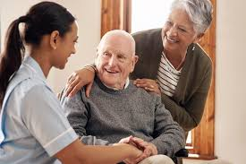
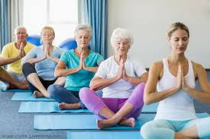
What jobs may exist in Health & Social Care by 2030.....
Care-Giving Specialist
People will be living longer and will want to stay in their homes. These careers will be for people who like to care for others.
Yoga Instructors for the Elderly
The number of people aged over 60 in the world, will hit 1.4 billion by 2030 (2.3 billion by 2050). More people are looking for natural ways to look after their bodies. Yoga is great for all ages of people, but it is predicted that older people will opt for yoga as a gentle option for keeping fit.

Slide 9
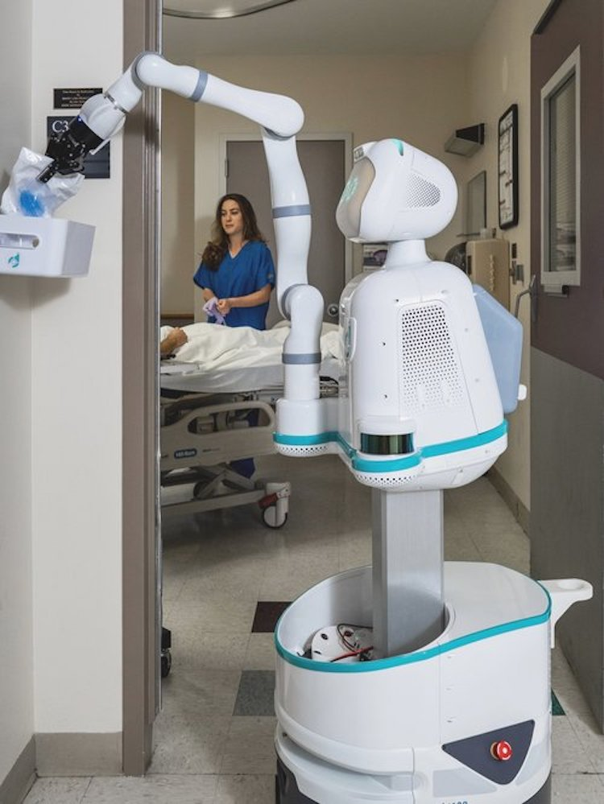
The possibilities are endless by 2030.....
Nursing
Some nursing tasks will be carried out by robots. Such as: giving patients drugs, taking blood pressure and carrying out vital tests. We will need people to design these robots and also programme them. More importantly though nursing will remain a very caring career.

Slide 10
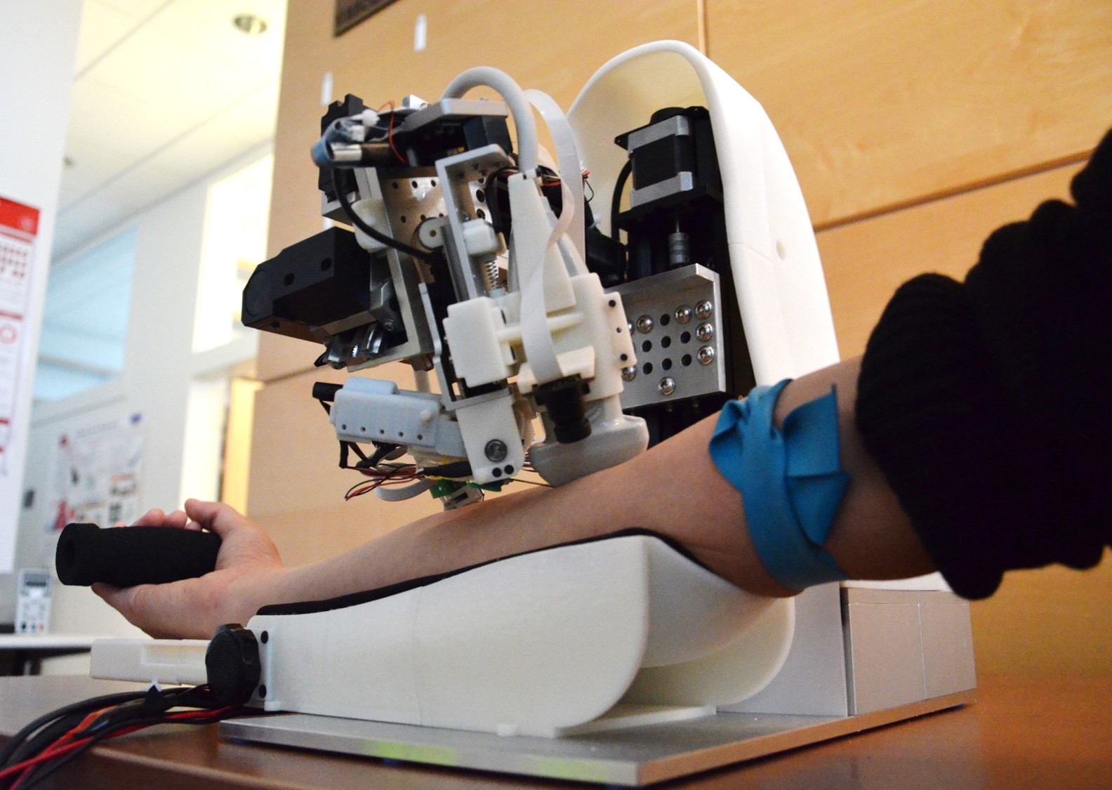
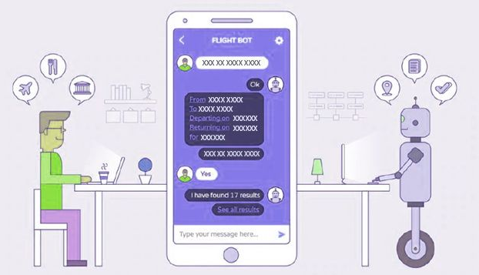
Some more good examples of Science in Health & Social Care by 2030
Food Engineer
Science is always advancing and by the mid 2030's food will be engineered and designed to avoid people becoming obese. The food will taste good but not contain any of the fats or sugars. Insects will also feature in our diets as a source of protein.
Blood Engineers
Who will produce blood artificially instead of using blood donors
Artificail Intellegence/
Chat Bots
Will be used when people dial 999

Slide 11
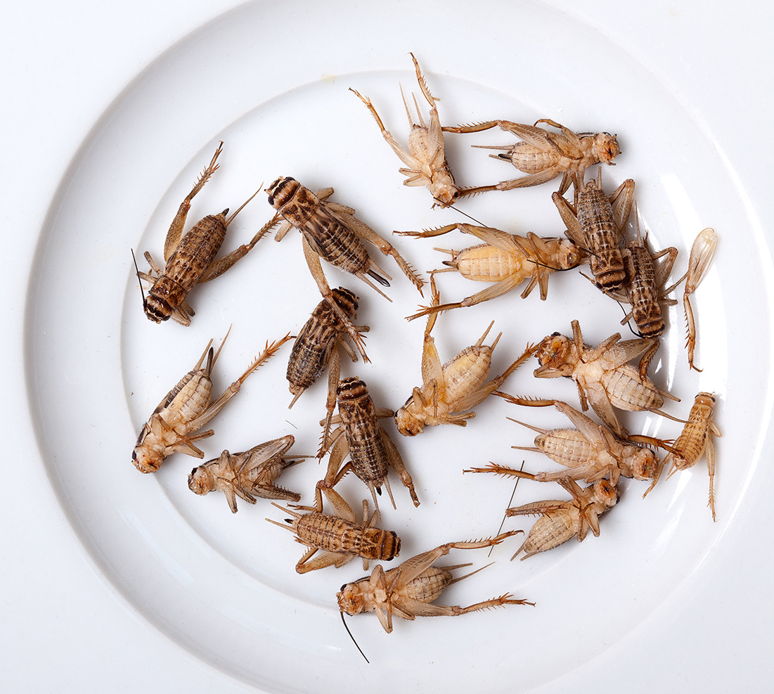
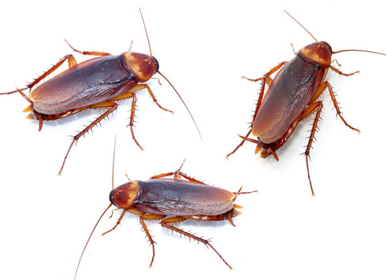
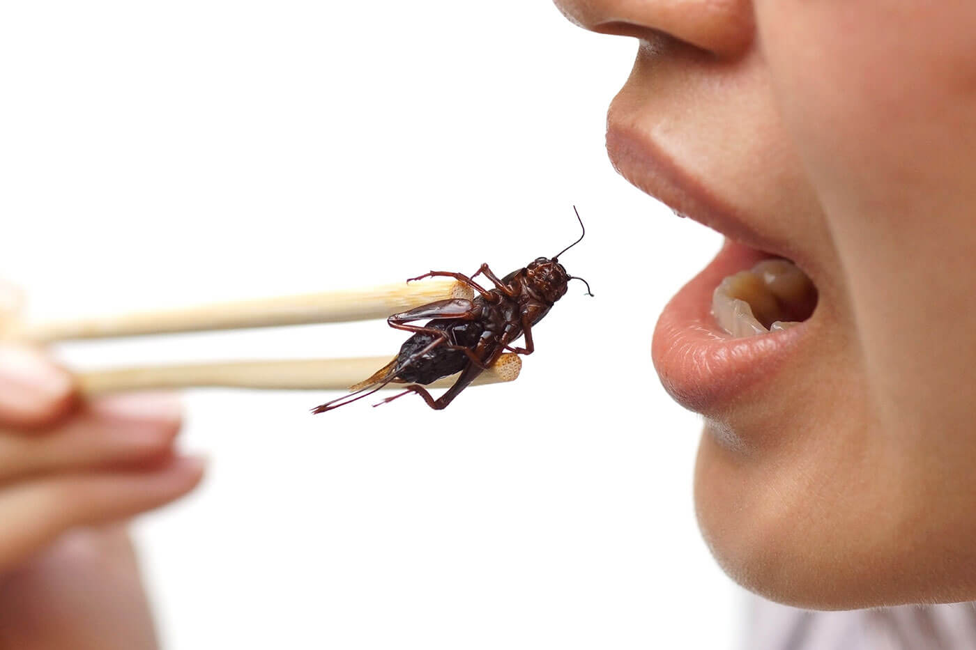
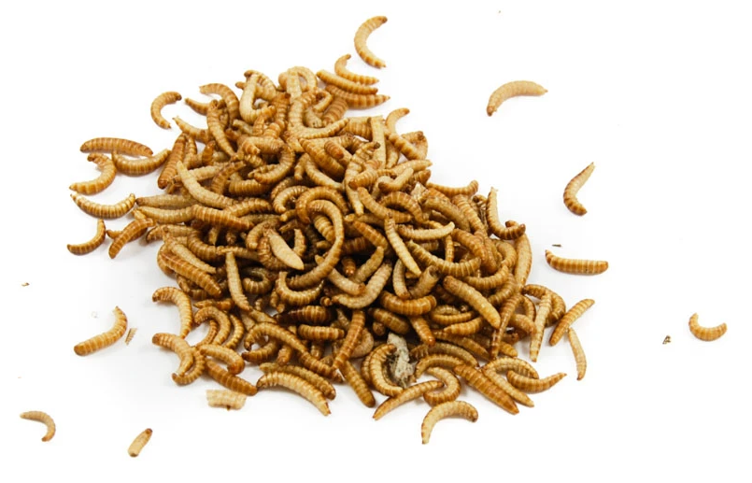
The future of food ?
There are about
7.5 billion people
in the world
By 2050 there will be well over 9 billion people in the world and they will all
need feeding
About 2 billion people already eat insects as part of their diet
Careers as dieticians will be very different in 10 and 20 years time as food changes
5gm Crickets
(about 10 crickets)
has the same amount of protein as an egg
The future of food ???
Protein is required by every cell in our body which uses it to build and repair tissues
Insects eat animal waste or plants that we cant, so help reduce environmental problems
They have a high iron content and lots of different vitamins which our body needs to be healthy

Slide 12
Task 2:
What personal skills do you think are important now?
….........................................................................
Do you think these skills will change in the future? If yes, how do you think they will change?
…..........................................................................

Slide 13
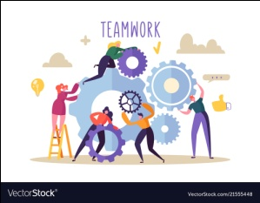
Top 8 Essential Skills are:-
Listening
Presenting
Creativity
Team Work
Leadership
Staying Positive
Aiming High
Problem Solving

Slide 14
Task 3:
Have you been inspired by anyone today?
..........................................................
Why? ..............................................
Have you been inspired by anything you have see today?
...........................................................
Why? ...............................................

Slide 15
Over to you for Questions ???

