Slide 1
Dream Big job hunt lesson
Alice Handelman-Pedroza, Senior Project Manager, 06/04/2020

Slide 2
LO: to explore and identify different jobs
Success Criteria:
I can name different jobs
I can group jobs given to me
I can explain that men and women can do the same jobs

Slide 3
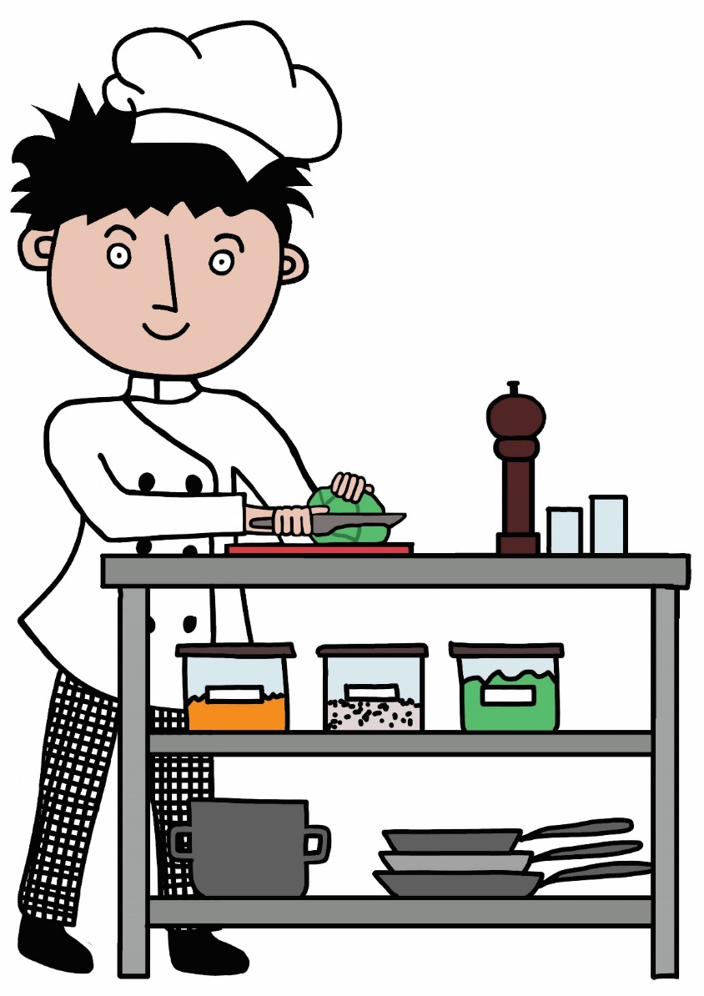
Who am I? What do I do?
LO: to explore and identify different jobs

Slide 4
Who am I? What do I do?
LO: to explore and identify different jobs

Slide 5
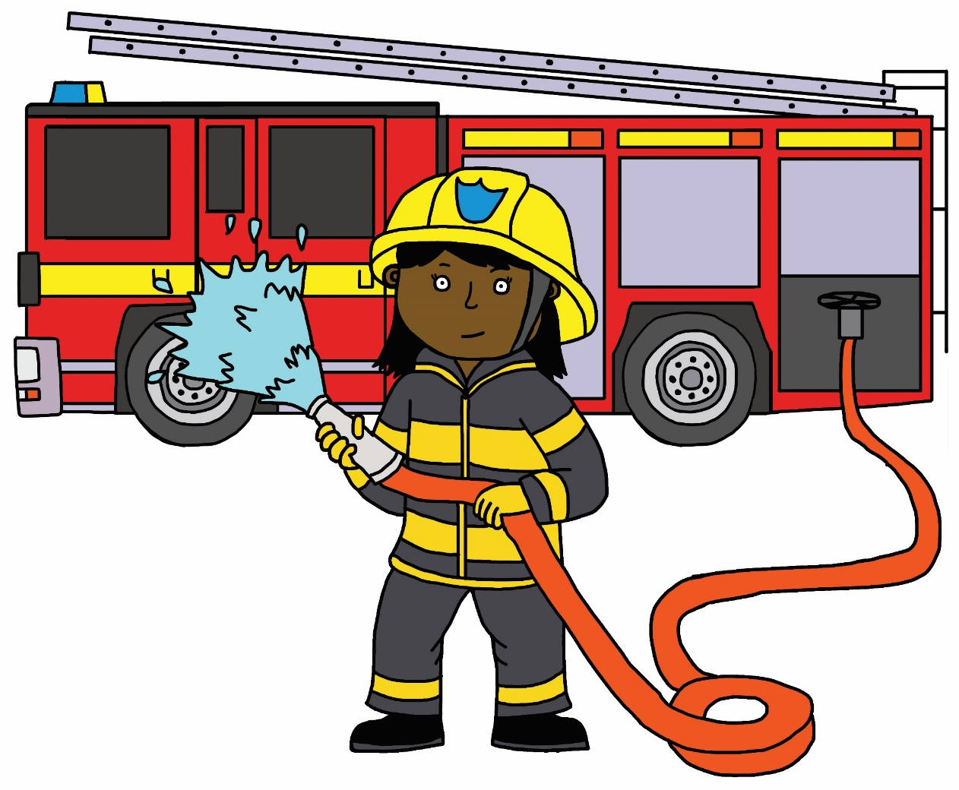
Who am I? What do I do?
LO: to explore and identify different jobs

Slide 6
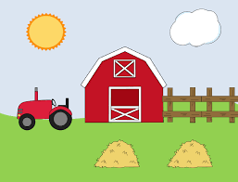
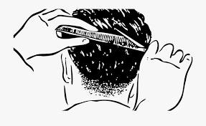
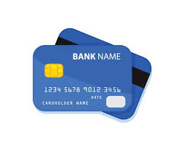
Do you know any other jobs?
LO: to explore and identify different jobs
Working is a way to earn money.
Grown-ups get paid to work
Jobs we know

Slide 7
What will you do when you grow up?
LO: to explore and identify different jobs
When I grow up, I want to…

Slide 8
Job hunt
LO: to explore and identify different jobs
We are going for a walk to see how many people we can find at work.
Get ready to be a detective!

Slide 9
Grouping flashcards
LO: to explore and identify different jobs
Which jobs do you know?
Which jobs would you like to do?
Which jobs require a hat?
Which jobs require a uniform or special clothes?
Which jobs are for men?
Which jobs are for women?

Slide 10
Grouping flashcards
LO: to explore and identify different jobs
Are any of the jobs only for men or only for women?
Why?

Slide 11
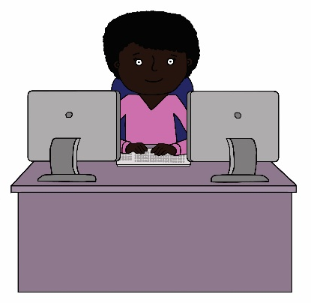
Plenary
LO: to explore and identify different jobs
Tara is feeling upset.
She wants to be a computer programmer when she grows up but some children in her class were teasing her and told her that she could not do that job. They told her that only boys or men could be computer programmers.
What would you say to Tara?

Slide 12
Contact: Alice Handelman-Pedroza, Senior Project Manager
Email: alice.handelman-pedroza@literacytrust.org.uk
T: 020 7587 1842
W: literacytrust.org.uk

