Slide 1
Career-related learning in your school
Alice Handelman-Pedroza, Senior Project Manager, 14/04/2020

Slide 2
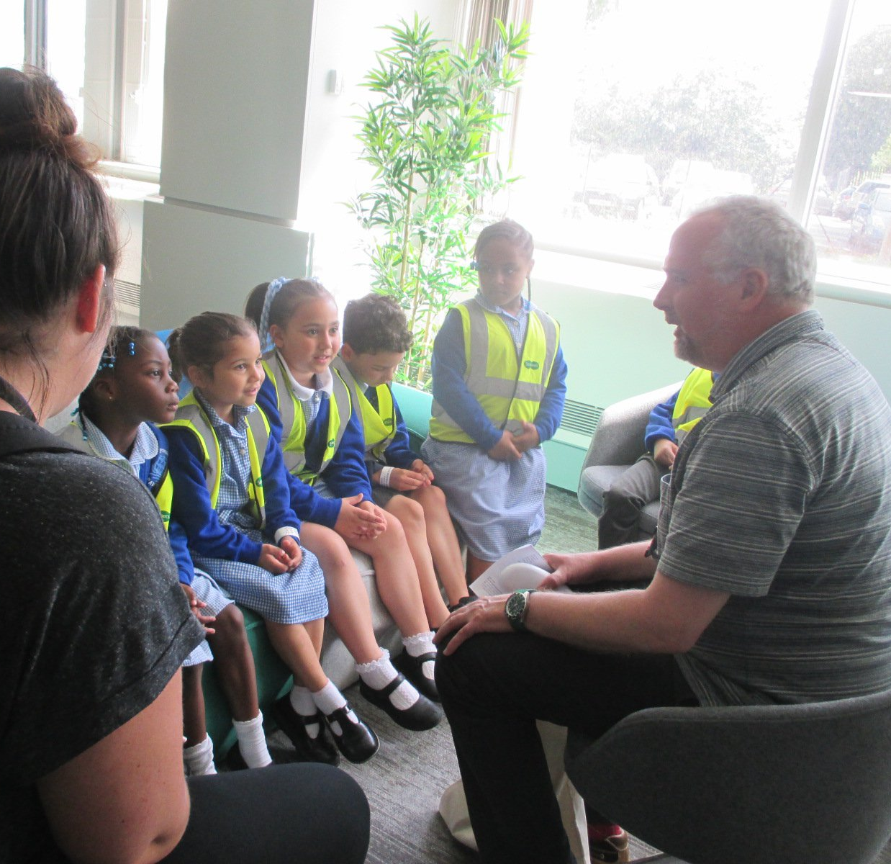
What we will cover
1. Career-related learning
2. Why is CRL important in your school?
3. Literacy, employability and aspirations
4. Effective career-related learning
→ External organisations
→ Embedding in the curriculum
5. Skills Builder - using a common language
6. Outside of the classroom
7. Other primary career programmes

Slide 3
Career-related learning
Three elements of effective CRL
School based learning
Work based learning
Extended learning (beyond the school day)
+
+

Slide 4
Career-related learning in your school
Pupils have improved access to literacy
Improved reading, writing, speaking and listening skills
Widens aspirations
Adults at home have an increased awareness of how to support a child's literacy skills
CRL can be used to challenge stereotypes

Slide 5
Literacy, employability and aspirations
Pupils who have careers sessions with employers are more likely to exceed predicted GCSE grades (Education & Employers 2019)
One in four (25%) employers are not satisfied with school and college leavers’ literacy and numeracy skills (CBI/Pearson 2018)
98% of teachers polled said careers lessons helped to challenge gender stereotyping about jobs and subjects (Tes 2019)
Children in disadvantaged areas are starting school up to 19 months behind their more privileged peers (The Communication Trust 2017)
Over two-thirds of employers (70%) rate literacy and numeracy skills as one of their three most important considerations when recruiting school and college leavers (CBI 2018)
Research shows that by the age of seven, girls’ and boys' aspirations are so often limited by stereotyping (Fawcett Society 2019)

Slide 6
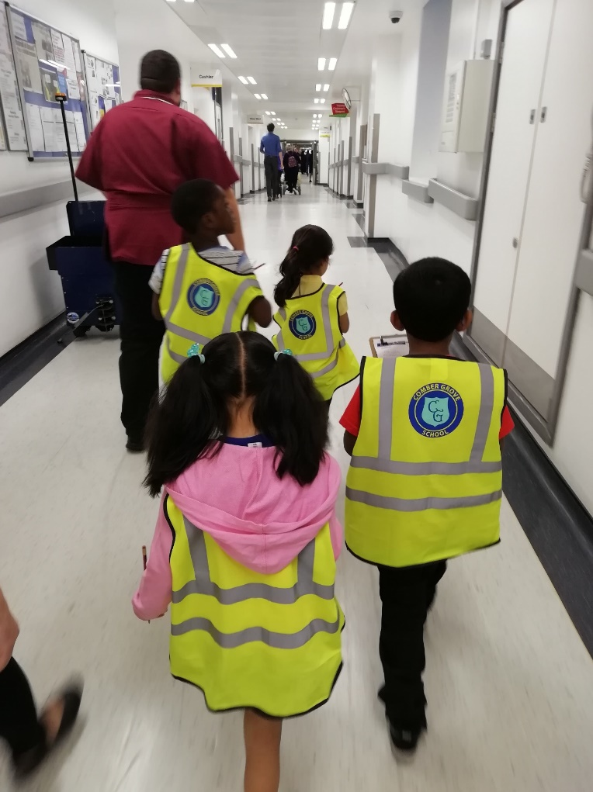
Tips for effective career-related learning
Effective leadership
Start early
Make it open to all
Ensure activities are age-appropriate
Involve external organisations and employers
Embed in the curriculum

Slide 7
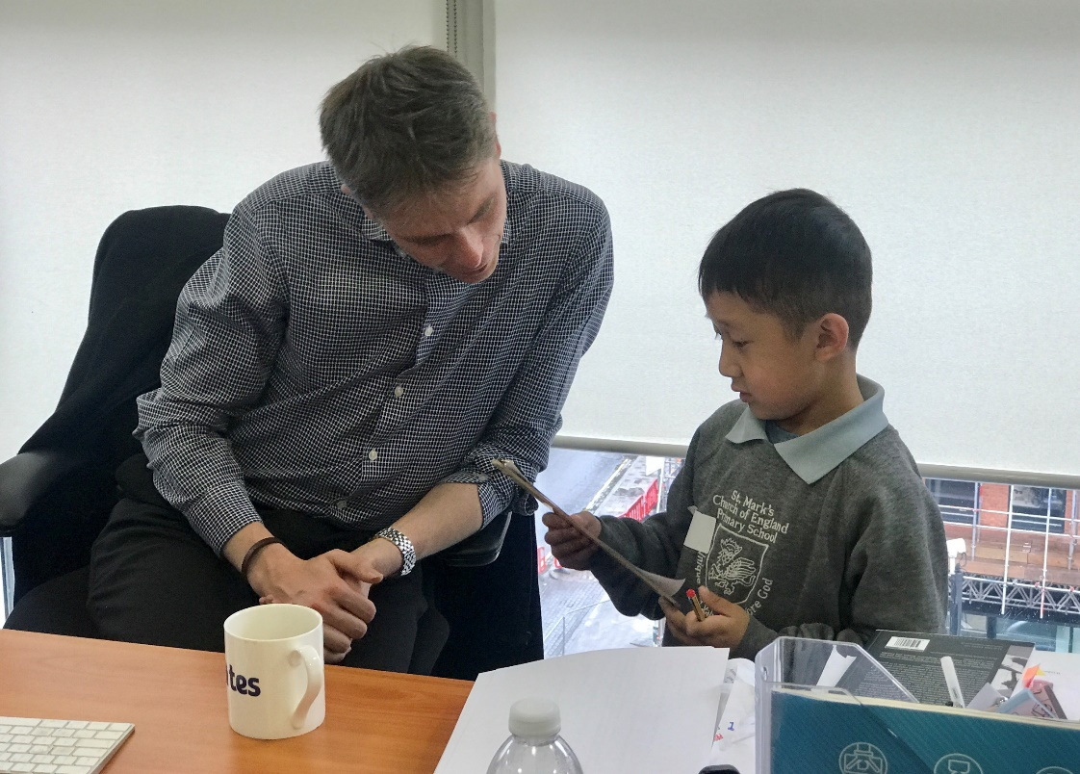
How to involve external organisations and employers
Use your network - perhaps you have friends or family who would come in and talk/host a visit
Invite parents and local community members to get involved
Approach local businesses – try emailing their HR departments as they often coordinate CSR activity
Reach out to nearby schools; they may already have links
Use Education & Employers online volunteer database Primary Futures

Slide 8
Embedding in the curriculum
This provides a context and purpose for learning about specific areas of the curriculum and encourages children to make links between school-based learning and the wider world.
how changes in population/ transport links have affected employment
farmer
pilot
science at work
diver
electrician
local history
local employers today
local employers in the past
astronomer

Slide 9
Literacy and CRL
Literacy is a fantastic tool to incorporate career-related learning in to your school day.
Books – use our ‘When I grow up’ booklist (http://www.wordsforlife.org.uk/when-i-grow-up/book-list)
Speaking and listening activities – role-play different jobs and scenarios
Grammar activities – explore the use of formal vs. informal language and when to use each of these
Writing activities – write about dream jobs and aspirations, focus on a specific job and ask pupils to write what the role involves
Research activities – find out about the jobs and workplaces which are in the local area

Slide 10
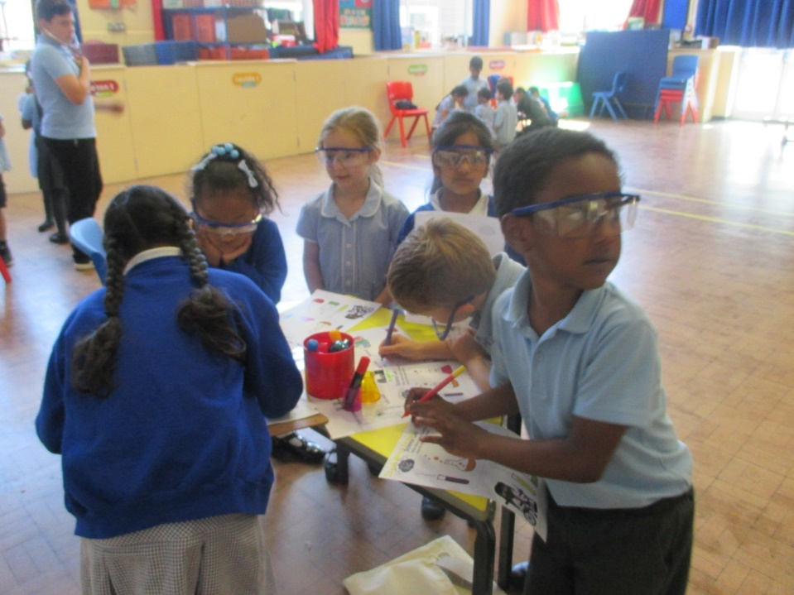
Success story: Howard Primary School & Dream Big
What worked well?
Used the programme to plan a whole half-term of activities around careers education
Invited parents and people from the local community to talk about their jobs
Collected work in a booklet to take home with them
During the celebration event the children presented what they had done to their parents
Reena, Year 1 class teacher said “it was a positive and enriching experience and all children benefitted” and that after the programme “children in my class now feel they can be whatever they aspire to be”

Slide 11
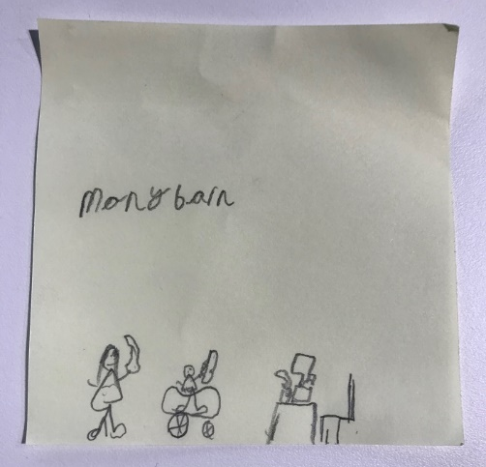
Success story: St Alban’s C of E Primary School & Dream Big
What worked well?
What worked well?
Pre-visit lesson on careers to give context to the workplace visit
Used the ‘when I grow up’ book list and accompanying lesson plans to bring careers to life
The Year 1 class held a whole school assembly to show the work they had done in the programme
Invited the volunteers from the workplace to the assembly and show the work they’d completed
Rachel, the class teacher, said that the workplace visit “…was an amazing and immersive experience with enthusiastic volunteers.”

Slide 12
Success story: Oasis Academy Harpur Mount & Primary Futures
What worked well?
The school held a whole school Aspirations Week
Each year group had an age-appropriate theme e.g. Year 1: People who help us, Year 5: Journalism
Engaged external volunteers through classroom talks, Q & As about their roles, trips with the children
Children watched TV shows related to their topic to bring it to life
Claire from Oasis Academy Harpur Mount finds Primary Futures vital in the organisation of Aspirations Week, she said “I really struggle to find people to come into talk to the children. We don’t have a bank of parents to do it and previously I had to rely on favours from friends.”
https://primaryfutures.org/aspiration-week/

Slide 13
Skills Builder – Using a common language
A consistent whole-school focus on essential skills helps ensure a shared understanding
Frequently referring explicitly to each skill will help pupils to recognise them
Work around these skills should be progressive and build on previous learning
Ensure pupils see the relevance of these skills by linking them to real life

Slide 14
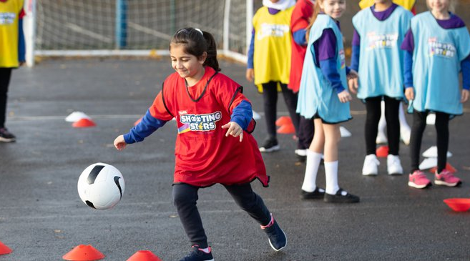
Beyond the school day
‘Extended career-related learning’ refers to education beyond the school day, you can:
Inform adults at home about the importance of CRL and what they can do e.g. talk about which roles there are in a supermarket when they go shopping
Encourage children to pursue their interests and participate in activities outside of school which help them to develop soft skills
Encourage adults when reading at home to identify different jobs in books

Slide 15
Primary career programmes
National programmes
Words for Work: Dream Big – National Literacy Trust (KS1)
Primary Futures – Education and Employers (primary)
Skills Builder (primary)
Future First - membership (primary)
Local opportunities
Eden Project Takeover Day - Cornwall
Careers 2030 - The Black Country
Academy FM Folkestone - Folkestone

Slide 16
Top three tips for CRL
1. Use literacy as a vehicle for introducing career-related learning
2. Build up a bank of external organisations and employers
3. Use the free resources available

Slide 17
Contact: Alice Handelman-Pedroza, Senior Project Manager
Email: alice.handelman-pedroza@literacytrust.org.uk
T: 020 7587 1842
W: literacytrust.org.uk

