Slide 1


Challenging Gender Stereotypes
Staff and parents presentation
The East Sussex Primary Careers Hub

Slide 2
Consider these images

Slide 3
Consider these images

Slide 4
Consider these images

Slide 5
Consider these images

Slide 6
Consider these images

Slide 7
Consider these images

Slide 8
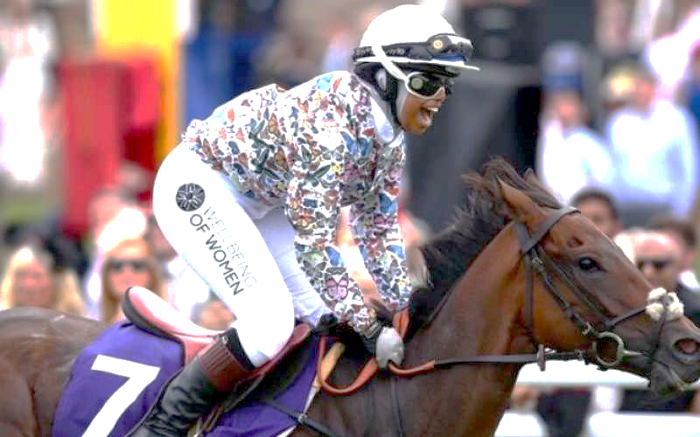
Consider these images

Slide 9

Why does it matter?
Should we challenge traditional gender stereotypes?
Should boys and girls have equal opportunities?
What can we do to support our children to achieve more?

Slide 10

Current position
On a scale of one to ten, where one is poor and ten is excellent,
How would you rate the school’s current position on gender stereotypes?

Slide 11
Capacity to change
On a scale of one to ten, where one is poor and ten is excellent,
How would you rate the school’s capacity to challenge gender stereotypes?

Slide 12
The future
On a scale of one to ten, where one is poor and ten is excellent,
Where would you like the school’s position on challenging gender stereotypes to be?

Slide 13

Our best
If we were a ‘ten’ …..
What would we be doing differently?
What would parents say?
What would children do or say?
Who else would notice?

Slide 14
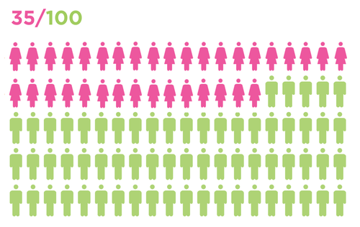
The stats
35% of STEM jobs were carried out by women (WISE Campaign 2019)

Slide 15
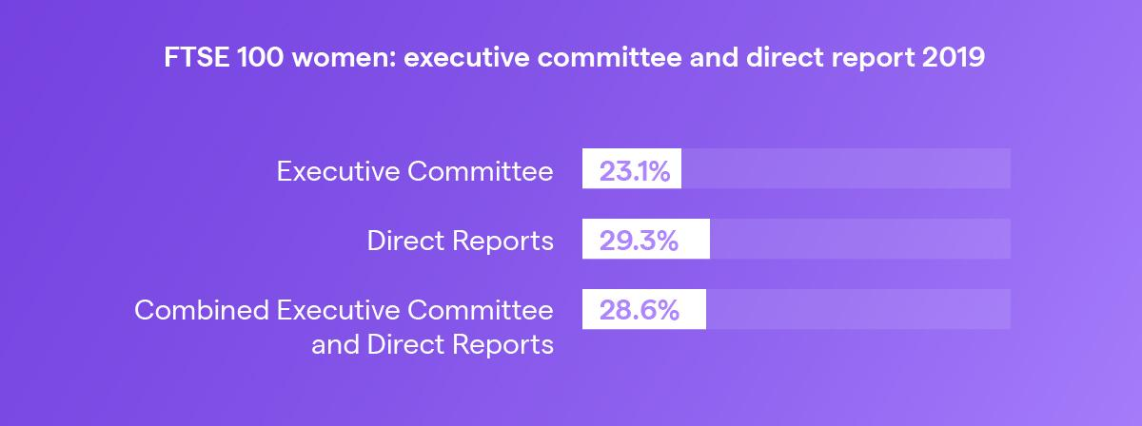
The stats
Less than a quarter of FTSE-100 companies had a female CEO.

Slide 16
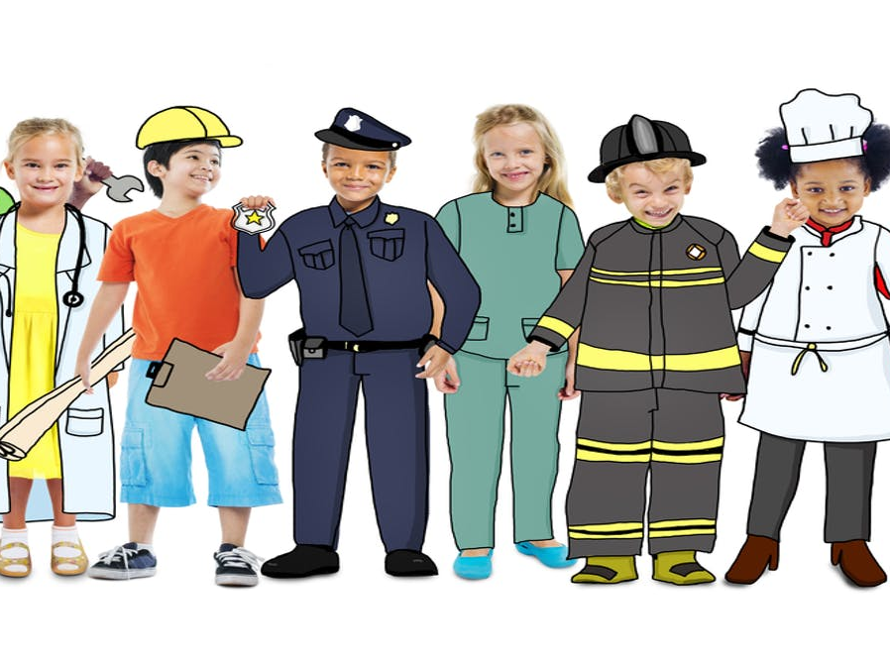
The evidence
Most children have allocated a gender to most jobs by the age of five
By the age of twelve they have ruled out a significant percentage of careers for their future
This Photo by Unknown Author is licensed under CC BY-ND

Slide 17
No more boys and girls
Link here https://www.bbc.co.uk/programmes/b09202jz
Three clips available
Other sources of the programme are available
First published on BBC 2017

Slide 18
So what’s your plan?
Why not have a look at our other resources…
East Sussex Primary Careers Hub
www.careerseastsussex.co.uk

